Slide 1
Using Elluminate / Collaborate Inside of the LMS
Doug Cohen
SUNY Learning Network
Associate Director, Academic Technology Services
Ryan McCabe
Finger Lakes Community College
Assistant Director, Online Learning

Slide 2
One Student’s Perspective

Slide 3
Overview
M.S. in Information Design & Technology
Full-online degree program
Two courses (6 credits) per semester
ANGEL (version 8)

Slide 4
Scheduling
Weekly “SyncTalk” (Elluminate) sessions
Scheduled based on instructor’s convenience

Slide 5
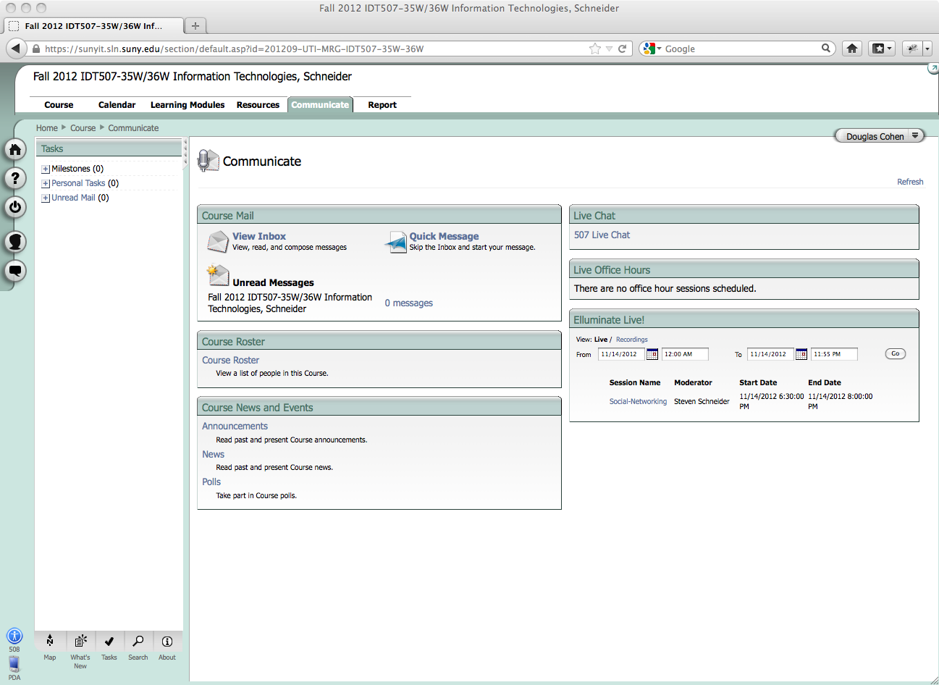

Slide 6
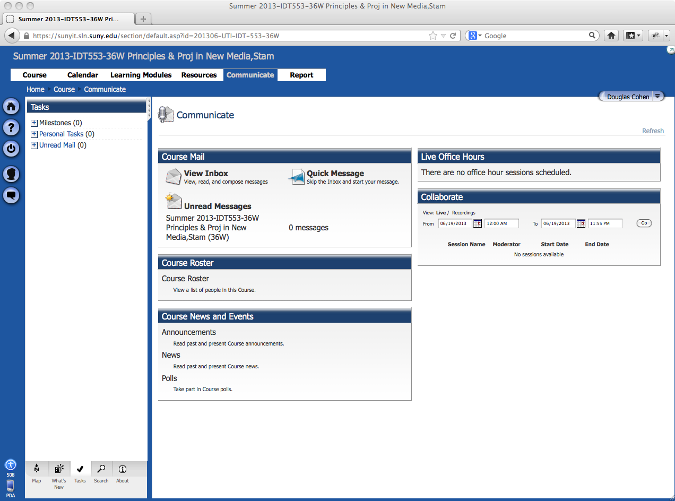

Slide 7
Value (Live Sessions)
“Facetime” with instructor & peers
Chat
Whiteboard
Voice
Convenience
Live “lecture” without commute

Slide 8
Value (Recordings)
Review session content at any time
Review content multiple times
Recording indexes are crucial

Slide 9
Difficulties
Technical difficulties
Instructor troubles sharing screen
Limits value of recording (w/o screen share)\
Java updates
Scheduled time not necessarily convenient

Slide 10
Elluminate / Collaborate Support
a.k.a. Roadside Assistance

Slide 11
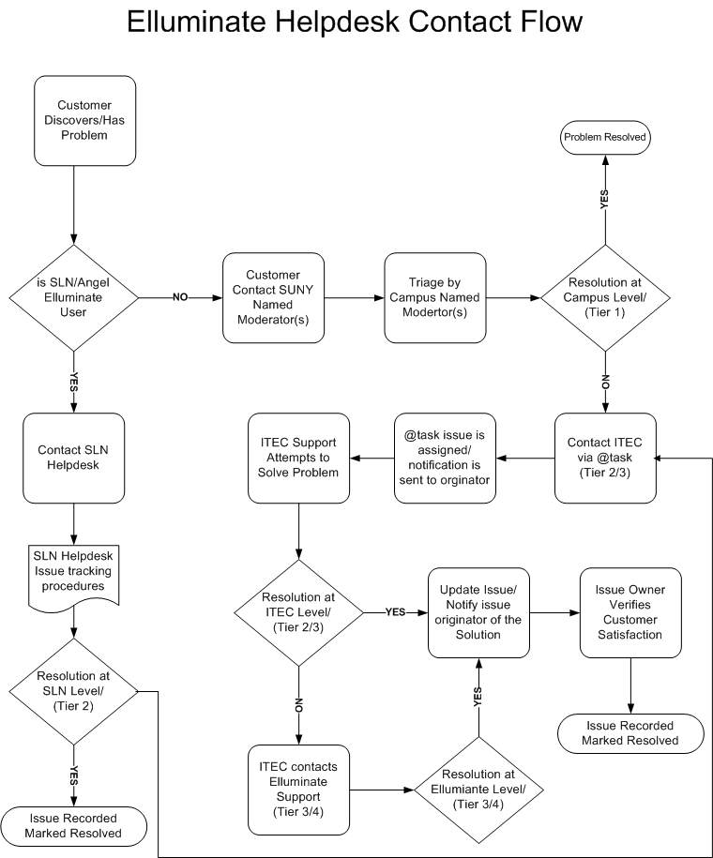

Slide 12
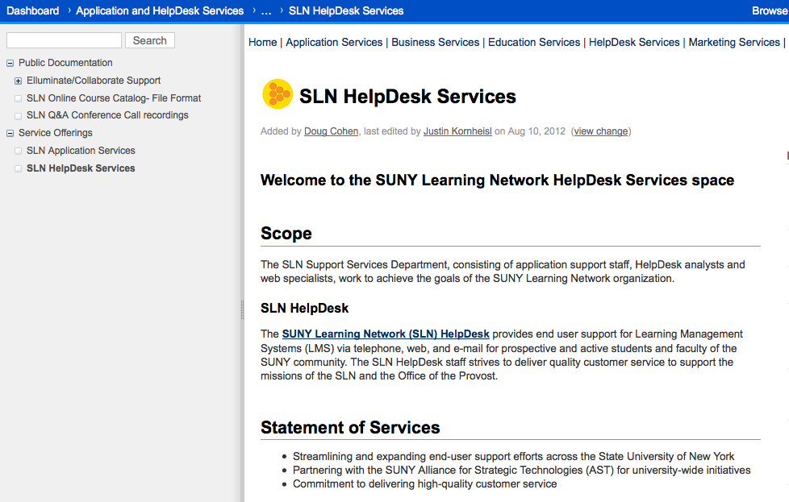
Where to find Support

Slide 13
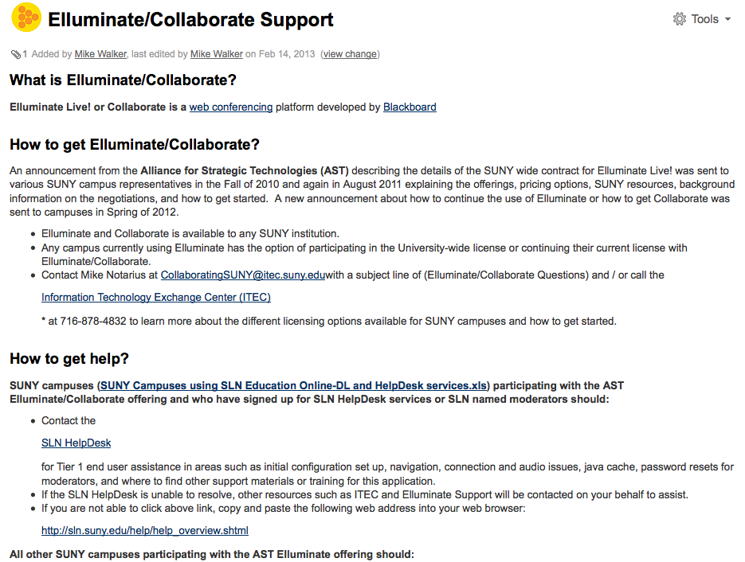
Support page on wiki.sln.suny.edu
Notes:
Various links on page to get you to the support you are looking for.

Slide 14
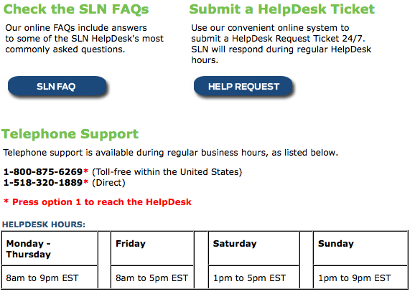
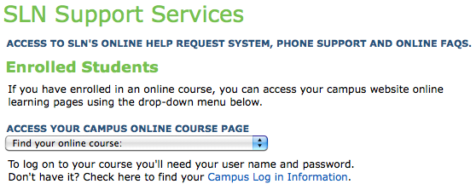
Are you an SLN Campus? Contact SLN HelpDesk.
Notes:
If do not know, wiki.sln.suny.edu Elluminate support page lists who is.

Slide 15
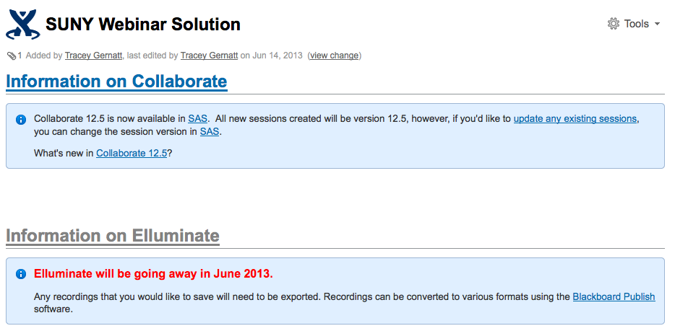
Other SUNY campuses, contact ITEC

Slide 16
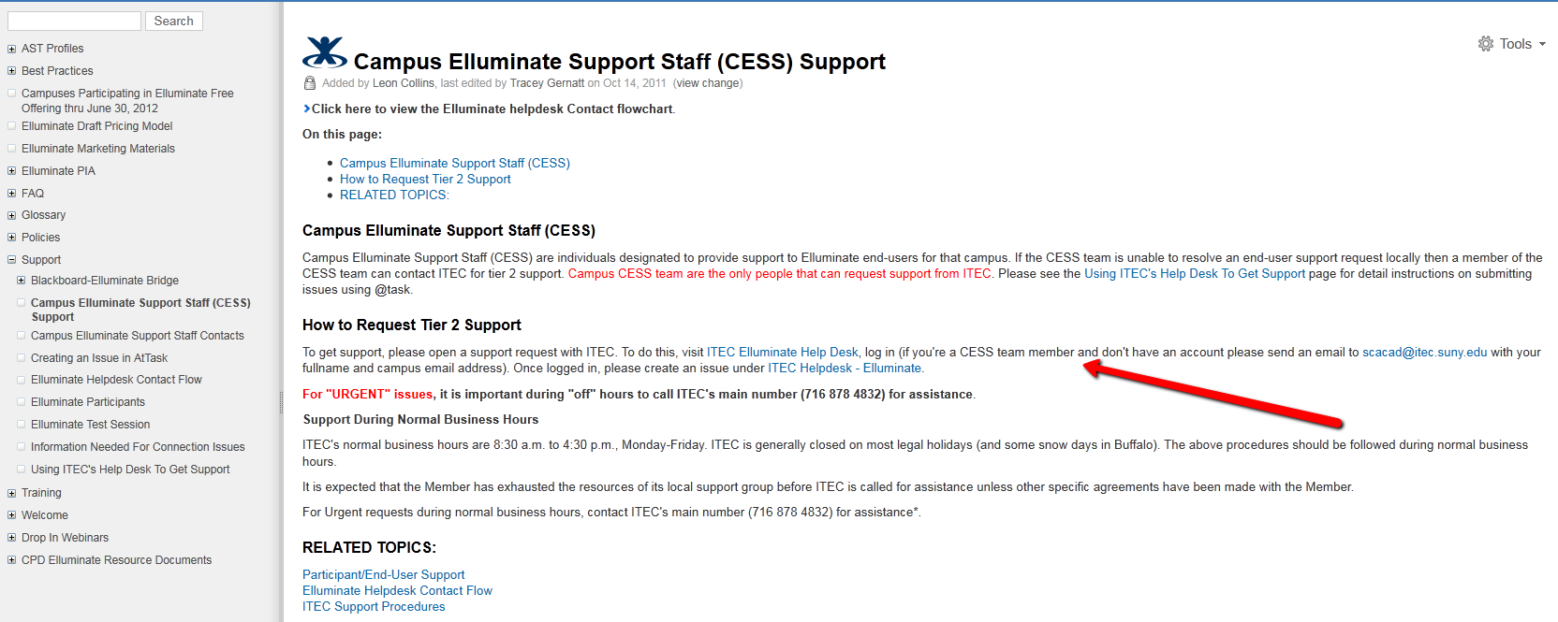
Campus Elluminate Support Staff (CESS)

Slide 17
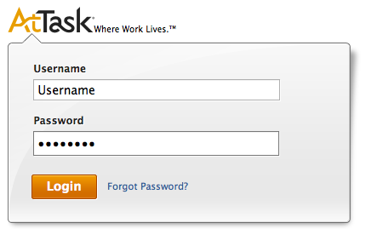
ITEC AtTask
Notes:
Need to have AtTask account to submit ticket at helpdesk.itec.suny.edu. If do not have one, need to contact ITEC.

Slide 18
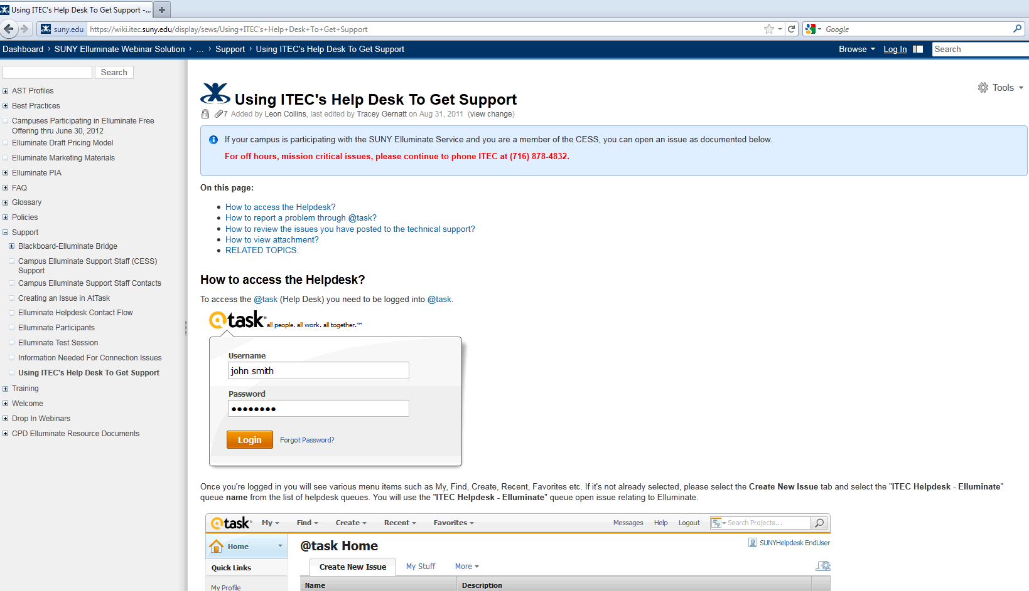
wiki.suny.edu Support
Notes:
ITEC will likely speak to their support in afternoon but point out site once again as a go to. Example – shows how to use AtTask which is not the same as SLN Footprints.

Slide 19
Helpful Information when contacting SLN or ITEC
Notes:
Another example of what documentation is on their wiki. This information is also helpful if contacting SLN.

Slide 20
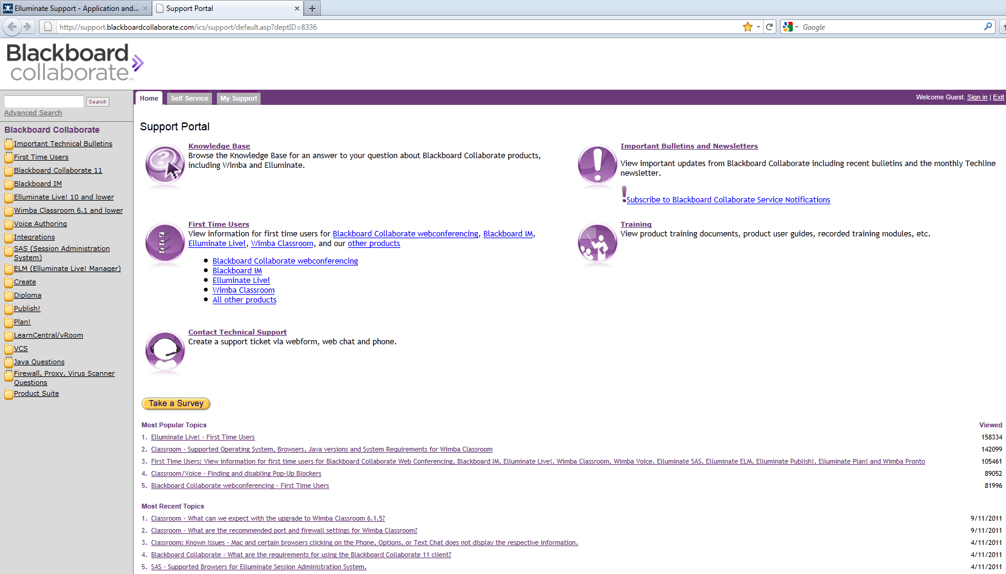
Other Resources
Notes:
Blackboard Collaborate Support Portal

Slide 21
Finger Lakes Community College
Ryan McCabe

Slide 22
Finger Lakes Community College
Located in Canandaigua, NY
6,000 students
200 online courses per semester
Faculty and students across the globe

Slide 23
Enhancing Interactions

Slide 24
From Administrator Perspective
Instructors love it
Instructional value
Intuitive = low training needs
Feedback
Moderator Privileges
Mobile
Both accessible and transportable

Slide 25
Disadvantages
Java
Apple
Automatic start does not always work
Application sharing

Slide 26
Finger Lakes Campus Use
“Welcome Session”
During first week of class
Targeted Review/Help Sessions
Office Hours
Hybrid Course Delivery
Technical Training for faculty
Student Assistance

Slide 27
From an Instructor’s Perspective

Slide 29
Provide “teaching presence” not teacher presence, with a manageable amount of time and effort

Slide 30
From Instructor Perspective
Easy to use/Connectivity
Creating strong connections, persistence
Recording of sessions, explaining concepts
Visual, auditory, and hands on, learning styles
Allows moderator to control other screens, guided tour

Slide 31
Questions or Comments

