Slide 1
Hadoop: Is It Right For You?
Jeff Murphy
jcmurphy@buffalo.edu

Slide 2
What is Big Data?
Multi-terabyte
Generally static data (log files, bio data, etc) or data that grows but doesn’t get updated/edited
Not transaction oriented
Geared towards analytics

Slide 3
What is Hadoop?
A filesystem (HDFS)
A computation system (MapReduce)
Opensource managed by Apache Software Foundation

Slide 4
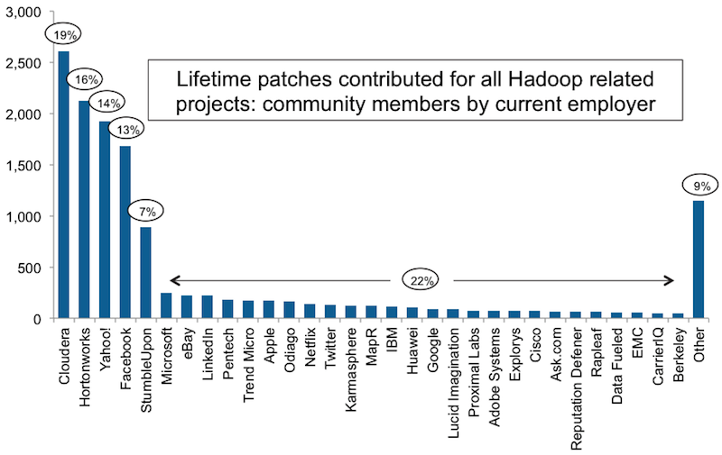
Community Backing
http://blog.cloudera.com/blog/2011/10/the-community-effect/
Notes:
Somewhat dated – analysis is from 2011.

Slide 5
HDFS
NameNode: tracks filenames, metadata to block locations
DataNode: manages blocks
Fault tolerant (data replicated across DataNodes)
Highly Available (multiple NameNodes)
Derived from GoogleFS
Very scalable (2012: Yahoo 50k nodes, Facebook 10k nodes, goo.gl/ZFdyw)
Generally accessed via a put/get command but is mountable using FUSE
Notes:
Blocks are replicated across multiple nodes. Raid on each node is not nec’y. If a node fails, HDFS is ok.

Slide 6
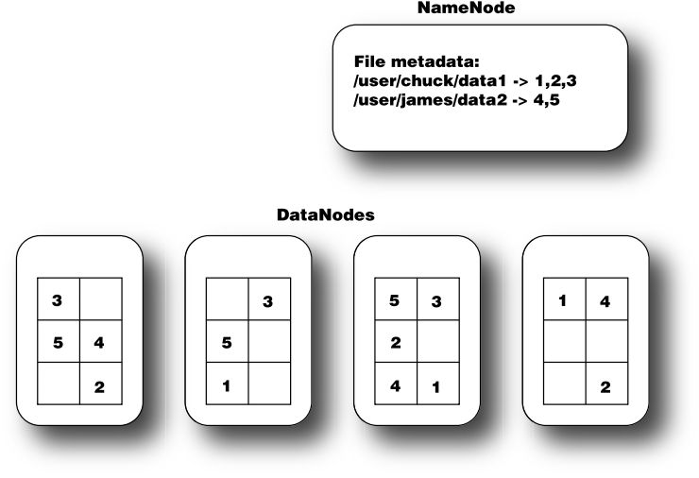
HDFS Architecture
The NameNode keeps track of the file metadata—which files are in the system and how each file is broken down into blocks. DataNodes provide backup storage of the blocks and report to the NameNode to keep the metadata current.

Slide 7
HDFS (Cont)
“Rack Aware”
Supports simple tree hierarchy
Used to ensure adequate fault tolerance by replicating blocks across branches
Notes:
Blocks are replicated across multiple nodes. Raid on each node is not nec’y. If a node fails, HDFS is ok.
Configuring rack awareness: http://free-hadoop-tutorials.blogspot.com/2011/04/rack-awareness.html

Slide 8
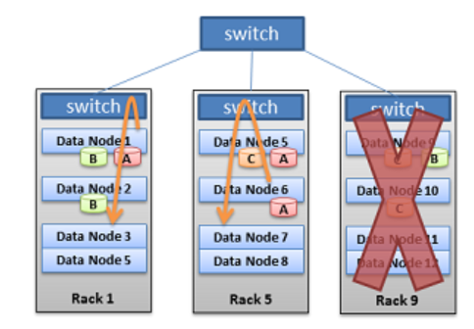
Data Replication by Rack

Slide 9
MapReduce
JobTracker – Sends jobs to nodes running TaskTrackers. Knows where the data is, tries to keep the jobs and data together. Otherwise uses rack-awareness to fetch data from “close” machines
TaskTracker – executes the actual MapReduce code.
Input is HDFS files
Output is HDFS file(s)
Notes:
Reduce network traffic

Slide 10
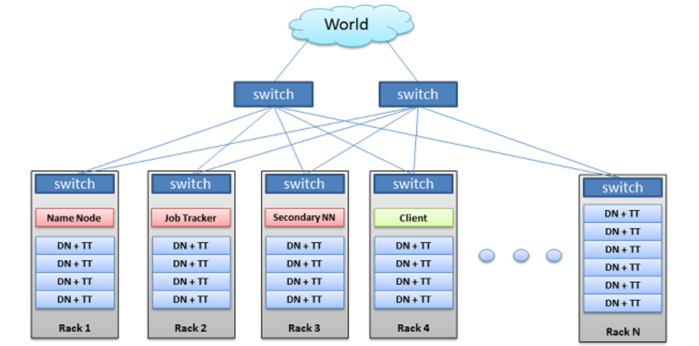
Data/Compute Collocation
In-rack = lower latency.

Slide 11
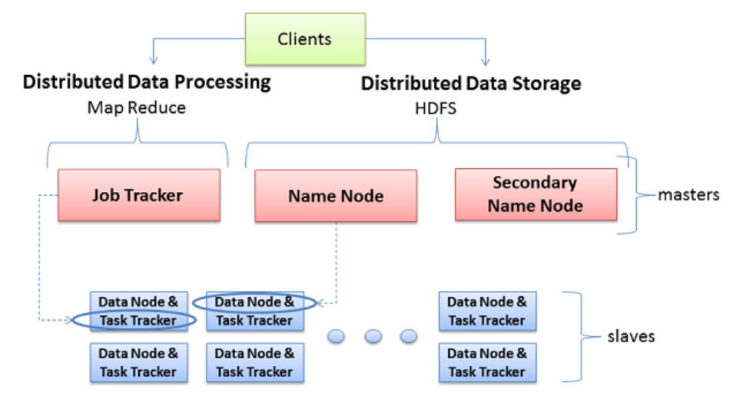
HDFS + MR = Hadoop

Slide 12
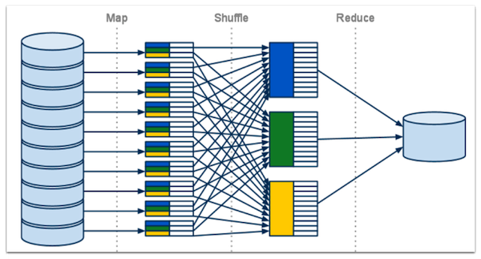
MapReduce Overview
Notes:
Mapper maps a set of input K/V pairs into a set of intermediate K/V pairs.
Reducer reduces a set of K/V pairs that share common K values into a smaller set of K/V pairs.

Slide 13
MapReduce Overview

Slide 14
Counting Words Seems Impractical?
>gi|215778351|ref|YP_002261491.1| conjugative transfer protein TraY [Aliivibrio salmonicida LFI1238]
MKKETSVNIVMDQKCNHLLNISKETSGRTKRNEAAARLKDHLLRFQHQDSWEVQKK
>gi|215778352|ref|YP_002261492.1| conjugative transfer protein TraA, putative fimbrial protein precursor [Aliivibrio salmonicida LFI1238]
MMKKWITPRNLLLTGTSVLLATQPALAADMFASGKTAIKDTVGTDSTVETAILSAGAVGAALTGFITKNWIGAIGGFAVGMIFWSVVAPMVGL
>gi|215778353|ref|YP_002261493.1| conjugative transfer protein TraL [Aliivibrio salmonicida LFI1238]
MEDPHLFYAIPKHLNKGKTIVGLPQSEVLPALLLFAVFFIAKHQLIGLVIGVVWFAGLRIIKTKYGDNIIPLALHWYGSTHVNQHLFTRTPSANKRYWIF
1
2
3
4
5
6
Assume you have TB of this type of data…

Slide 15
Asking Questions About Protein Structure
>gi|215778351|ref|YP_002261491.1| conjugative transfer protein TraY [Aliivibrio salmonicida LFI1238]
MKKETSVNIVMDQKCNHLLNISKETSGRTKRNEAAARLKDHLLRFQHQDSWEVQKK
How many species match '[MLIV]Q...R’?

Slide 16
Asking Questions About Protein Structure
K = [Aliivibrio salmonicida LFI1238]
V = MKKETSVNIVMDQKCNHLLNISKETSGRTKRNEAAARLKDHLLRFQHQDSWEVQKK
Transform into K,V to feed into Mapper

Slide 17
Asking Questions About Protein Structure
Every time your Map function sees a match, it outputs “Species,1”
e.g. Aliivibrio salmonicida LFI1238,1
No match -> nothing to output.
Shuffle/Reducer does the counting and merging.

Slide 18
Approachable(?) MapReduce
You can use Java
Or Python
Or Pig
But probably Hive is easiest

Slide 19
Other Useful DB Members of the Hadoop Ecosystem
Hbase
Hive
Sqoop

Slide 20
HBase
Semi-structured (has columns but you can add them on the fly)
Primary-Key only (still based on K/V)
Column Oriented (K->[V1,V2,V3])
Primary Key and Column Names can be overloaded to simulate an index
Auto sharding
Auto compressing (uses Snappy)
Supports insert/delete/update/select (but doesn’t use SQL)

Slide 21
HBase
It’s important to know your questions in advance.
Eg. Tracking flow data: “find all flows related to 10.10.1.1 between time A and time B”
That question will have a large impact on how you overload your primary key (rowkey) and column headers.

Slide 22
HBase
An interesting thing about Hbase:
The rowkey/column-name give you O(1) access to a value (cell)
This isn’t true of the other storage systems which generally require MapReduce (full scans) to locate a data element.
Check out “OpenTSDB” and it’s schema for an interesting demonstration on how to leverage this.

Slide 23
HBase
Also highly recommended:
HBase: The Definitive Guide
Esp Chap 6: Key Design
Understanding Key Design is, ehem, key to taking full advantage of HBase.

Slide 24
Hive
Uses SQL
Acts like an RDBMS (you define your table structure before loading data)
Doesn’t support delete/update (only insert/append/truncate/select)
Supports joins
Really just text files under the hood
Uses MapReduce under the hood (implies “full table scan”)
Has some useful semantic extensions to SQL (can call python functions)

Slide 25
Sqoop
Connects to databases that have JDBC drivers (MySQL, Oracle, MSSQL, etc)
Copies table data out of the RDBMS
Deposits it as delimited text files in HDFS
You can then transform the data using MapReduce or Hive
And re-export it to an RDBMS

Slide 26
Hadoop (and friends) = RDBMS?
What is an RDBMS?
Normalized, indexed, relational
Hive = structured, but no “update” no “delete” append/overwrite only, no indexes, does have SQL
HBase = minimal structure, Key/Column/Value, “primary” index only, no joins, no SQL
HDFS/MR = No structure, no index, no SQL

Slide 27
When Not to Use Hadoop
Transactional environments that require data consistency
Fast query requirements (mapreduce isnt sub-second queries, but over vast amounts of data it beats RDBMS queries)

Slide 28
When Not to Use Hadoop
“if you are doing sub-second interactive reporting from your data, or using the data in multi-step, complex transactions, an RDBMS solution may still be your best bet, since Hadoop is not particularly strong in these areas. If your data is being updated and changed through insertions and deletions, that's another reason to shy away from Hadoop.” goo.gl/ZFdyw

Slide 29

Questions/Evaluation Time!
http://www.cvent.com/d/scqth8?dvce=2

