Slide 1
Mahoodle in the “SUNY Nebula”
An engagement in open source technology
Keith Landa
Teaching, Learning and Technology Center Director
SUNY Purchase
Keith.Landa@purchase.edu
Scott May
Assistant Director Computing Services
SUNY Delhi
maysa@delhi.edu

Slide 2
Overview
An open path to shared services
Why open?
Why shared?
ePortfolios & the LMS – VLE solutions
User experience
Admin issues
Shared services ePortfolio projects

Slide 3
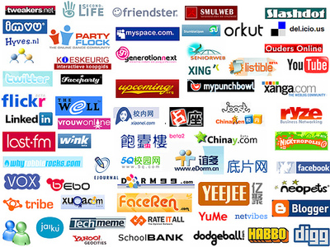
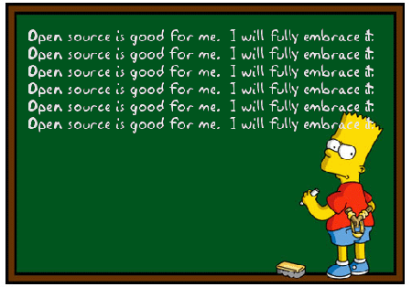
Focus on teaching & learning
- Robust set of activities & resources
- Add-on modules from the community
- Moodle development pathway
Integration
- Other systems
- Web 2.0 world
Why @ Purchase?
Flexible open architecture
Costs
- No licensing costs
- Similar support costs
Risk management
- Risks of open source
- Commercial products have different risks

Slide 4
Student
Information
System
Academic
Analytics
Library
Information
Systems
Live
Classroom
Campus
Repository
The View from 30,000 Feet
Notes:
Moodle is our learning management system platform. We switched from Blackboard to Moodle over the course of the 2009/2010 academic year.

Slide 5
Why Best Source @ Delhi
Adopted Agile life cycle, Moodle and Enterprise Wiki in 2008
Shorten Delivery time
Reduce Costs
Expedite procurement
Control Risks
Culture / Challenge

Slide 6
SUNY Shared Services
Share expertise and infrastructure among campuses
Advantages of open applications
Flexibility
No licensing or procurement issues

Slide 7
in

Slide 8
SUNYMoodleUsersGroup.org
To promote an awareness around the usage of Moodle within SUNY
To promote the usage of open source software within SUNY
To promote collaboration and sharing in the use of open source software and ideally develop a Model Moodle Implementation (MMI) that could be a blueprint for any campus wishing to adopt Moodle for e-learning.

Slide 9
A peek inside the Nebula

Slide 10
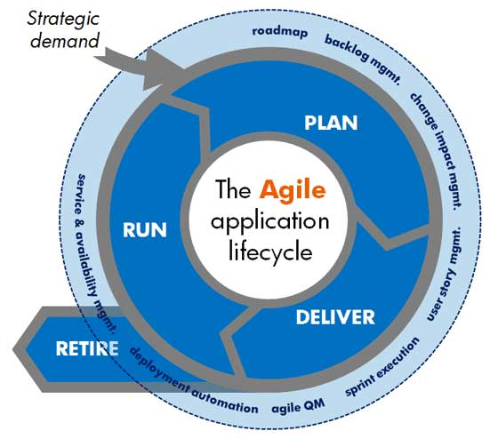
The Projects
Project 1 –
Project 2 – Web Meeting Tools

Slide 11
ePortfolio projects
Let go
Outsourced
SUNY sourced
ePortfolios
Campus sourced

Slide 12
LMS & ePortfolio → VLE
LMS
Course focus
Learning activities
Course management
Semester based
Life long learning?
ePortfolio
Individual focus
Artifacts of learning
Collect, select, reflect
Ongoing
Life long learning?

Slide 13
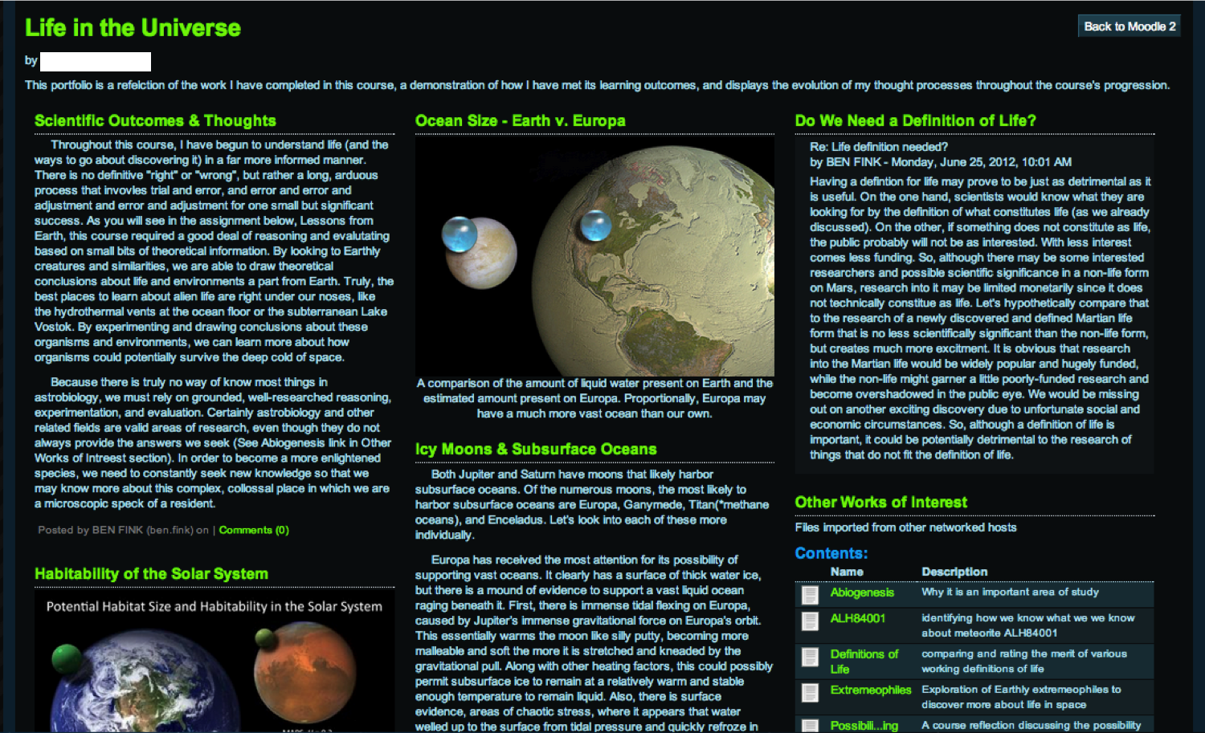
ePortfolio examples
Demos

Slide 14
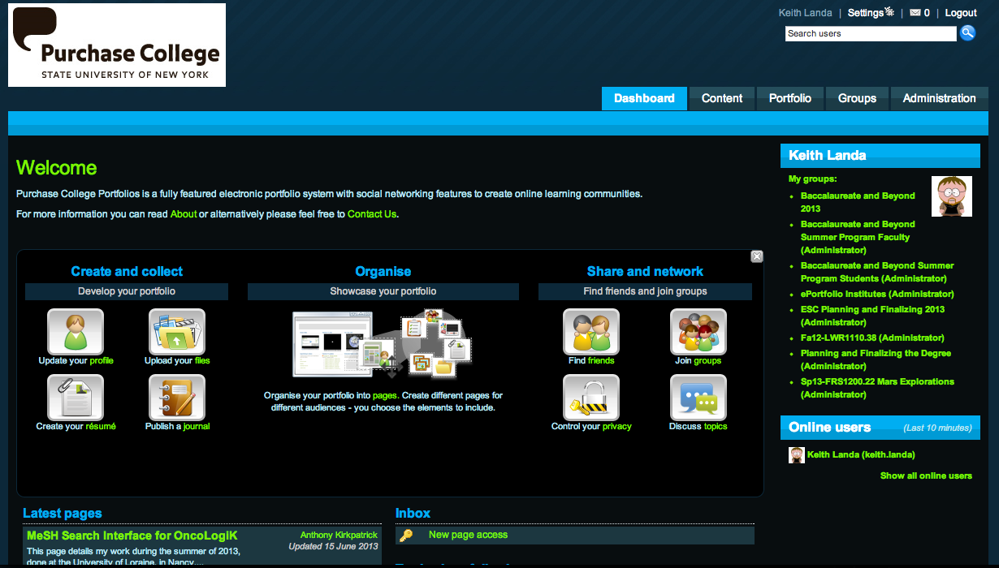
Mahara user experience
Demo

Slide 15
Moodle – Mahara integration
Networking settings on each application
Exchange of public keys
Authentication setup on Mahara
XML-RPC for SSO in from Moodle
Other authentication methods
Portfolio setup on Moodle
Managing peer services
Enabling portfolio services
Mahara assignment type
Demo

Slide 16
Mahoodle – LMS/ePort integration
Single Sign-on
Export to Portfolio
Content
Pages
Mahara Assignment type
Rubrics
Gradebook
(Outcomes)

Slide 17
Export from Moodle to Mahara
Forum postings, documents, online assignments, glossary & database entries, and other learning activities by students can be captured directly into their Mahara ePortfolio

Slide 18
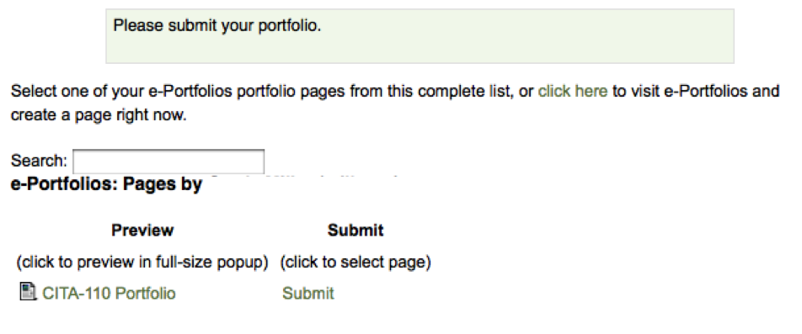
ePortfolio processes
Folder in Mahara to collect incoming artifacts from Moodle
Mahara assignment activity in Moodle to receive finished portfolio pages for grading and assessment, using Moodle’s rubric and narrative feedback tools

Slide 19
ePortfolio assessment
Grading interface in Moodle provides instructor access to student portfolios in Mahara, allowing use of all of Moodle’s grading and assessment tools.

Slide 20
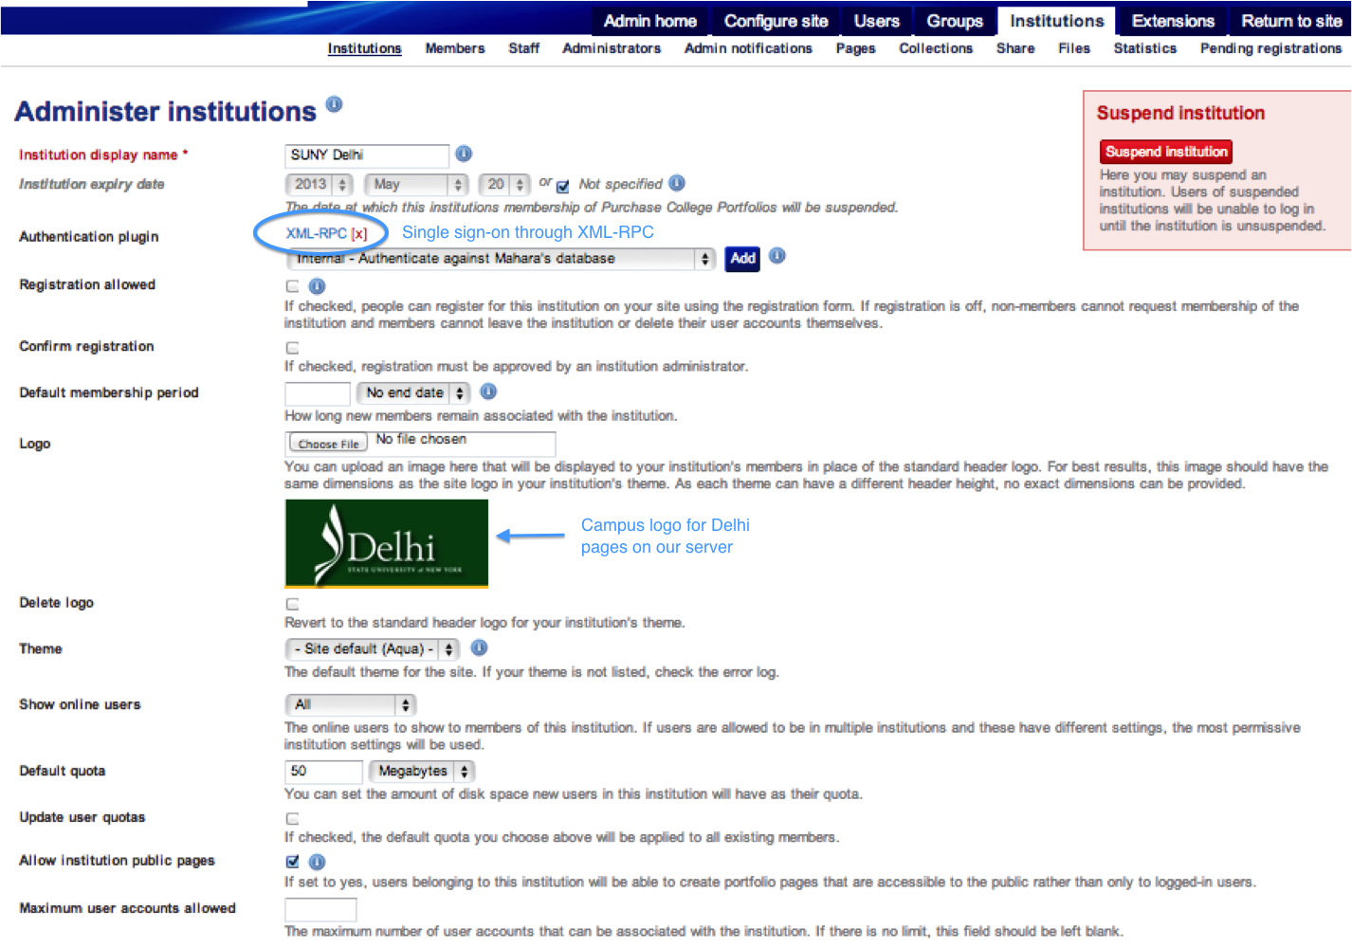
Delhi/Purchase Mahoodle

Slide 21
Delhi ePortfolio project
Connect Moodle to Purchase's existing Mahara site
Single Sign On (SSO)

Slide 22
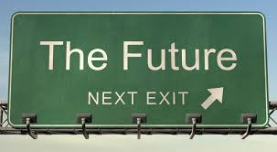
E-Portfolio Futures @ Delhi
Immediate interest
BSN Nursing
Hospitality
Architecture

Slide 23
Survey of ePortfolio projects
Empire State College – ePortfolio support while they move to MoodleRooms
Delhi – SUNY Nebula Mahoodle project
Purchase Bridges to Baccalaureate program, students from our partner community colleges
Oswego – summer research program
Morrisville – IITG grant, ePortfolios in college writing
ESC/Global Center – IITG grant, ePortfolios for intercultural assessment toolkit

Slide 24
Mahara multi-institution support
Demo

Slide 26
Thank You
Please visit the STC 2013 Evaluation site, after the conference ends
http://www.cvent.com/d/scqth8?dvce=2

