Slide 1
Using Windows Deployment Service and MDT as an Image Deployment Solution
Joe Leroux
Systems Administrator
SUNY Canton
lerou114@canton.edu

Slide 2
Reasons For The Change
Previous solution was time intensive
Hardware differences required large amounts of storage for images
Deployment failures
Media USB sticks got lost
Need for automation
Human error
Sector based cloning (Time consuming builds)
Lack of flexibility
Notes:
FOG, Clonezilla, and Ghost
Number of advantages to using a native Microsoft tools for you imaging strategy.
Budget, time and efficiency have been reduced.
Better quality deployment
Can be used in the data center.
Thin, Hybrid and Thick images
130 GB lab image reduced to 48 GB with multiple images down from 1 TB

Slide 3
Windows Deployment Services
This server role allows for PXE deployment over the network.
Unicast
Multicast
Server 2008 R2 gives multiple streams for multicast: High, Medium, and Low.
Can be used directly to deploy and capture images but is not very flexible.
Notes:
Chose to use this over installation media. First experiments with WDS standalone. MDT incorporated in with WDS makes it much more versitale.

Slide 4
What is MDT?
The Microsoft Deployment Toolkit is a free Microsoft Solution accelerator that allows for the automation of large scale deployment of Windows operating systems.
The toolkit uses core deployment tools from Microsoft that reduce the complexity of deployment.
WinPE-Bootable Deployment Platform
Image X-Editing tool for WIM images used for Capturing, and applying WIMs.
DISM-Used for offline servicing of WIM files
WISM-Used for image unattended.xml file editing.
Notes:
The deployment workbench is a MMC that allows you to manage your deployment shares, task sequences, images, drivers and database from one location.

Slide 6
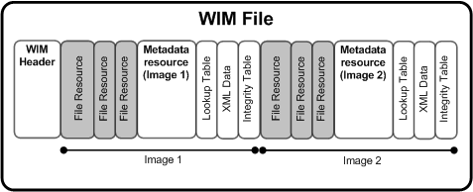
What is a .wim file?

Slide 7
Why use MDT?
MDT can be configured to do Lite Touch deployments with minimal human interaction
Can be used for desktop and server platforms
Highly configurable
Deployments can be as complex or as simple as needed
File based image rather than sector based
Notes:
http://download.microsoft.com/download/f/e/f/fefdc36e-392d-4678-9e4e-771ffa2692ab/Windows%20Imaging%20File%20Format.rtf

Slide 8
Features
Hardware agnostic
Less room for human error in building images and at deployment
Less storage required for images
More flexible
Easy to configure and manage drivers using the MDT workbench
You can use thin, hybrid, or thick images.
Service offline images with drivers and patches or stream patches from WSUS to the image at deployment
Customizable
Can be customized with Vbscript
Allows for execution of PowerShell, cmd, and batch files during task sequence

Slide 9
Features continued
Automation
Domain join
Application installation and scripting
Adding features and roles
WMI queries can be used for filtering deployments
Bitlocker
Deployment of VHD directly (MDT2012)
Option allows for a dual boot using VHD files
User state migration for refreshes and replacement scenarios
Deployment monitoring and logging Remote connection using MDOP or Remote desktop post deployment
Local policy packs for additional security
Powershell from within the PE - MDT 2012 (update 1)

Slide 10
How images are built
Hyper-V or VMWare workstation
Images are built in VM rather than on hardware so images can be snapshotted
No need to build on hardware and make configuration changes
Hyper-V preferred zero prep to get a compliant image. VMWare workstation can be used but you need to take few extra steps.
Using Hyper-V you add no drivers so you get a “pure/compliant” hardware agnostic .WIM file.
Notes:
Drivers are managed in MDT and injected during the imaging process.

Slide 11
Lite Touch Deployment using MDT
WDS for PXE boot install
PE boot WIM created in MDT workbench is added to boot images on WDS server for starting deployments
Media Install-DVD or USB
Linked Deployment Shares
Deployments can be scripted to automatically replicate
Configuration for deployment can be done two ways
Settings text file
MDT data base (Current method)
Notes:
Lite Touch with WDS was our chosen method. We used multiple deployment points. Currently we are working on multicasting. Started deploying using the custom setting files. Currently we are using the database which defines the attributes hostname and other settings for the deployments.

Slide 12
Lite Touch Deployment Cont.
Driver cabs are added to the workbench
Images then don’t need drivers installed UPNP selects them at deployment or can be forced to apply to the image
Most major vendors have drivers packaged for deployment: Dell, HP, Lenovo
Some may take a little work (installable drivers)
Service accounts can be used for deployment and alternate credentials used in a task sequence.
Third party applications can be installed at deployment.

Slide 13
Deployment Options
Media
USB or DVD
PXE Options
Multiple deployment points for unicast
Linked Deployment shares
SMB share (Windows 7 desktop budget)
Customize location using XML files for deployment shares
VLANs DHCP IP helpers for WDS
Multicast
Network changes IGMP snooping and PIM

Slide 14
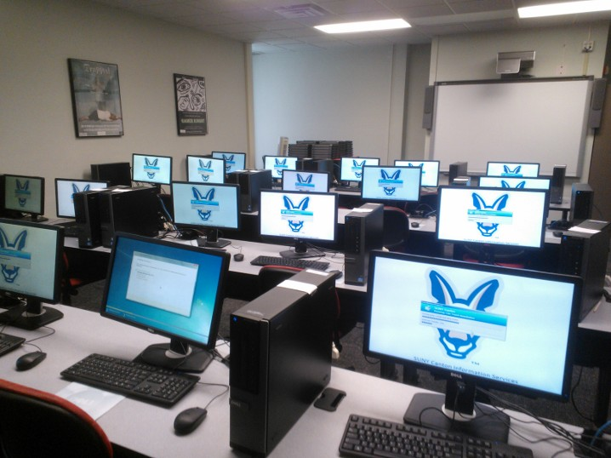
Multicasting

Slide 15
Tools and Resources
DISM GUI
DISM can be used to install updates and packages to an offline WIM rather than recapturing entire image
GImageX
WIM files can be combined to save space on deployment points
Uses a GUI to execute imageX commands
KMS Key management service
Can be used not only for KMS, but MAK activations
MDT Web Frontend
Codeplex
MDT Wizard Studio
Codeplex

Slide 16
Questions

Slide 17
Websites & blogs
Mitch Tulloch
http://www.windowsnetworking.com/articles-tutorials/windows-7/Deploying-Windows-7-Part1.html
Deployment Guys
http://blogs.technet.com/b/deploymentguys/
Johan Arwidmark
http://deploymentresearch.com/
myitforum
http://myitforum.com/myitforumwp/
The urban penguin
http://www.theurbanpenguin.com/mdt.html
Michael Niehaus
http://blogs.technet.com/b/mniehaus/
True Sec (Johan Arwidmark)
http://www.truesec.com/deploymentcd
MYITForums (Forum and listserv MDT and SCCM)
http://myitforum.com/myitforumwp/

Slide 18
Tool links
Dism GUI
http://dismgui.codeplex.com/releases/view/85863
IMAGEX gui
http://www.autoitscript.com/site/autoit-tools/gimagex/
MDT Wizard Editor
http://mdtwizardeditor.codeplex.com/
MDT PowerShell module
http://blogs.technet.com/b/mniehaus/archive/2009/05/15/manipulating-the-microsoft-deployment-toolkit-database-using-powershell.aspx
MDT Web Frontend
http://mdtwebfrontend.codeplex.com/

Slide 19
Books
Deployment Fundamentals Volume 1
By Johan Arwidmark and Mikael Nystrom

Slide 20
Please visit the evaluation site

