Slide 1

Managed Output Project
SUNY COA Presentation
June 2013
David Ecker – Director, Research Technologies
David Ecker

Slide 2


Stony Brook University
24,000 students
Located 60 miles east of NYC
Encompassing Main Campus, Southampton campus, Manhattan, HSC (Health Science Center) and Hospital
28 residence halls/23 apartments housing 9,500 students

Slide 3
Division of Information Technology
Project Objective:
  To design and implement a secure managed output program solution that will:
  Meet user output needs (which will vary by cluster across campus)
  Establish new policies based on industry best practices.
  Standardize devices and consolidate vendors
  Strive for lessened landfill impact with all waste, reduce CO2 emissions, decrease consumption of paper and other associated products, close the loop for all products used in the MPS process.
  Increase service levels and minimize equipment downtime.
  Support migration to paperless workflow.
  Reduce overall costs
David Ecker

Slide 4
Agenda:
Student Printing Implementation
Student Review and Quota
Sustainability (Toner, Paper and E-Waste)
Departmental Implementations

Slide 5
Section 1:
Student Printing Implementation

Slide 6
Summer 2012 - Student Print System
Our 15 Student Sinc Sites used Pharos for quota
GoPrint in our HSC Library (3 computer labs)
No print quote in the Residential Halls.
Our Goal one system and one quota through out the campus.
Are there any low hanging fruit?
Notes:
Notes: 15 Sinc sites – 900 computers – currently 1115 pc’s (may 2013)
HSC Library – 200 computers
Residencial Hall. – at least one lab of 30 computers in 8 quads

Slide 7
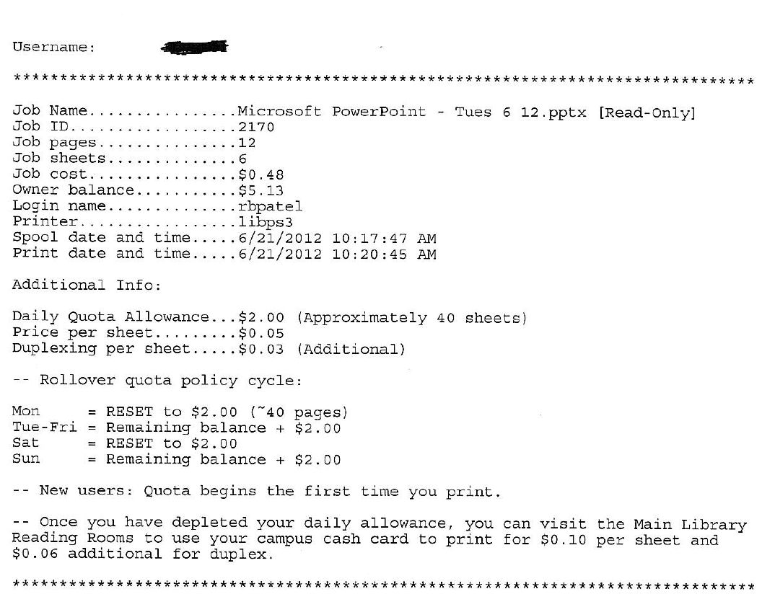
Division of Information Technology
Student Printing Output Change
(Reduced 800,000 pages per semester)
David Ecker
Notes:
1.6 million cover sheets over a year.
800,000 per semester.

Slide 8
Division of Information Technology
Student Quota
Charged with implementation on one quota for all labs.
Merging two existing quota’s and integrating into Wolfie Wallet (FSA CBORD system)
      One system gave students 40 pages a day. (accumulated through the week, reset on Friday night and Sunday night)
      One system gave 280 pages on Monday, reset each Monday
      Undergrad Student Government and GSO discussion
        Implemented system wide 280 pages on Monday
  Various technical teams involved to implement.
Notes:
Matt – Sinc Site technical staff
Andrew – Library technical staff
FSA – technical staff
Management – David Ecker, Andrew White, Chuck Powell, Kevin Kelly

Slide 9

Division of Information Technology
Student Implementation
      Implementation took over 9 months from Start to Finish.
      Required us purchasing all new Xerox devices for the HSC Library and Residential Halls.
        Pharos system limitation with Print from Anywhere one print driver.
      Integration into our new WolfieWallet system
      Purchasing of additional hardware devices called Omega’s at all locations.
      Coordination meetings and having technical teams with various degree’s of expectations.
      Success on Dec 19, 2012

Slide 10
Outcomes:
Expected reduction in printing that has not occurred. We are expected to print 20 million prints in our TLT sinc sites.(Year end May 2013)
HSC Library labs reduction in printing from 6 million to 3 million.
Implementation of expanding an existing Pharos system required us to implement a duplicate environment. (We are now exploring a system review)
Decreased the complication of quotas for students.
Year | Total Student Output
2012-2013 | 21,770,000 pages
2011-2012 | 19,970,000 pages

Slide 11
Section 2:
System Review & Quota Management

Slide 12
Printing Systems Utilized – COA List
Notes:
This was through the COA List an informal survey of the types of system that are used to manage print quota.

Slide 13
Printing Systems – based on CIO List
Notes:
Total number of schools in our survey= 166
P Counter- 45
Pharos- 27
N/A-23
Papercut- 16
Vendacard- 14
Print Manager Plus- 11
Uniprint- 5
Equitrac- 4
Others-21

Slide 16
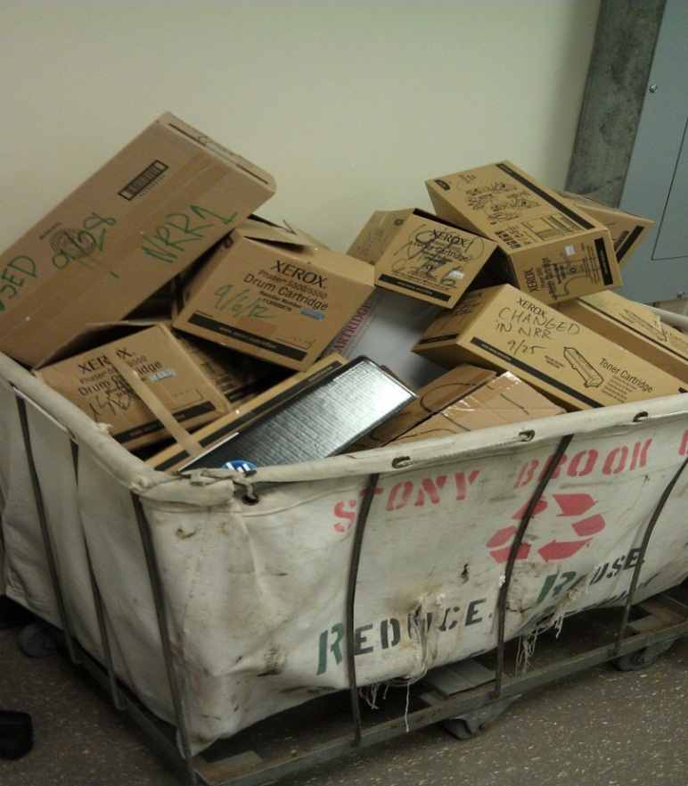
Division of Information Technology
Section 3:
Sustainability – Toner, Paper and Equipment
David Ecker

Slide 17
Division of Information Technology
Sustainability parts of the Project
- Toner Recycling
- Recycled Paper usage
- E-Waste

Slide 18
Campus Wide Toner Recycling Program
Discovered campus process (Fall 2012):
Toner entering waste stream
Cartridges sent back to HP
Costing Stony Brook resources
    ½ FTE for pickups
    1 truck
    Gas for vehicle
    Storage
    Resources to dispose
Return to campus for recycling $2,000 annually.

Slide 19
Toner RFI – Published in Campus Reporter – 10/26/2012
The University is interested in creating a University-wide toner recycling program. The program
must be vendor agnostic and accept all printer, copier toner and ink cartridges. The program
should include both self-serve receptacles and perhaps the installation of custom collection points
that match the current University recycling efforts. In addition, the program must include details of
the disposition of the material with a goal of 0% landfill impact and 100% use of all waste
materials. Further we would like to see a reporting mechanism attached to the program so that
the University can evaluate and assess its recycling efforts. Last, not only should the program
involve the collection of these products, but we are hopeful that a program can be designed that
includes a give back to the University whether that be in terms of cash, donation to charity or
returning some product back to the University. This program is and may be incorporated into
future University RFP’s and the vendor/proposal maybe the basis for the inclusion on future
projects.

Slide 20
Campus wide toner program cont..
Collaborated with Procurement, Office of Sustainability and Information Technology
RFI for toner in 3 Parts.
1. Large scale weekly pickups.
2. Assist departments collection boxes
3. Public locations.
Note: Toner spend on campus for 2012-2013 year is $600,000

Slide 21
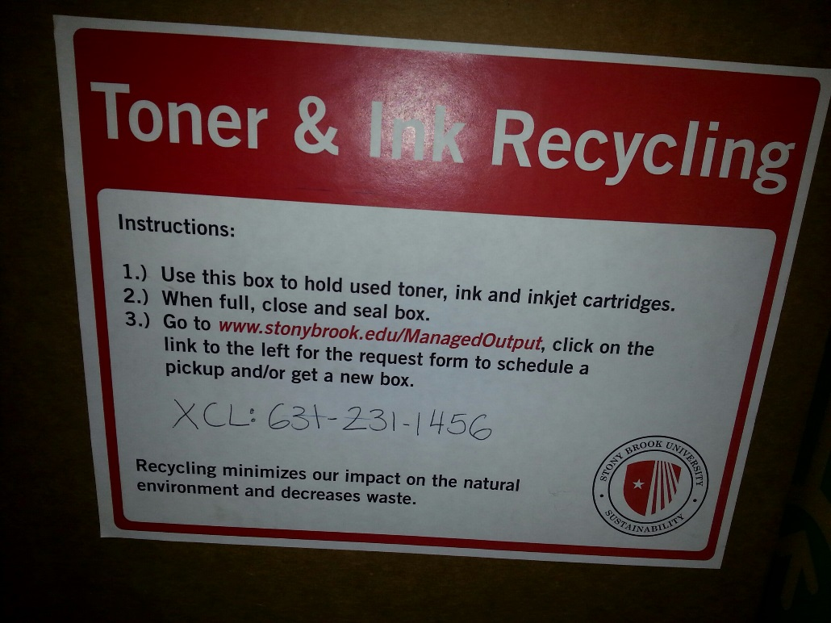
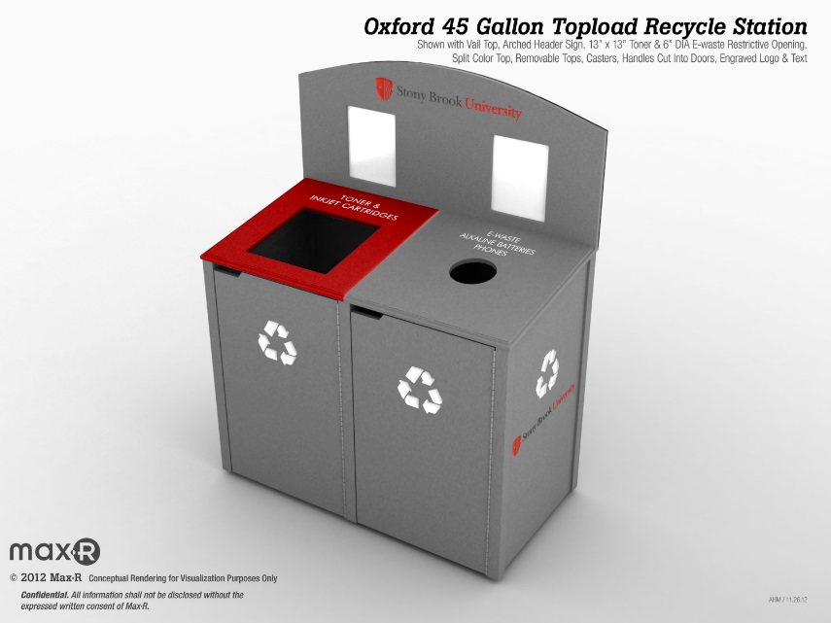

Slide 22
Paper Purchasing and use
Discovered the campus was purchasing Virgin paper.
Prices from vendors varied from $14 a ream (Forester Scientific) to $3.50 from Staples.
Most of the campus purchased standard virgin white paper.
The Sinc sites tested 30% recycled paper on high volume printers and no disastrous effects on the Xerox devices.
Research discovered some departments found 30% recycled was cheaper to purchase.
Purchasing started to go through old Purchase orders and find out where paper was being purchased. To eliminate any purchases not within the standard Office supplier.

Slide 23
Outcomes from Discovery:
Purchasing spoke to Staples to drive the cost down for 30% and 100% recycled to be at a comparable cost.
VP for Finance recommended policy to only purchase 30% or 100% recycled paper on campus.
Focused on most common sizes - 8.5”x11”, 8.5”x14” and 11”x17”
Negotiation change in all contracts to include the following sections:
The Contractor agrees to utilize recycled paper whenever possible and specifically utilize paper that has some portion of post-consumer waste materials for all University departmental printing purchases.
The Contractor agrees to recycle toner cartridges in partnership with the manufacturer and/or participate in the University's toner, maintenance kit, drum recycling project in order to ensure that these items do not end up in the local waste stream. By ensuring participation the Contractor will assist the University in achieving a 0% landfill impact goal as well as additional cost savings.

Slide 24
University Moving Exclusively to Recycled Paper (Announcement Project 50 site)
Effective April 1, 2013, the University will transition from procurement of 100% virgin copy paper to exclusively paper with post-consumer waste (PCW) content.
Besides realizing significant sustainability benefits, the University will save $10,000 to $26,000, which will be re-purposed to directly benefit students, faculty and staff. This procurement action will also increase the percentage of University partnerships with minority- and women-owned businesses.
Ultimately, all copy paper purchased in the three major sizes, 8.5”x11”, 8.5”x14” and 11”x17”, will have 30%, 50% or 100% PCW content, regardless of color and weight.
The recycled paper initiative is a component of Project 50 Forward’s Operational Excellence Managed Output Project, led by DoIT’s David Ecker and team members Lynn Davis from Procurement and James O’Connor from Transportation and Sustainability. The team’s goals include reducing costs, increasing sustainability and improving services related to document production. The team recently introduced the toner recycling program.

Slide 25
E-Waste(Discovery)
1. No standard on campus process for disposal
2. Equipment under $5,000 doesn’t need to be tracked by NY State
3. No process of recycling most classified as scrap.
4. Outside Vendor pickup with no return to campus.
5. Limited types of equipment picked up, most cell phones, batteries, etc entered waste stream.
6. Missing procedure for redistribution of working equipment.

Slide 26
E-Waste RFI – Published May 2013
The University is interested in creating a University-wide Electronic Waste (E-waste) program for electronic equipment/devices, used cell phones, desktop printers, faxes, CD/DVD’s, USB/thumb drives, multi-function printing devices, copiers, computers, laptops, tablets, servers, batteries, electronic boards, radios, document scanners, electronic equipment on heating/ ventilation equipment, electronic boards/components of lighting ballasts, etc. The program must be vendor agnostic and accept all equipment regardless of any manufacturer. The program will include a streamlined process that will easily allow the university community to recycle e-waste using the “classification types” highlighted below. The University is interested in understanding how this program will support the university sustainability efforts in the recycling of the equipment or disposition of the material of working towards “zero waste” generation with the ultimate goal of 0% landfill impact and 100% use of all materials. Vendors are required to demonstrate how their company will work with Stony Brook University to achieve goals to limit landfill impact and preference will be given to companies that are R2/RIOS and ISO certified and such companies are requested to detail their appropriate certification(s).
The University's long term goal is 0% landfill impact.
Further, the University would like to see a reporting mechanism attached to the program that will demonstrate the university commitment to recycling the equipment through this initiative by demonstrating the devices recycled on a monthly basis.
The University would like to use the revenue received from the collected e-waste as a credit towards recycling batteries that are collected in this program. All types of batteries are to be accepted (re-chargeable, alkaline, etc) so they can be recycled with minimal impact on the landfill.

Slide 27

E-Waste Update.
Current Progress on this initiative…

Slide 28
Campus Communications:
  Managed Output Site.
    Managed Output Toner box form for requesting a box
  Public digital signage on campus screens (SCALA)
  Public announcements through a campus announcement system
  Recommendations by Administration

Slide 29
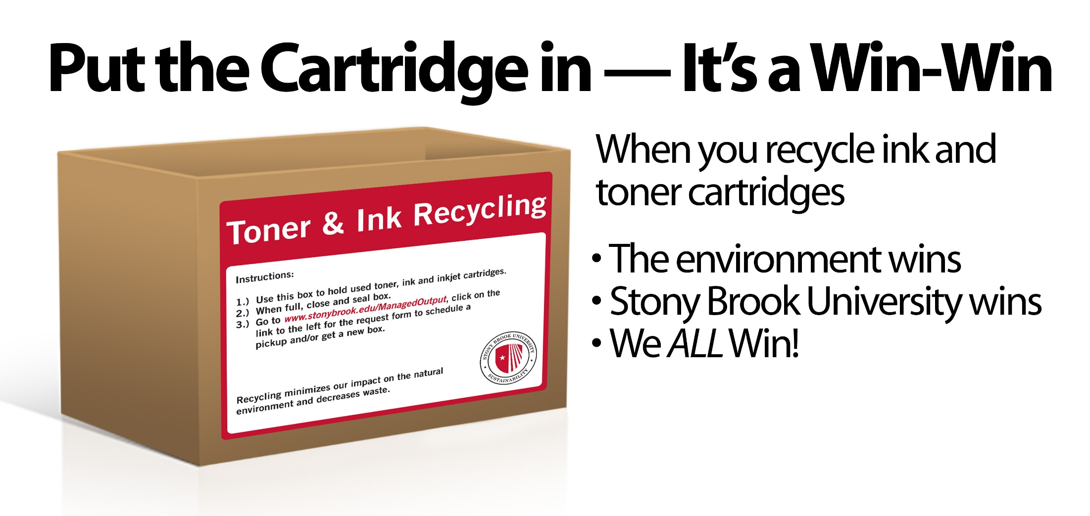

Slide 30
Managed Output Team Interview - http://www.stonybrook.edu/sb/50forward/managed-output.html
April 22, 2013–The members of Project 50 Forward’s Managed Output team, project leader David Ecker, DoIT; Lynn Davis, Procurement and James O’Connor, Sustainability recently discussed their initiatives in the following interview.
The team is supported by project sponsors Chuck Powell, Interim Chief Information Officer and Charles Taber, Interim Dean of Graduate Studies.
What is Managed Output?
[Dave] Managed Output is a focused approach to manage the processes used in printing, presentation and distribution of paper documents and make them as user-friendly, sustainable and cost effective as possible.
Why the need for change?
[Dave] Stony Brook students, faculty and staff use approximately 25 million sheets of paper per year using myriad devices from many different manufacturers, many of which are old and obsolete. Further, there has been no systemized process to manage the purchasing, servicing and disposal of the equipment used to create those documents.

Slide 31
Section 4:
Departmental Implementations

Slide 32
Department Implementations.
Document Workflow Enhancement
Department device shared among two departments
Proactive supplies
Large scale implementation with a MPS pilot

Slide 33
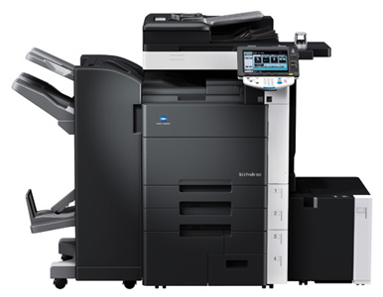
Division of Information Technology
Document Workflow Enhancements
Financial Aid & Undergrad Admissions
Received paper Faxes
Scanned Paper Faxes into computer
Discarded and shredded Faxes
Human Resources
Reduced 5 fax machines to 2 with MFP
Central release of secure print jobs
David Ecker

Slide 34
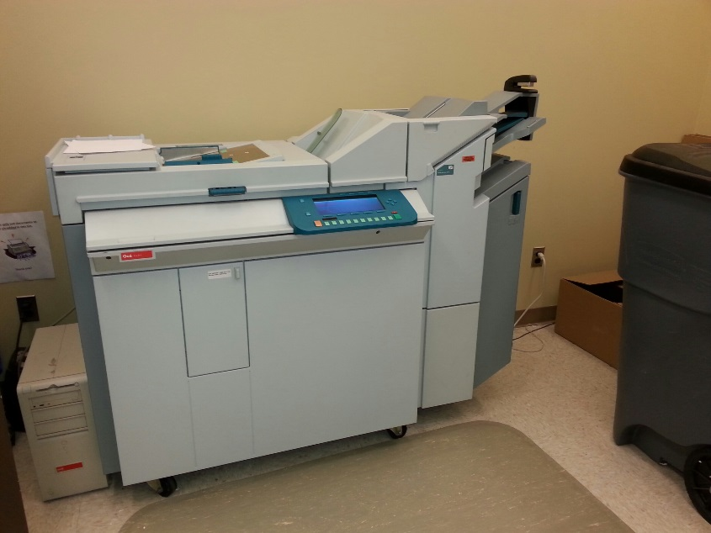
Linguistics and Africana Studies.
Request by Dean of College of Arts & Sciences:
Elimination of two copiers (one Oce device was 11 years old it took up a room)
Reclaim office space for Faculty
Purchase MFD:
Department collaboration
Release codes with Charge Backs
Discovered initial deployment was a
behavior change depts. weren’t ready
for change.

Slide 35
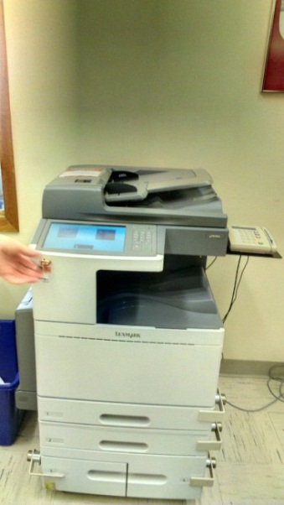
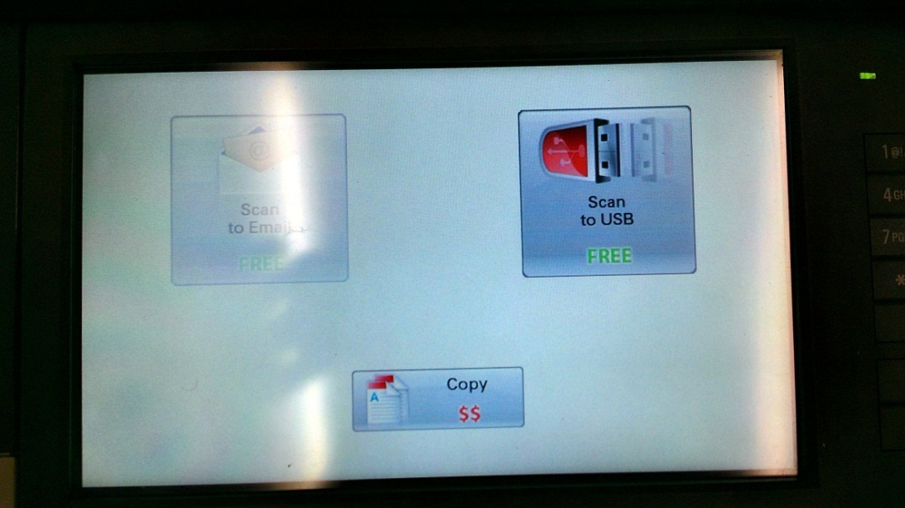
Division of Information Technology
Library Workflow enhancements
Replaced copiers with Multi-Function devices.
Improved workflow with Email and Scan to USB
David Ecker

Slide 36
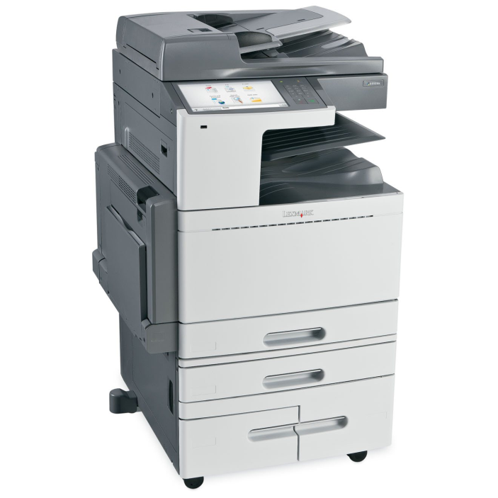
Division of Information Technology
Library Staff Implementation
Standardize and Reduce staff printing costs
Integration of electronic document management solutions (Email, scanning, etc)
Purchased Lexmark MFD
David Ecker

Slide 37
Division of Information Technology
Library Staff Implementation
Install 9 Multi-Function Devices in Melville Library
Locations: Central Reading Room, Inter-Library Loan/Document Delivery, Technical Services/Cataloging, Preservation, Special Collections, Circulation, North Reading Room, Music Library, Math/Physics
Install 3 Multi-Function Devices in HSC Library
Install Label printers at key locations to handle any bindery/label printing.

Slide 38
Various other department installations.
Enrollment and Planning
Computer Center
Internal Audit
Organization Health

Slide 39
Next Steps:
Campus survey of local devices
RFP for campus to choose a vendor for a segment of the community
Survey to campus on local device removal
Funding determination for large device purchases.

Slide 40
Questions?
David Ecker
Director, Research Technologies
David.ecker@stonybrook.edu
Thank you goes out to the Managed Output Team at
Stony Brook University
Lynn Davis, James O’Conner and Mitch Menarchem

