Slide 1
Web Meeting Tools in the “SUNY Nebula”
An engagement in open source technology

Slide 2
Speaker Introductions
Scott May
Assistant Director Computing Services
SUNY Delhi
maysa@delhi.edu
Keith Landa
Director – Teaching, Learning and Technology Center
SUNY Purchase
Keith.Landa@purchase.edu

Slide 3
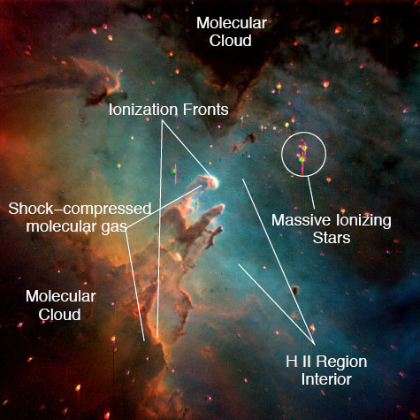
Why Nebula?
Conference Theme – “To the Cloud and Beyond”
Nebulous – unclear, vague, ill-defined
Nebula Latin for Cloud
Reuse
Not everything is visible
Objects forming – gravity

Slide 4
Top-Ten IT Issues, 2013: Welcome to the Connected Age (June 3, 2013)
"the US higher education sector has hit a critical juncture in the evolution of its business model" and that most colleges and universities "will have to lower their cost structures to achieve long-term financial sustainability and fund future initiatives."¹
"business as usual is not in the future cards and we must innovate."²
Source: http://www.educause.edu/ero/article/top-ten-it-issues-2013-welcome-connected-age

Slide 5
Why Best Source @ Delhi
Adopted Agile life cycle, Moodle and Enterprise Wiki in 2008
Shorten Delivery time
Reduce Costs
Expedite procurement
Control Risks
Culture / Challenge

Slide 6
Student
Information
System
Academic
Analytics
Library
Information
Systems
*
Live
Classroom
Campus
Repository
Open source @ Purchase
Notes:
Moodle is our learning management system platform. We switched from Blackboard to Moodle over the course of the 2009/2010 academic year.

Slide 7
Georgia Tech Announces Massive Online Master's Degree In Computer Science
Institute teams with Udacity, AT&T to launch first-of-its-kind advanced degree program
ATLANTA – May 14, 2013 – The Georgia Institute of Technology College of Computing announced today that it will offer the first professional Online Master of Science degree in computer science (OMS CS) that can be earned completely through the “massive online” format. The degree will be provided in collaboration with online education leader Udacity Inc. and AT&T.
All OMS CS course content will be delivered via the massive open online course (MOOC) format, with enhanced support services for students enrolled in the degree program. Those students also will pay a fraction of the cost of traditional on-campus master’s programs; total tuition for the program is initially expected to be below $7,000. A pilot program, partly supported by a generous gift from AT&T, will begin in the next academic year. Initial enrollment will be limited to a few hundred students recruited from AT&T and Georgia Tech corporate affiliates. Enrollment is expected to expand gradually over the next three years.
Source: http://www.omscs.gatech.edu/announcement/

Slide 8
in

Slide 9
The Breakthrough
COA Regional Forum January 2013
Moodle Moot for Systems Administrators

Slide 10
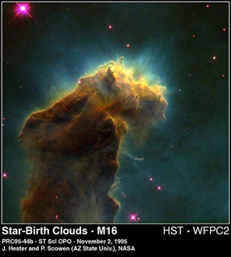
SUNYMoodleUsersGroup.org
To promote an awareness around the usage of Moodle within SUNY
To promote the usage of open source software within SUNY
To promote collaboration and sharing in the use of open source software and ideally develop a Model Moodle Implementation (MMI) that could be a blueprint for any campus wishing to adopt Moodle for e-learning.

Slide 11
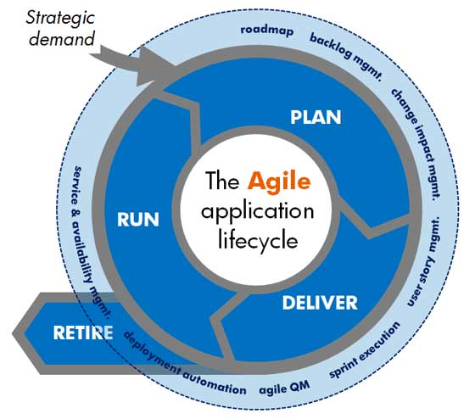
The Projects
Project 1 –
Project 2 – Web Meeting Tools

Slide 12
Development in the Nebula

Slide 13
Web Meeting Goals
Open Source
Plugins readily available for Moodle Integration
SIP integration capable
Capable of conferencing outside of Moodle

Slide 14
Bigbluebutton.org
Mozilla WebFWD
SIP integration using FreeSwitch
Runs on both Windows and Linux Servers
Uses Red5 (Java/Tomcat)
Requires Flash enabled browser to use
Latest Release: June 18, 2012

Slide 15
Openmeetings.apache.org
Recently taken under the Apache Foundation
SIP Integration using Asterisk
Runs on both Windows and Linux Servers
Uses Red5 (Java/Tomcat)
Requires Flash enabled browser to use
Latest Release March 22, 2013

Slide 16
Common Third Party Pieces
Operating System – Linux, Windows
DB – Derby, MySQL, Postgre, DB2, Oracle
ImageMagick (image conversion tool)
SWFTools (Flash developer toolkit)
Open Office (Document Conversion Tool)
FFMpeg (video conversion)*
Sox (Audio conversion)
Asterisk/FreeSwitch (SIP Integration)

Slide 17
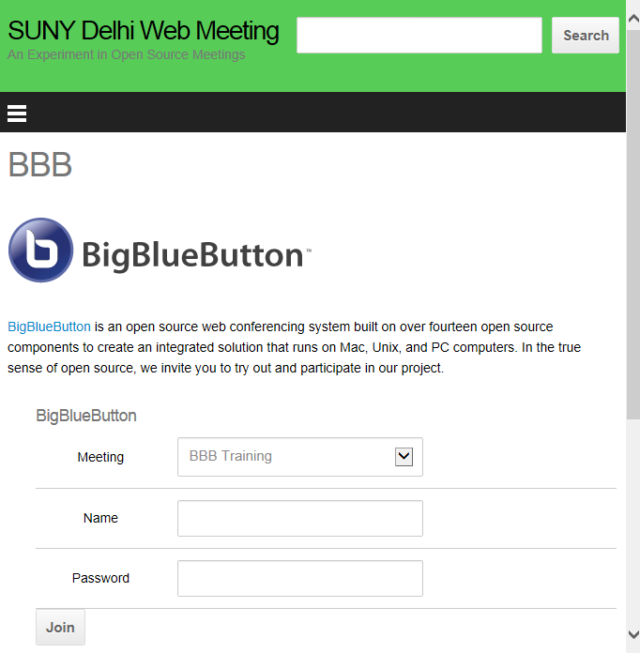
BBB Demonstration

Slide 18
OM Demonstration

Slide 19
Rising to the top
Surge of development effort from Apache Foundation.
Multiple whiteboards, file storage, video on whiteboard.
Asterisk integration for SIP is more widely used/documented
Meets or exceeds functionality of Commercial applications like Collaborate and WebEx.

Slide 20
Integration & Access
WordPress plugins readily available to front end both.
Moodle plugins readily available.
BBB uses security salt, no out of box front end.
OM uses an administrative users account dedicated to each Moodle installation.

Slide 21
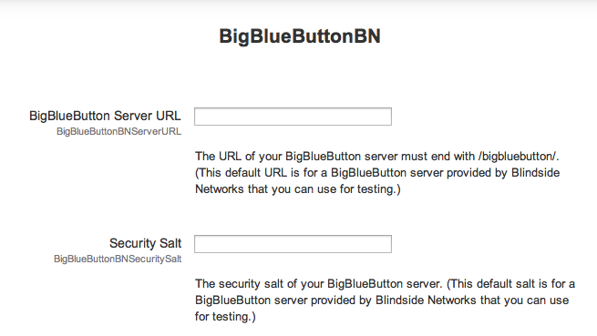
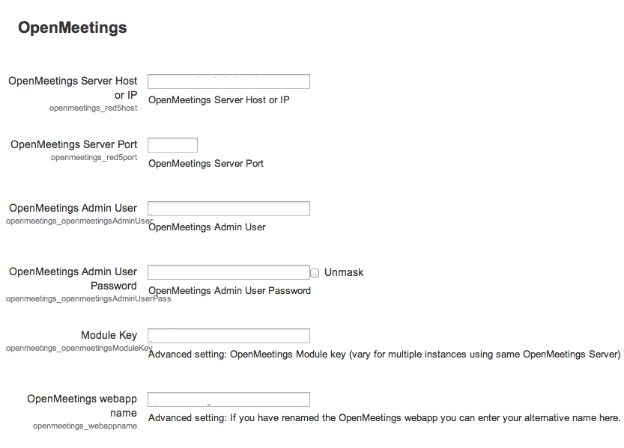
View from Purchase - Admin

Slide 22
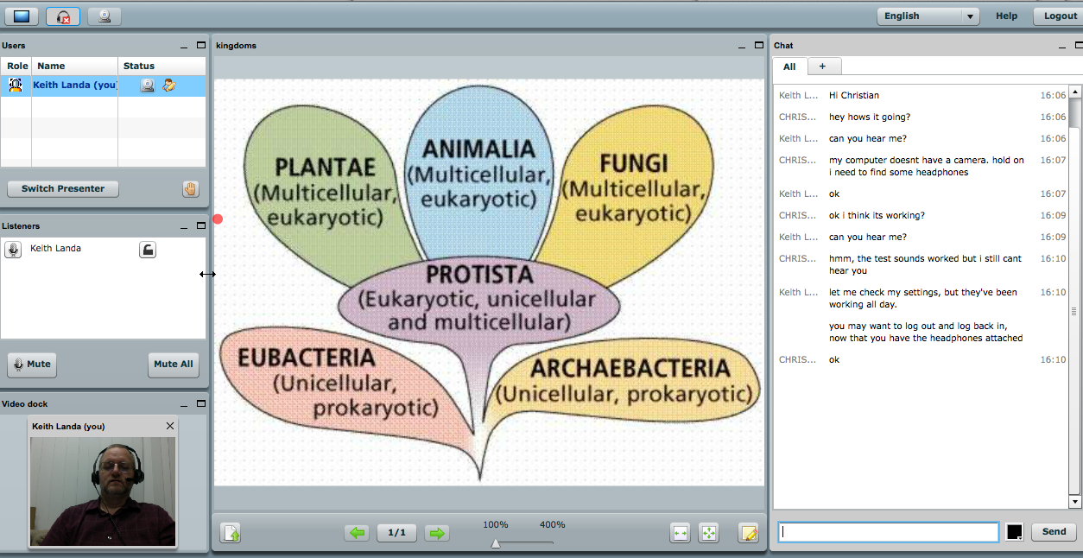
View from Purchase - Usage
Self-service for faculty
SSO – Purchase identity
BBB Demo – activity set-up and use

Slide 23
View from Purchase - Plans
Early pilots
Online course usage
Remote library instruction
Face to face courses

Slide 25
Thank You
Please visit the STC 2013 Evaluation site, after the conference ends
http://www.cvent.com/d/scqth8?dvce=2

