Slide 1
Stony Brook
University
Move to Google Apps
Experiences and Lessons Learned
an Admin's Perspective

Slide 2
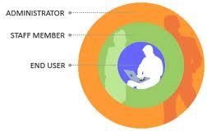
Why an Admin's Perspective?

Slide 3
History
June 2011 - CIO asks that email systems be reviewed. Steering Committee created to issue a recommendation.
December 2011 - Steering Committee picks Google Apps over Office 365
April 2012 - Pilot Group put on GAPPS.
December 2012 - All Students and 65% of Notes users migrated to GAPPS.
June 2013 - Almost All Notes Users Moved.
December 2013 - Applications Moved.

Slide 4
Old Email Environment
About a dozen different email Systems including:
Lotus Notes (5,000 Faculty and Staff main campus and 1,500 School Of Nursing users)
SUN Mail (30,000 Students)
Exchange (7,000 Hospital and Other Main Campus Departments)
Google Apps (Department of 150)

Slide 5
New Email Environment
-Google Apps for Faculty / Staff and Students
-Exchange for Hospital, predominantly Google Apps for Main Campus
-Have moved departments using email systems outside of DoIT into Google (Electrical Engineering, Pharmacology, Math, and Astronomy).

Slide 6
Did not Move to Cloud
Computer Accounts Application
EPO @stonybrook.edu mail redirect
Listserv

Slide 7
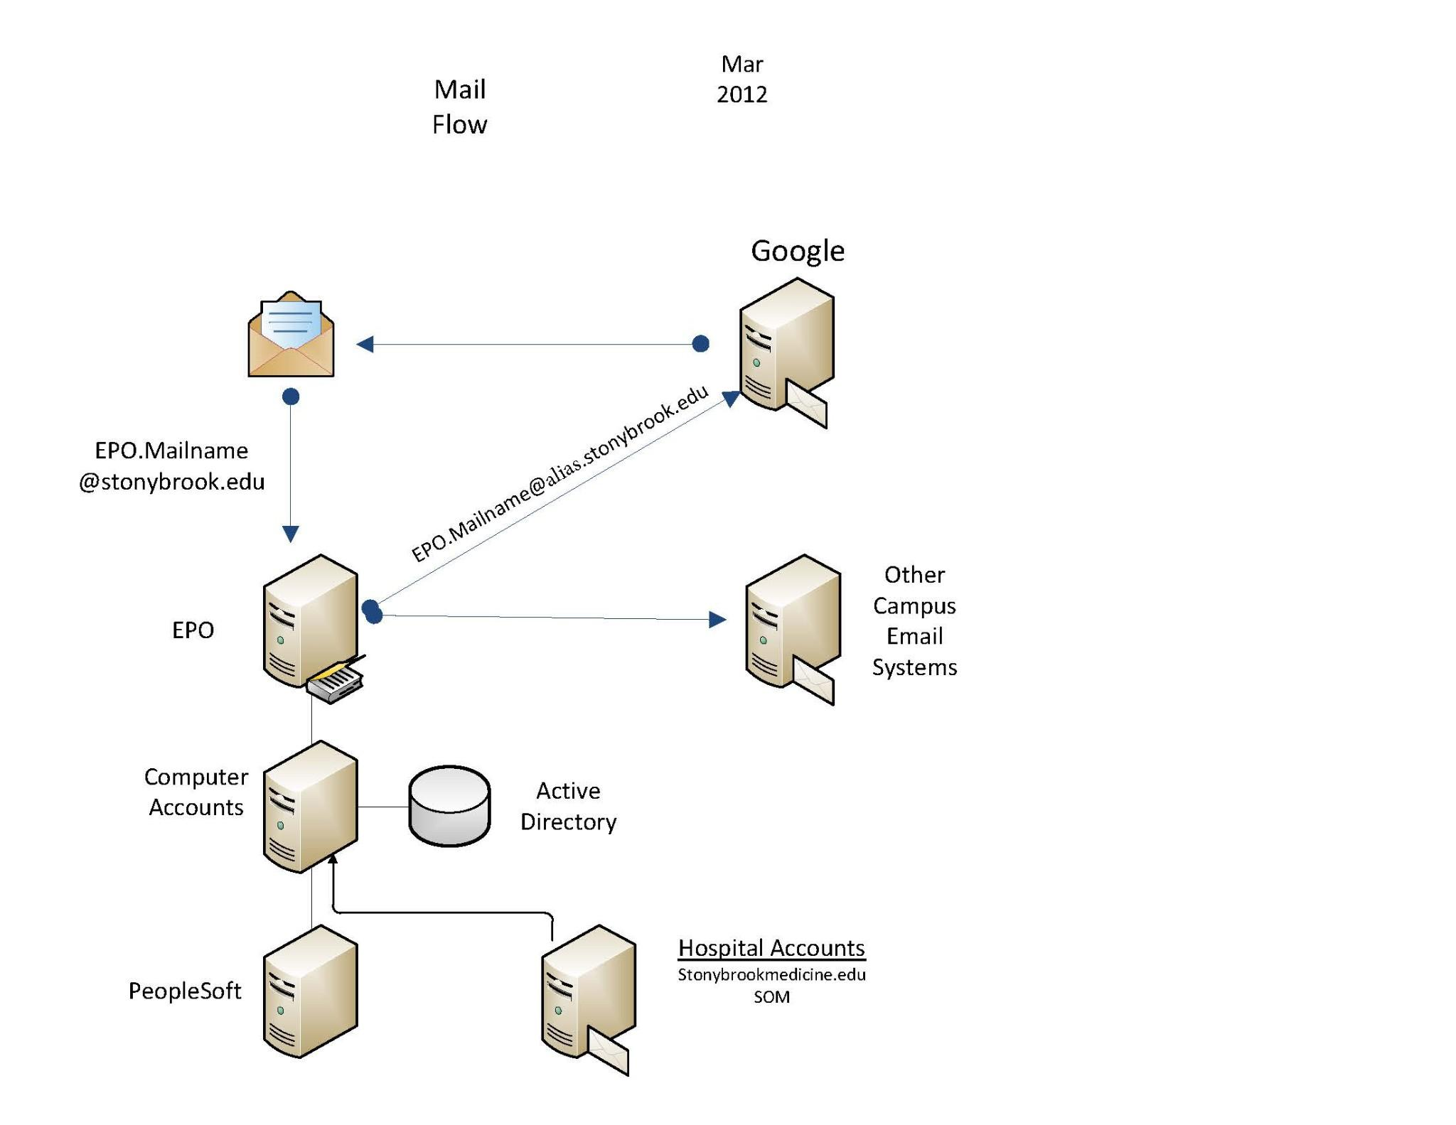
Mail Flow

Slide 8
Good or Better
-Standardized on an @stonybrook.edu email address for all Students, Faculty and Staff
-Standardized on Chrome as preferred mail client
-Mobile Device Support excluding BlackBerry
-Users can create and manage their own calendars
-Drive, Calendar, Talk and Groups are integrated into the product and work well via Chrome.

Slide 9
Good or Better
-25 GB Email quota, 5 GB Drive quota
New Combined Quota Coming Soon!
Can buy additional Drive space thru a reseller
-Allow users to access email a variety of ways compared to Notes
-Eliminated the BlackBerry Server
-Eventually Eliminate Cost of Notes Software
-Eventually Eliminate Notes Hardware Costs
-GAMLN Migration Tool Great!

Slide 10
Not as Expected
-Admin Control Panel lacking features including:
email logs only going back 30 days
can not effectively administer sites and docs without third party tools.
can not tell who deleted documents out of a mail file for those files with delegated access.

Slide 11
Not As Expected
-Uptime and Response Time
"This issue is affecting less than 0.007 percent of the Google Mail user base. The affected users are unable to access Google Mail,"
http://www.google.com/appsstatus
http://downrightnow.com

Slide 12
Not as Expected
-Google has it's own limits related to download bandwidth and email spamming that can not be overridden.
-See below for Bandwidth Limits-> http://support.google.com/a/bin/answer.py?hl=en&answer=1071518
-See below for receiving email limits ->
http://support.google.com/a/bin/answer.py?hl=en&answer=1366776&topic=28609&ctx=topic
- Storage Limits for Google Drive

Slide 13
Not as Expected
-No built in way for end users to encrypt email
-no way to tell if account is compromised and sending out spam
-no way to recover email deleted permanently from Trash or Spam without purchasing Google Message Vault.
http://support.google.com/a/bin/answer.py?hl=en&answer=112445

Slide 14
Not as Expected
-Full login information (username, IP, log in and log out time) is only avaliable from Google with a court order.
-No simple way to move a commercial Gmail account (email, contacts, chat contacts, docs, calendar) to an Google Apps account or from one Google Apps domain to another.
-Can use GAMME tool to migrate from an IMAP server to Google.

Slide 15
Spent Additional Money On
-Purchasing Applications to replace ones that were developed in-house in Notes
-Users that want additional Drive space.
hard and soft quotas would be useful!
-No built in eDiscovery solution, need to purchase Google Apps Vault.
(Can not enable Hangouts with Vault)
-No built in backup and recovery
-Password resets

Slide 16
Google Tips
-Turn on SSL
- Get Apps Updates http://googleappsupdates.blogspot.com/
-Barebones domain does not allow users who forgot password to reset it themselves. Need to build a front end, SSO or password sync (GAPS) with AD.
-Use two factor authentication for Admin accounts and hide account. Super Admins can delete the whole Domain!

Slide 17
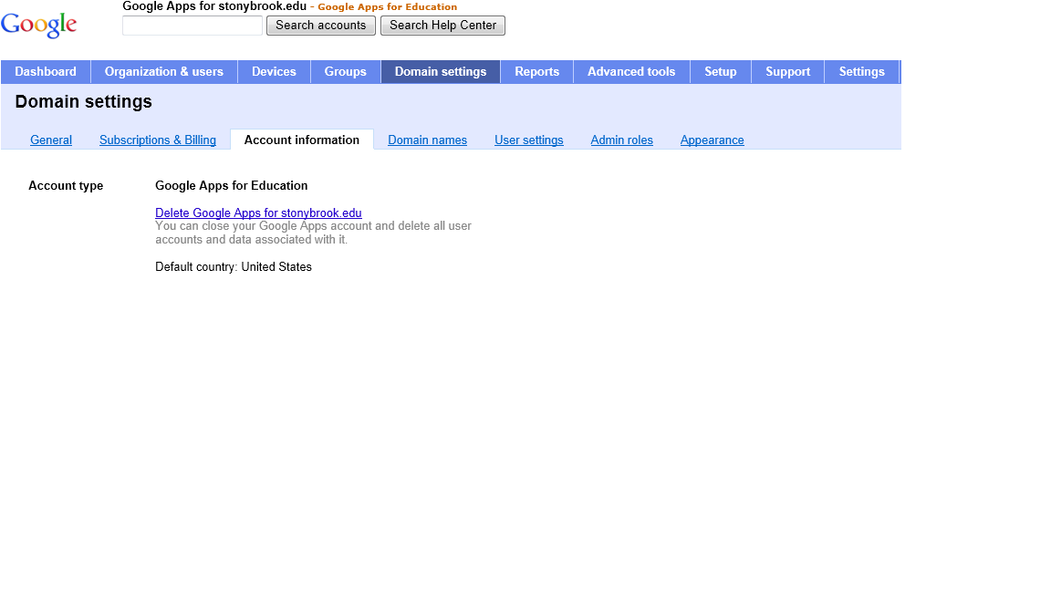
Scary Stuff

Slide 18
Google Tips
-Multiple Domains can be controlled by one Control Panel
-Additional Google Drive Space for EDU customers can be purchased from a Third Party Provider
- Get Data Out of Apps
http://support.google.com/a/bin/answer.py?hl=en&answer=100458
above only for end users to do so.
-GAM Tool Indispensible
http://code.google.com/p/google-apps-manager/

Slide 19
Google Tips
-Create Google Domains
http://www.google.com/a/cpanel/education/new
-Suspend Accounts Instead of Deleting Them
-https://xxx.google.com/a/stonybrook.edu
where xxx = admin, drive, mail, groups, calendar works!

Slide 20
Additional Services
-SUNY Counsel informs us not to turn on any services beyond the core 7. Other apps are "consumer services".
- Not the same experience as a regular Gmail user if you do not turn them on.
- Many things either do not work or simply break if you do not turn on. No Google+, Hangouts, Group, etc.
-Anyone notice Talk transitioned to Google Hangouts recently

Slide 21
SSO or Not?
-Google out of the box does not have a way for end users to change their passwords.
-Stony Brook used SSO - Jasig CAS
-IMAP and Mobile Clients do not use SSO.
-Sync Google Passwords from AD
Google Apps Password Sync (GAPS) is free

Slide 22
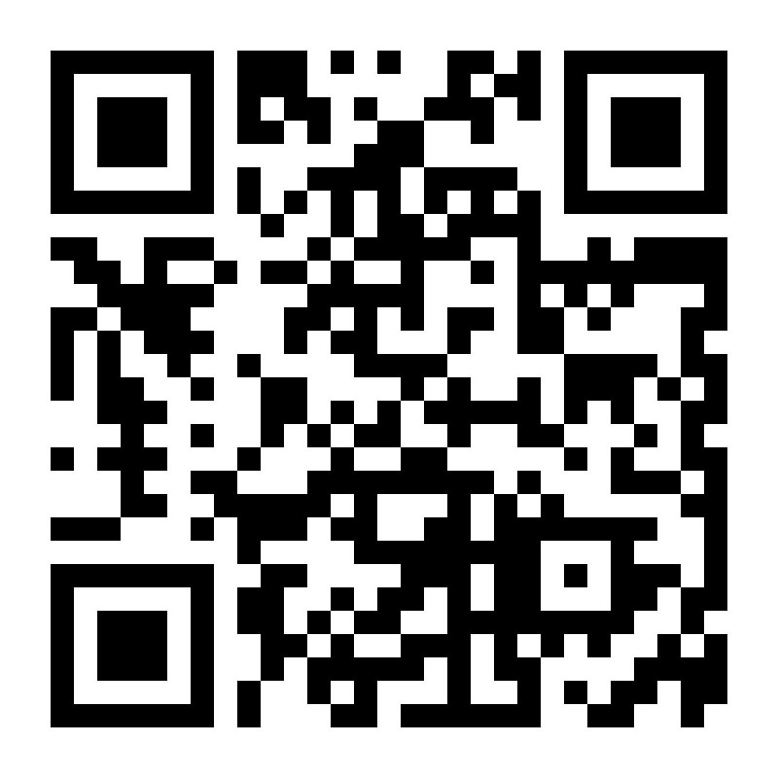
Patrick.Iannuccilli@stonybrook.edu
Please fill out evaluation form.
Thank You!
http://www.cvent.com/d/scqth8?dvce=2

