Slide 1
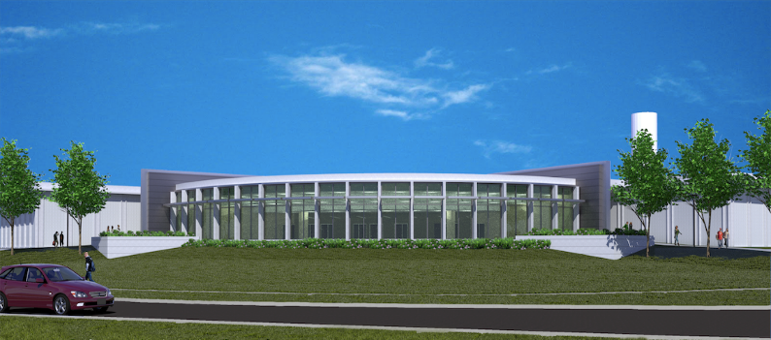
One ITS
Enterprise Applications Services
Research IT
OCIO
Inf. Security
Inf. Security
Enterprise Infrastructure Services
Client Services and Support
Project Charter
06/15/2015

Slide 2
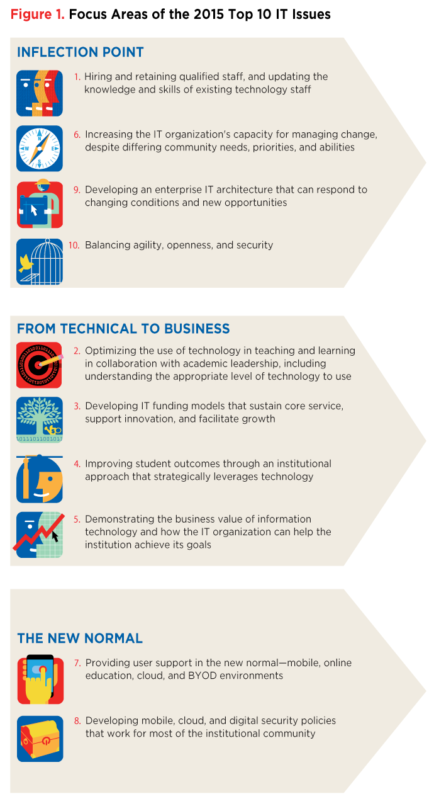
Why - Market
Pace of change in Higher Education business models
driven by economic and technological advances
fundamental economic principle of supply and demand
Create 3 Areas of Focus:
“inflection point” - trends that have dominated thought leadership & early adopters are now mainstream.
“technical problems to business problems” - the ensuing interdependence
"new normal”
“technical to business” - fundamental reason for the organizational change
Applications staff not organized in relation to the business, focus is perpetually diluted
Top 10 IT Issues, 2015: Inflection Point by Susan Grajek Published on Monday, January 12, 2015

Slide 3
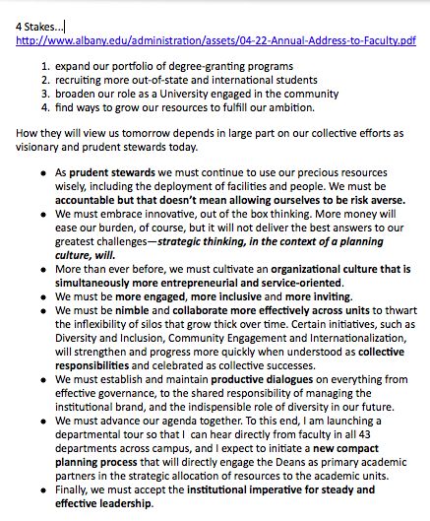
Why – UAlbany!
A University reaching for the world with 4 “stakes” ambitiously in the ground, requires an IT Applications unit that has people organized to be:
Engaging and Collaborative
Entrepreneurial and Service-Oriented
Disciplined and flexible
Compact and Accountable
Steady and Effective leaders of efficient and effective applications services
Annual Address to the Faculty by President Robert Jones Published on Tuesday, April 22, 2014

Slide 4
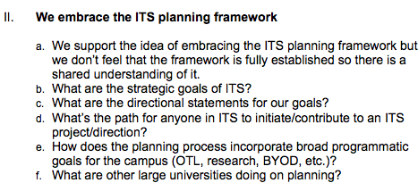
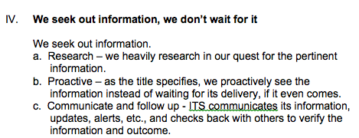
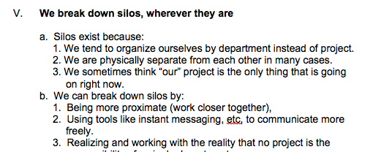
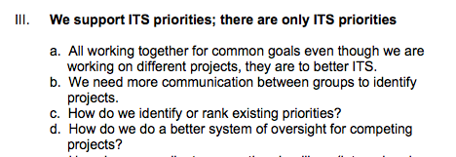
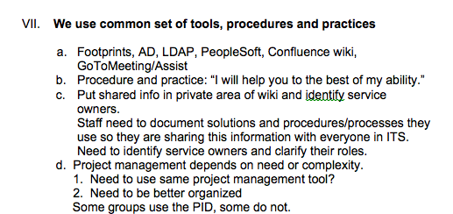
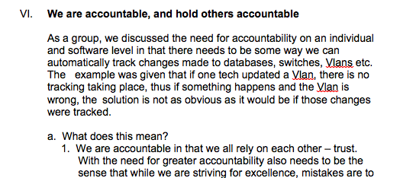
Project Overview – Your input!
Driven from the ITS feedback on the concept and 7 driving principles… Available on the Wiki for reference
https://wiki.albany.edu/display/OCIO/All+Staff+Meetings

Slide 5
Project Overview – Goals
Streamlined Goals
One ITS principles are time and technology transcendent
Ensured through the use of industry standard disciplines to ensure:
We communicate, often and honestly, across the University
There are only University priorities, and we work together to balance them
We seek out information and use it to break down silos, wherever they are
We hold ourselves and one another accountable
We use a common set of tools, procedures and practices
1
2
3
4
5

Slide 6
Project Overview – Objectives
Coverage
Implement standard administrative items that Symbolize One ITS
if we cannot do these, we cannot do anything else
Implement a Project & Portfolio Management process that is engaging, disciplined, and transparent
Informed by the Project Management Institute PM Body of Knowledge (PMBOK)
Implement Service Management process that is customer engaging, disciplined, and transparent
Informed by the Information Technology Infrastructure Library
Implement foundational Enterprise Architecture materials and processes that include the current and future states for road-mapping and budgeting optimization
Informed by enterprise architecture disciplines of business, information, and technical modeling
1
3
4
5
1
2
3
4
5
1
2
3
4
5
1
3
4
5

Slide 7
Project Overview – Scope Summary
4 Parallel Paths of Work – each one informing the other
Symbols *
Project and Portfolio Management *
Service Management
Enterprise Architecture
*Start first…
Notes:
----- Meeting Notes (10/9/14 12:10) -----
Not going to wait to start the other 2...

Slide 8
Project Overview – Scope Summary
In Scope
Each path will:
Define Current State process, people, and technology
Define Immediate fixes/implementations
Evaluate alternatives (peers, market)
Propose Desired State process, people, and technology
Implement short-term and plan long-term
Out of scope
Sweeping organizational and/or financial changes
Completed implementation – long-term implementation

Slide 9
Project Overview – CSFs and Risks
Critical Success Factors
Cabinet Buy-in to Oneness
Manager / Leader / Team Member Buy-in to Oneness
Enable:
Service Based and Campus Budgeting
IT Governance
University at Albany is what we are here for…
Will our service consumers engage in this willingly?
Would You?
High Level Risks
Customer reaction to process standardization
Facing the unknown together
Pinky Swear!
Communication
Stay Together

Slide 10
Change Acknowledgement
This will impact the way you work in a positive manner…
We all need to be positive change agents
Overt, Healthy Dialogue is the Way!!!
That starts now…

Slide 11
Project Overview – Assumptions
Assumptions
Overall FTE Count not increasing (positions to fill)
Budget not increasing
Technology and new service offerings available to be leveraged
ITS enthusiasm for U Albany will ensure positive change
Desire to do a good job!
Constraints
Staff engagement and schedule – think/work differently
General disbelief in ability to get this done!

Slide 12
Project Scope Concept – Path Overlay
BUSINESS VALUE & STRATEGIC PLANNNIG
BUSINESS VALUE & STRATEGIC PLANNNIG
Service Support
Project & Portfolio Management
CAPTURE
ALL
DEMAND
MANAGE STRATEGIC CHANGE
Departmental Strategic Plan
Service Delivery
Roadmap
DEPLOYMENT
ServiceDown?
ALIGN THE
PORTFOLIO
Yes
No
INITIATION
Communication
Training
KPI Reporting
Satisfaction Surveys
Work Portfolio
Proposed Projects
Active Projects
Operations
INCIDENT MGMT
SELECTION
Parallel Output
SR / Proj?
Project
PLANNING
Resource Portfolio
Availability
Allocation
Effort
Problem?
EXECUTION
SR
EFFORT REPORTING
Yes
PROBLEM MGMT
No
End
CHANGE & RELEASE MANAGEMENT
Service Catalogue
Change Roster & Configuration Management DB
Enterprise Architecture & Symbols

Slide 13
Legend
Shape | Description
 | Input accumulator
 | Decision step
 | Process output and input connector
 | Macro – process start and end
 | Process – a set of activities logically grouped
 | Information used as output or input to a process.

Slide 14
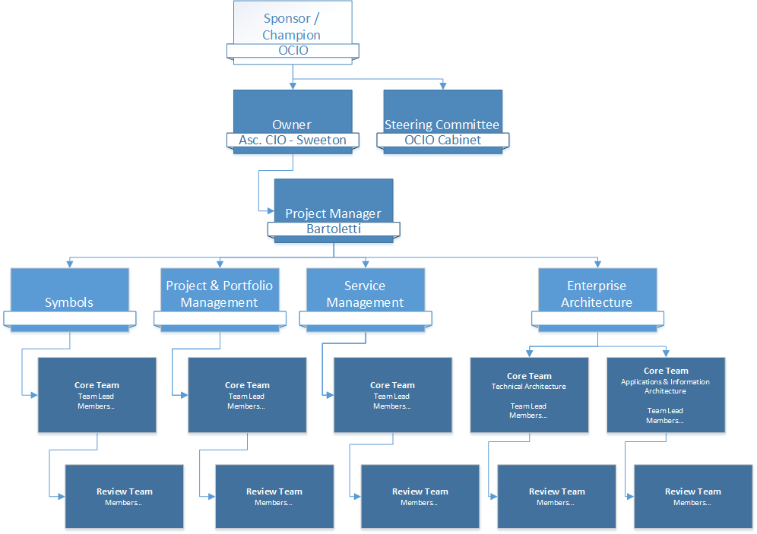
Project Organization
Approve
Manage
Propose
Cross Departmental Team
Consult

