Slide 1
Utilizing the Starfish Retention Tool to Maximize Student Success

Slide 2
The Problem
Face-to-face – 74.7% SUNY
Fall 2014 FLCC 81%
Online – SUNY 68.4% roughly 5% less than national average
Fall 2014 FLCC 60%

Slide 3
What to do?
Strategic Plan Proposals centered around retention
Aspiring nurses, educational outreach to high schools, writing improvement
Greater academic monitoring, communication, connection - Starfish

Slide 4
Starfish
Starfish Early Alert
Starfish Connect

Slide 5
Initial Set up
Role Creation
Where do we want to focus?
Who will be involved on the staff side?
How?

Slide 6
Integration
Blackboard
Colleague
Soon – Smarthinking, Outlook

Slide 7
Blackboard
B2 – automatic authentication with correct role by course: Faculty/Student
Module on home page – static
Course and organization enrollment pass to Starfish

Slide 8
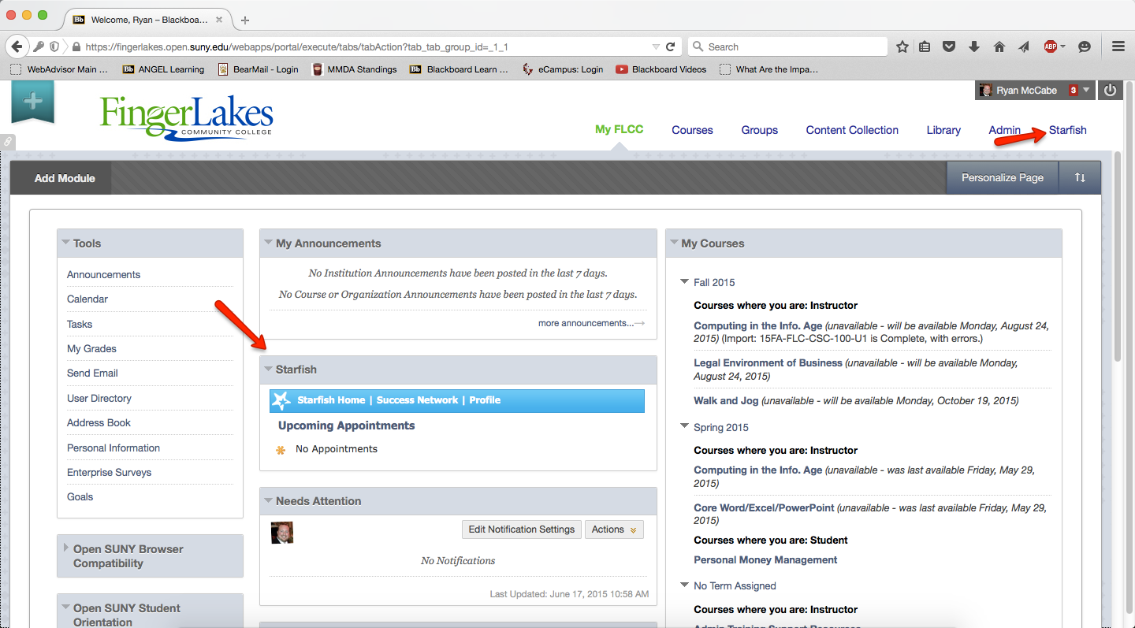
User View

Slide 9
Colleague
Starfish accepts data from both Blackboard and the SIS
Colleague manages course rosters in BB and soon organization rosters
Sends other student data to Starfish – non-immunization, athletes, tuition delinquency
Non-academic concerns – personal issues - radar

Slide 10
What it does
Each student can be monitored within each of his/her courses in the following areas: Academic Performance, Participation, and Attendance.
Faculty/Staff can “raise flags” on students outside of these, manually or in batches, for areas FLCC identifies as road blocks to success (e.g., financial issues, mental or physical health issues, academic support needs)
Allows for easy flow communication between college and student and provides student with one-click support services

Slide 11
How it works
Students see their own “Success Network” on their Blackboard page of faculty and providers.
As communication occurs between individuals and students, notes and other communication tools are used within the system to show a ‘full-picture’ to providers.
For example: if a student habitually schedules meetings but fails to show up, this is visible on Starfish.
Students are part of the communication link, reinforcing the message that this is their education.
Statistical summaries can be pulled for analysis.

Slide 12
Success Networks
Any faculty/staff can raise a flag on a student for help with a resource (e.g., tutoring), and the student and the resource are both notified.
If the “flag raiser” isn’t the course instructor – the instructor will also be notified (rare instance).
If the student is in a “special population,” the associated leader will also receive notification of the flag. (e.g. Project Success, Aspiring Nurses, etc.)
Only the provider or the specialized coach can “clear” a flag.
STUDENTS can raise “flags” on themselves!

Slide 13
Flags?
Writing Assistance
Science Assistance
Mathematics Assistance
Tutoring Assistance
Low participation in class
Attendance concerns
At risk of failing
Disability Services – student raised

Slide 14
Success Checks
Probation Students
Athletes
Aspiring Nurses
EOP
Double DST
Project Success
Other special populations

Slide 15
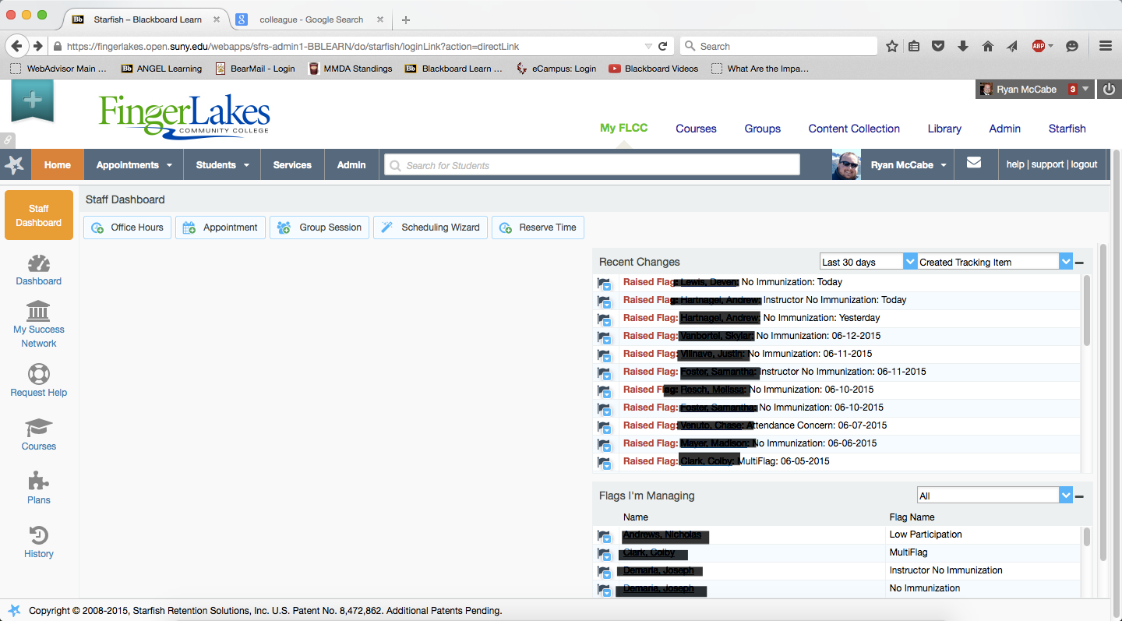
Staff Success View – Instructor, Coach, Provider

Slide 16
Student View

Slide 17
STUDENTS are still in charge of their own education.
Instructor | Advisors | Students | Coaches/Provers
Raise Flags when appropriate | Raise flags | Email notification | Receive email notifications from starfish
Submit success check | View flags that are raised | Contact Appropriate Support Provider | Record Follow up Action
 |  | Speak with instructor | Close loop with instructor

Slide 18
Where do we go from here?
Increase utilization and services
Appointment tracking – Connection with Outlook, Smarthinking
Greater use of Kiosk
Surveying all students – who will manage?
Pre-enrollment services – Hobsons
Success Check Management – schedule change
Kudos
Data, Data, Data

