Slide 1
Enhanced 911 next generation 911
Rick Coloccia
Network Manager
SUNY Geneseo

Slide 2
E911 Defined
links emergency callers with the appropriate public resources.
call is typically answered at the Public Safety Answering Point (PSAP) of the governmental agency that has jurisdiction over the caller's location

Slide 3
E911 Defined
PSTN – public switched telephone network
LEC – local exchange carrier
PSAP – public safety answering point
ANI – automatic number information
ALI – automatic location information
MSAG – master street address guide
GPS – global positioning system

Slide 4
E911 Defined
Two challenges:
Know where all the phones are
Relay 911 calls to the right PSAP!

Slide 5
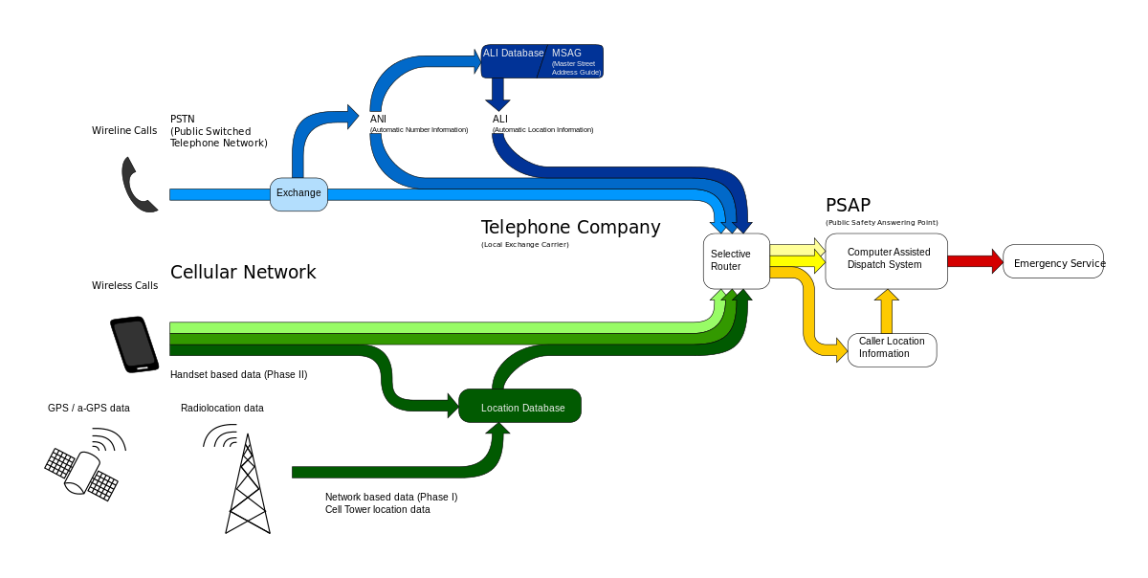
E911 Defined

Slide 6
How E911 Works - landlines
Remember before VoIP and Cell Phones? 911 was a manual and somewhat simple process back then.
When the LEC installed a phone at an address, someone behind the scenes manually updated a ALI database.
A user dialed 911, the PSAP referenced the ALI database, and emergency services were dispatched.

Slide 7
How E911 Works - cell phones
Now add cell phones to the mix…
An entirely new process was needed to manage moving clients. A separate database system was created, responsibility for this data falls on cellular carriers.

Slide 8
How E911 Works - cell phones
Cellular carriers update a database with tower location and phone location based on radio frequency triangulation or handset gps information.
Calls to 911 come into the PSAP. The caller location lookup process is redirected from the normal ALI database to entries in the cellular carrier databases using pointers.

Slide 9
How E911 Works - campus pbx
For many of us with a traditional voice system using a PBX, we have worked out manual processes with our carriers where we inform them, one way or another, when we do a move, add, change, or delete.
I, C, D in 911 lingo. Simple, manual, possibly burdensome at various times of year.

Slide 10
How E911 Works - VoIP
VoIP brings many good things to the party:
Reduced infrastructure costs
Simpler moves, adds, and changes
Easier systems to support
Features are available much more quickly
Amazing flexibility
Flexibility brings challenges to 911!

Slide 11
How E911 Works - VoIP
How do you know where a VoIP phone is?
How do you know where a computer is?
What if someone moves that computer? Do you know?
How do you know where a wifi handset is?
Do you have a policy about who can move devices?

Slide 12
How E911 Works - VoIP
Most VoIP E911 reporting systems require:
Precise correlation between switch ports and the room at the end of the data cable patched into each jack.
Most VoIP E911 automate the first part of the process by:
Polling network switches for connected devices
Polling VoIP servers for connected devices
“Gluing” these devices together in a local database

Slide 13
How E911 Works - VoIP
Now that you have a system on your campus that knows where all your phones are, there is a new challenge: Updating the ALI database.
Establish a relationship with your LEC. Some will ask you to send them a file in a specific format. Others will sell you an account to enter data directly in their database.
Third-party hardware and software can be purchased to automate this update process.

Slide 14
How E911 Works - VoIP
What if you have multiple campuses?
Option 1: Duplicate this system once per campus. Expensive. Requires duplications of servers, multiple PS-ALI accounts, etc. $$$
Option 2: Purchase a service to intercept your outbound 911 calls and reroute them to the right PSAP. This service would also host your location information database and send the correct location information to the PSAP. $$$

Slide 15
How E911 Works - VoIP
What if you have WiFi handsets/softphones?
Develop a naming protocol for these devices.
Educate users regarding the unreliable nature of placing 911 calls with these devices.
Consider purchase of a third-party system which can discern location of wireless devices using WiFi management tools and then relay this location information into your local location database.
Location information is then uploaded to LEC as usual.

Slide 16
How E911 Works - misc.
A relationship with your LEC is necessary.
You will do testing with the PSAP.
Addresses will be verified against the MSAG.
There is a “workaround” to avoid regularly updating the ANI database, but it costs money: Purchase a second set of phone numbers assign locations to those numbers, and do translation as the calls enter and leave your phone network. Third-party tools needed.

Slide 17
How E911 Works - misc.
Some solutions assign the same external number of a set of phones all in the same geographical area (hall, wing, floor, etc.)
Most VoIP phone systems don’t handle 911 reporting natively, so there are many third-party tools to explore.

Slide 18
Next Generation 911
NG911 is coming!
Allows text, video, and images to go to PSAP
National Emergency Number Association (NENA) first identified the need for NG9-1-1 in 2000
A Proof of Concept project was executed by the DOT in 2008
Standards are not yet fully defined!

Slide 19
Next Generation 911
Implementation expected to take several years
Will require changes to existing communications infrastructure
Will require changes to the way PSAPs operate

Slide 20
Next Generation 911
Involves creation of an Emergency Services IP Network (ESInet) to deliver voice, video, text and data "calls" to the PSAP
Expected to be either SIP based or use a protocol called IP Multimedia Systems, which is SIP based.

Slide 21
Next Generation 911
Includes some reverse 911 concepts where the system can send notifications encouraging people to avoid disaster areas based on handset locations
Includes greatly improved functionality for the deaf, hard-of-hearing, and speech impaired
Hundreds of pages of details at 911.gov

Slide 22
Next Generation 911
Almost every current stakeholder in the 911 conversation will have work to do to migrate to NG911:
ISPs
Voice providers
Alerting services
911 call centers
Local and state governments
Phone system providers
…and so on!

Slide 23
Q & A?
Thanks for coming, have fun tonight!
Rick Coloccia
coloccia@geneseo.edu

