Slide 1
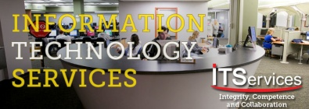
Keeping the plates spinning: developing and implementing IT project planning cycles. Three steely-eyed SUNY CIOs and assistants discuss their experiences while one CIO tries to coordinate the show.
Holly Heller-Ross, CIO and Panel Moderator.
John Bradley, Asst CIO
John Kaftan, Dean of Information Technology
Karlis Kaugars, CIO

Slide 2
Keeping the plates spinning: developing and implementing IT project planning cycles
What makes IT a strategic enabler in the academic enterprise, and how can the CIO keep just enough plates spinning at one time to make that happen?
In one word…
Planning
Notes:
Why, how, and when did your institution get started with an IT project planning cycle (big picture example..it was 1998, we were overloaded, we went way over budget on a key project…got VP buy-in and implemented over the next 2 years)?
What are the specifics of your process (big picture specifics…like it’s an annual cycle, starts with a project request, goes through a campus-wide It governance committee, etc)?
What have been the major pains and gains since your implementation?
What are your plans for the future with your IT project planning cycle ?

Slide 3
Keeping the plates spinning: developing and implementing IT project planning cycles
Planning is the essential ingredient for sustained success;
Planning is the first action in Peter Duckers' sequence: Plan, Do, Check, Act;
Planning keeps us more focused on the important, rather than the urgent;
The absence of planning can be Chaos!

Slide 4
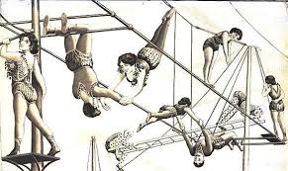
Keeping the plates spinning: developing and implementing IT project planning cycles
http://vintageprintable.swivelchairmedia.com/entertainment/entertainment-circus-shows/
Notes:
There are as many different ways to plan, as there are different ways to think. This session introduces you to IT project planning cycles in various stages of implementation.
After the panelists speak, we’d like to have a conversation with you about what you heard, and what you might be doing at your campus.

Slide 5
Keeping the plates spinning: developing and implementing IT project planning cycles
First Act: John Bradley, SUNY Plattsburgh

Slide 6
Keeping the plates spinning: developing and implementing IT project planning cycles
Why?
Overwhelming, undocumented, and unchecked demand
Incomplete alignment of resource with campus business goals
Insufficient coordination and communication
On our first attempt to create a dashboard, we had well over 150 projects identified …
…yet a self-reported capacity study showed that staff perceived they spent only about 7% of their time on project work

Slide 7
Keeping the plates spinning: developing and implementing IT project planning cycles
What are the specifics of your process?
Quarterly cycle designed to allow opportunities for prioritization by VPs/Exec Cabinet
Standard and Accelerated Request/Initiation Process
Proof of Concept Tools
User-facing Origination form
Origination review dashboard
Project Dashboard
All in Google Apps

Slide 8
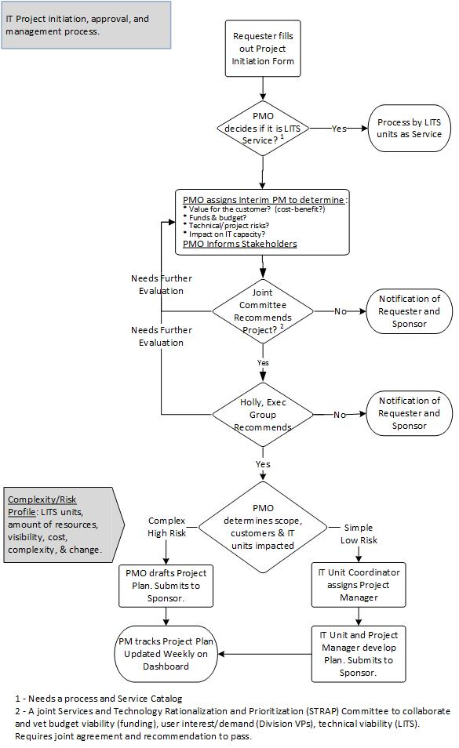

Slide 9
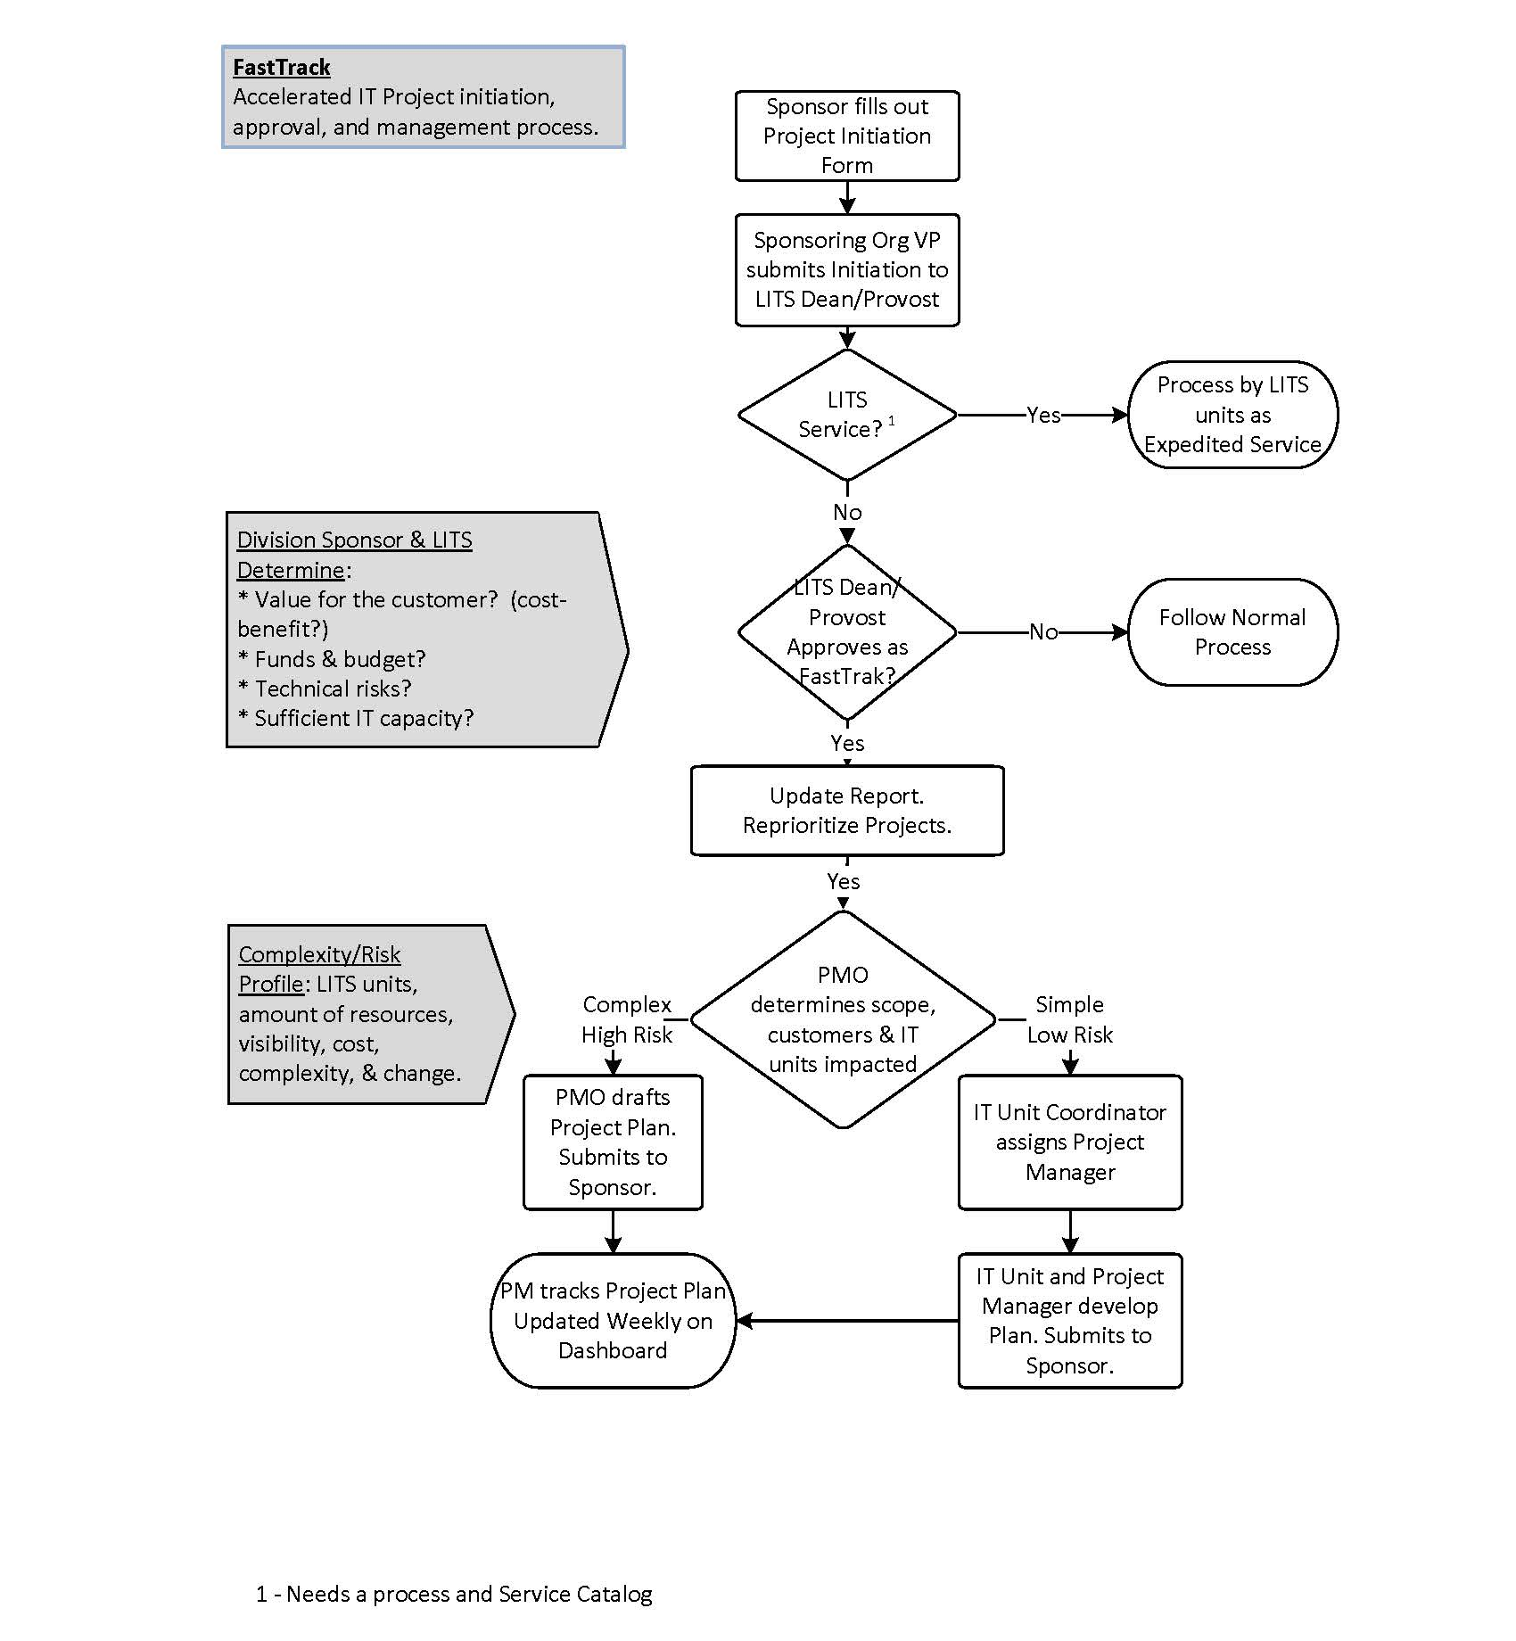
Keeping the plates spinning: developing and implementing IT project planning cycles

Slide 10
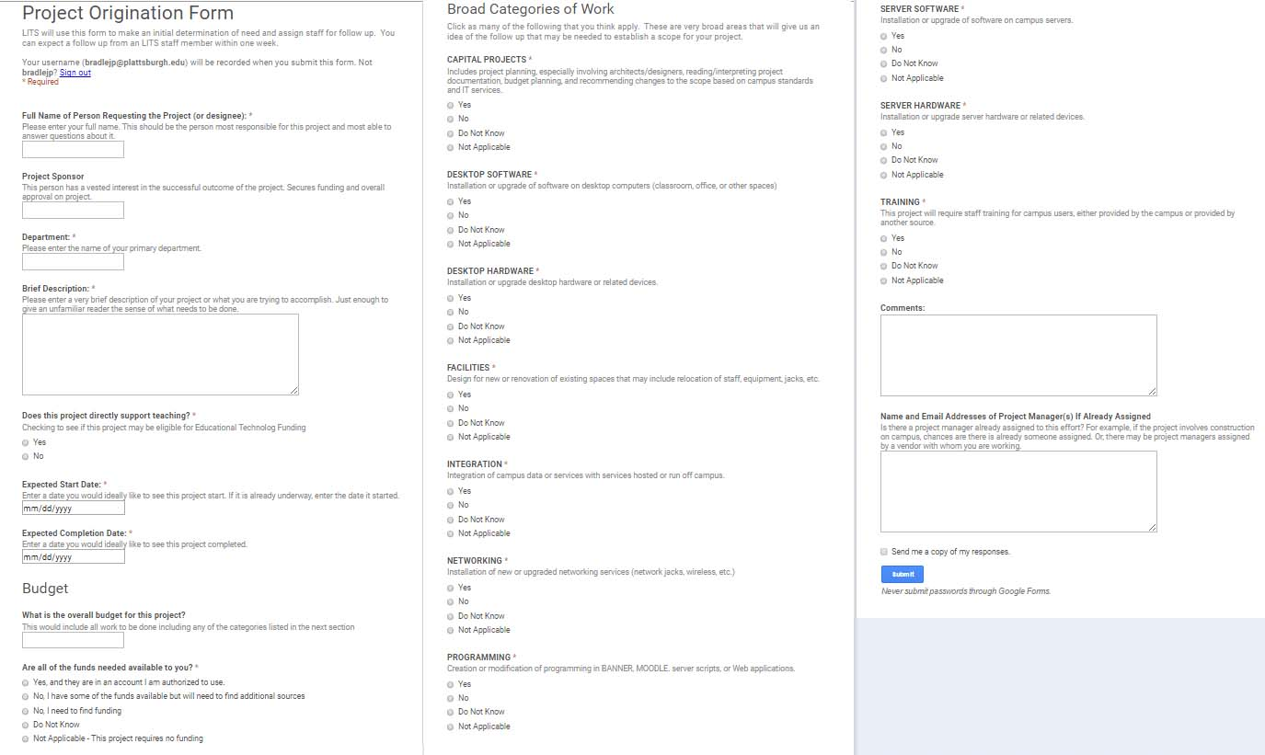
Keeping the plates spinning: developing and implementing IT project planning cycles

Slide 11
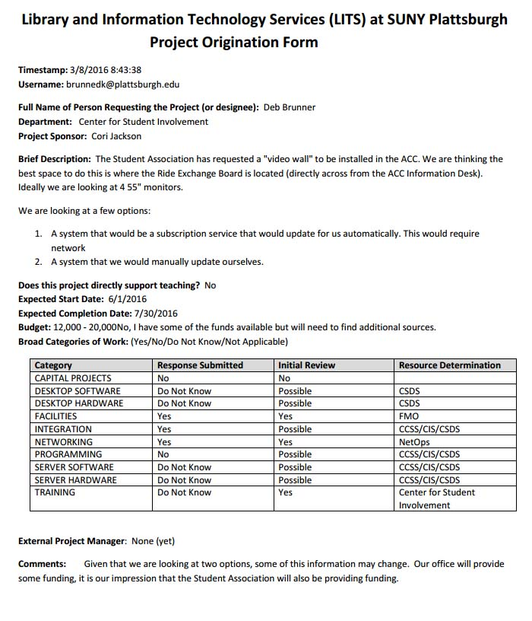
Keeping the plates spinning: developing and implementing IT project planning cycles

Slide 12
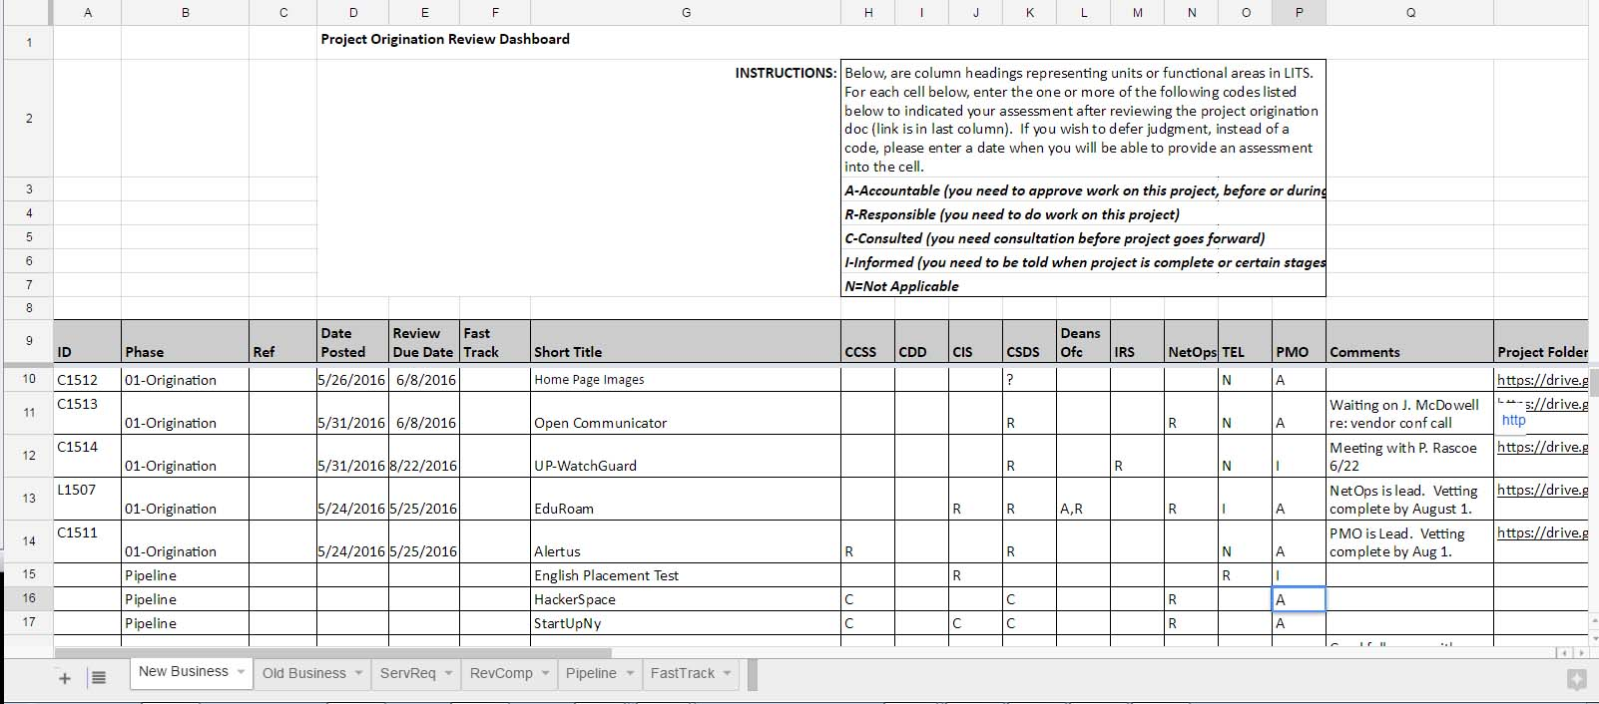
Keeping the plates spinning: developing and implementing IT project planning cycles

Slide 13
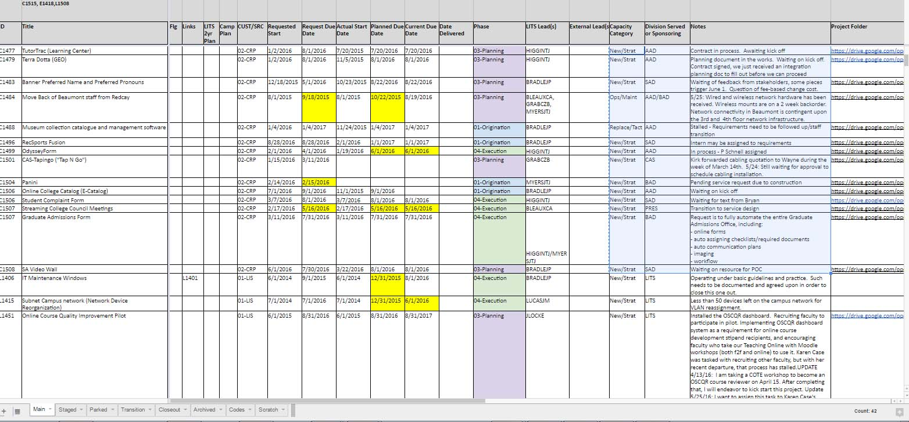
Keeping the plates spinning: developing and implementing IT project planning cycles

Slide 14
Keeping the plates spinning: developing and implementing IT project planning cycles
Pains/Challenges/Lessons Learned
Organizational culture
It is not how IT has done things
It is not how decisions are made
Nothing to connect to campus wide
Organizational change
Better understanding of our processes and better methods for tracking and assessing performance
Capabilities vs competencies
Capacity
It is our process not our people

Slide 15
Keeping the plates spinning: developing and implementing IT project planning cycles
Need a strong and common understanding of project classification
Requests acting like projects
Projects acting like requests
Cherry picking and dumping
Requirements gathering and tracking need to be consistently or competently practiced
Prioritizing the delivery of outcomes may be hurting our process/practice
Implementing before we have a full understanding of scope

Slide 16
Keeping the plates spinning: developing and implementing IT project planning cycles
Capacity tracking and forecasting, along with alignment and clear understanding of value are critical
A lot is getting done and people are working hard
Status quo is fine only if all projects and requests are of equal value
Managing flow and prioritization of operational work along with projects
“The cobbler’s kids have no shoes”

Slide 17
Keeping the plates spinning: developing and implementing IT project planning cycles
Authority/Governance
Need to define and clarify authority over resources and implementation decisions
Need to review how we assess competency with regard to resource and implementation decisions
Akin to “informed consent” - need to be sure decisions makers have all information they need to render the decisions placed before them
Better understanding of firmness of support for a project or direction

Slide 18
Keeping the plates spinning: developing and implementing IT project planning cycles
Gains
Visibility
Accountability/Alignment
Communication and coordination
Less than 50 projects currently being tracked…
All are improvements but not necessarily at the maturity level we need

Slide 19
Keeping the plates spinning: developing and implementing IT project planning cycles
Future Plans
Assessments based on cost, schedule, scope, and quality.
Automate more
Adding a vetting cycle to the project origination stage
Regular practice to invite project requestors to bi-weekly PM meetings as part of the vetting/origination activities
Adding an initial estimated time scoping attribute to project dashboard
Under consideration but not yet agreed upon:
Formal assignment of hours of staff to certain projects (per week, month, etc.)
Unit-based segmenting/blocking of time for project work and meetings.

Slide 20
Keeping the plates spinning: developing and implementing IT project planning cycles
Second act: John Kaftan, Cayuga Community College!

Slide 21
Cayuga Community College
Problem
Project Failure (Luminis, ODW,)
Traction Issues (Projects vs Operations)
Lack of Accountability
Lack of clarity regarding priorities
Solution
Project Management Process
Ticketing
Annual IT Planning Process

Slide 22
Keeping the plates spinning: developing and implementing IT project planning cycles

Slide 23
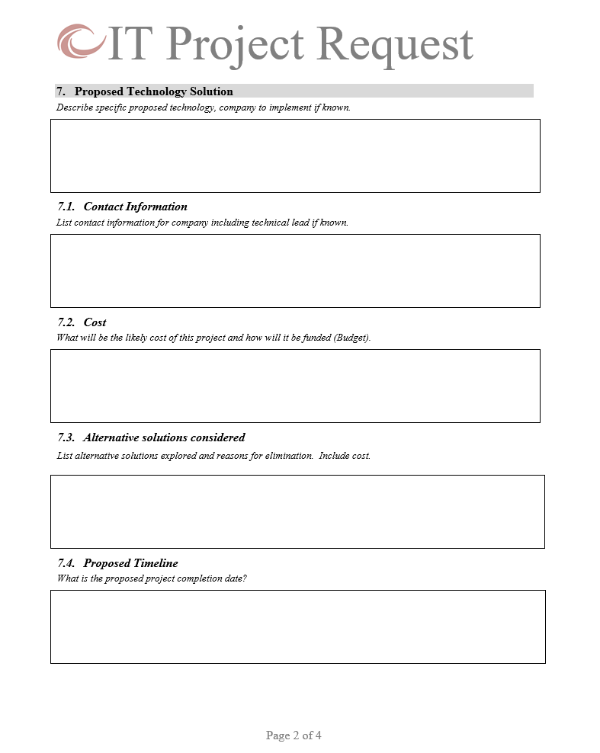
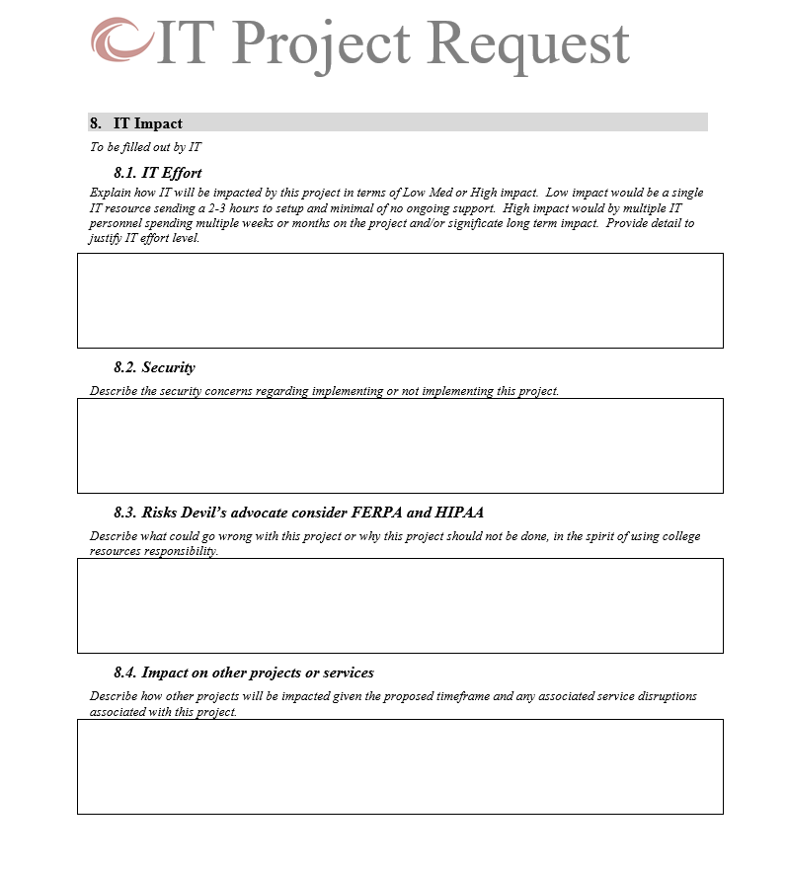
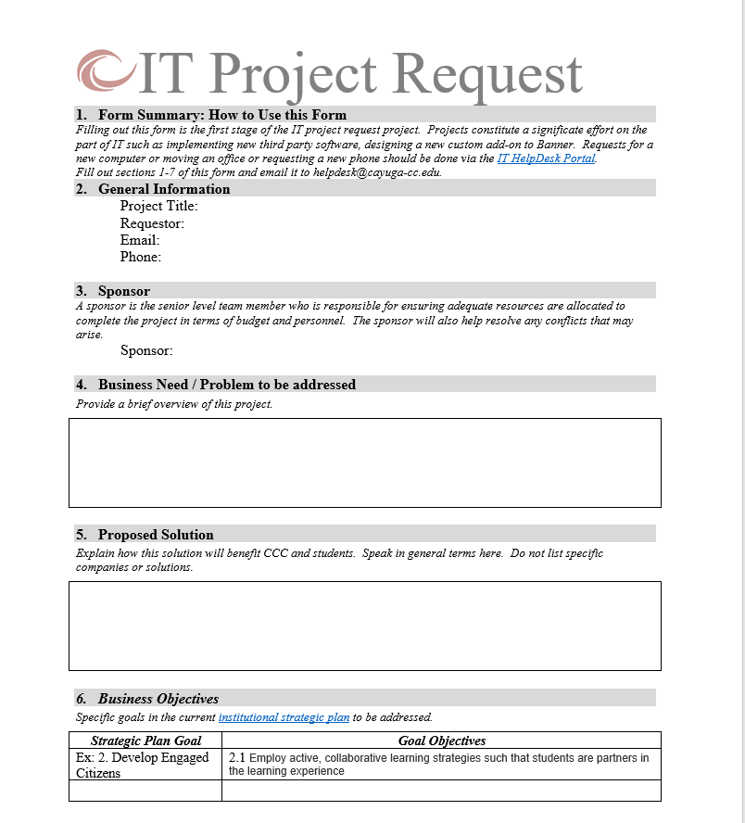
Keeping the plates spinning: developing and implementing IT project planning cycles

Slide 24
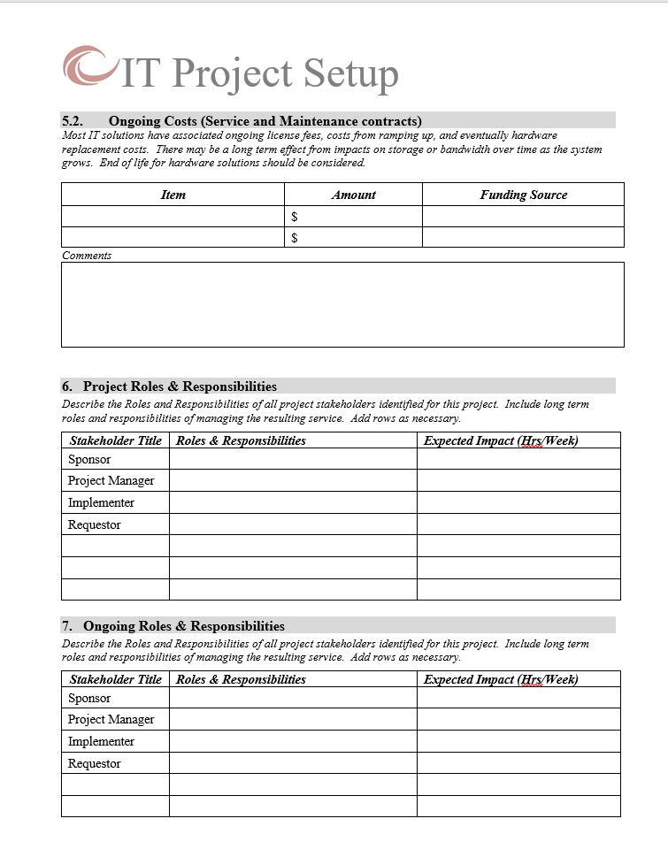
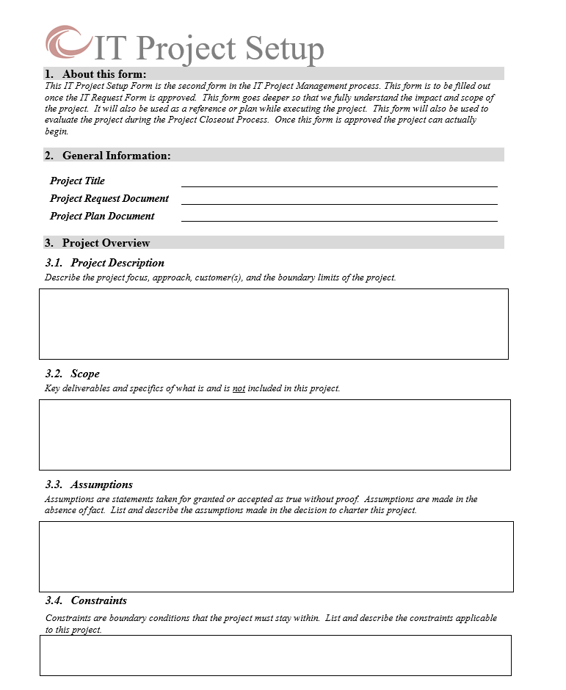
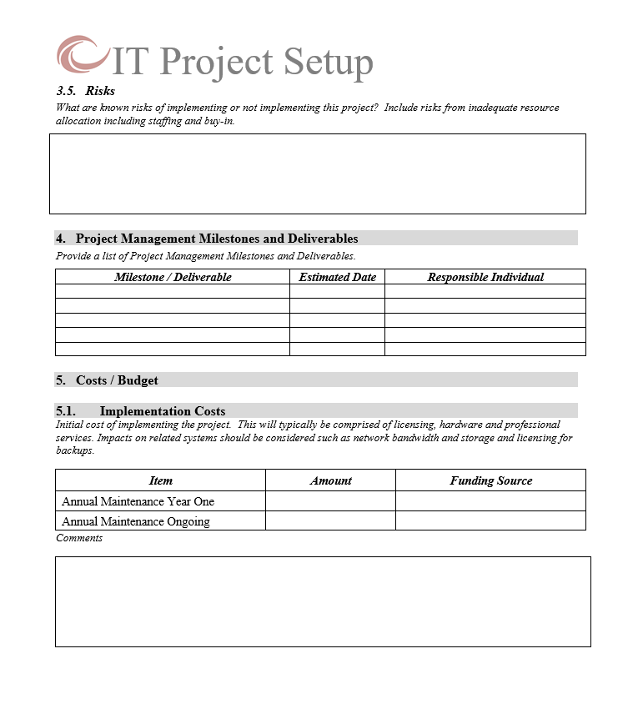
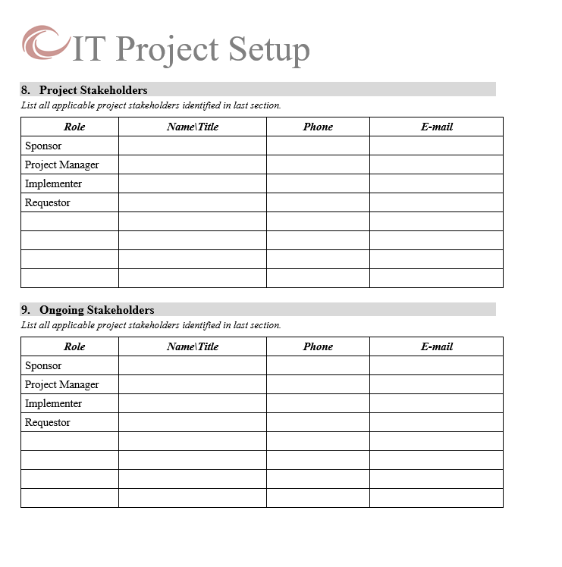
Keeping the plates spinning: developing and implementing IT project planning cycles

Slide 25
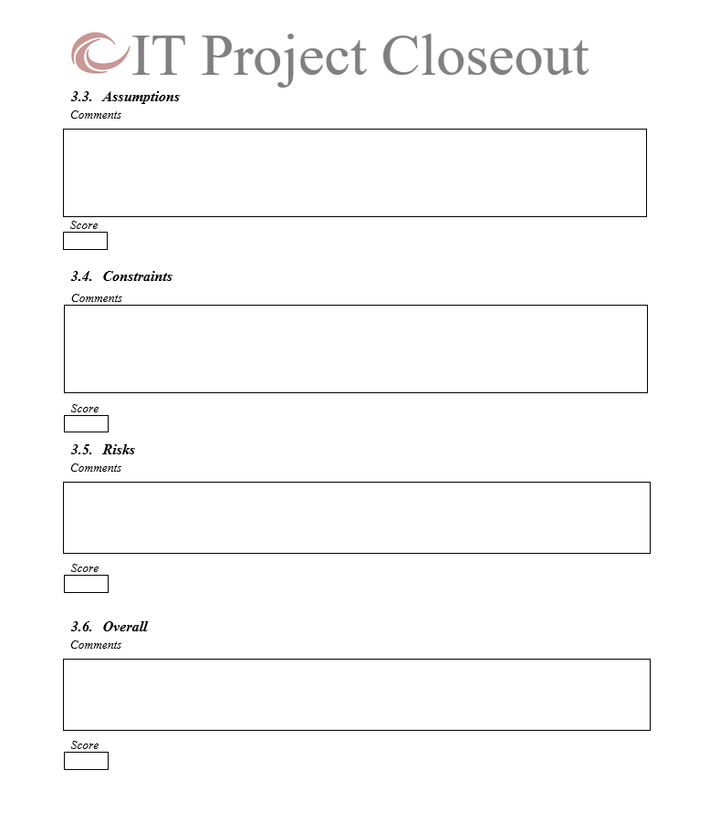
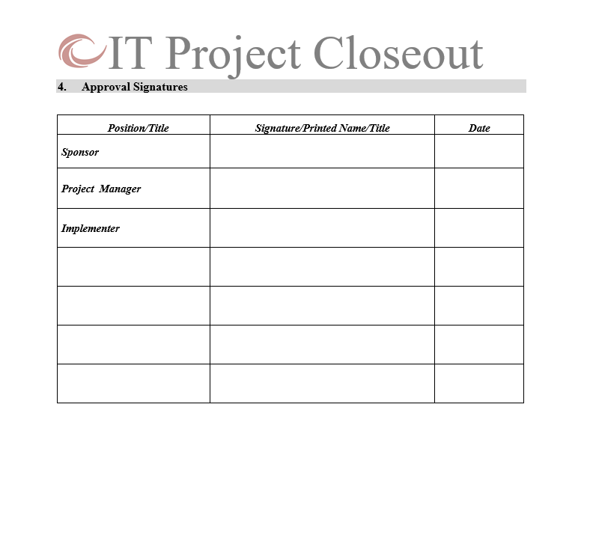
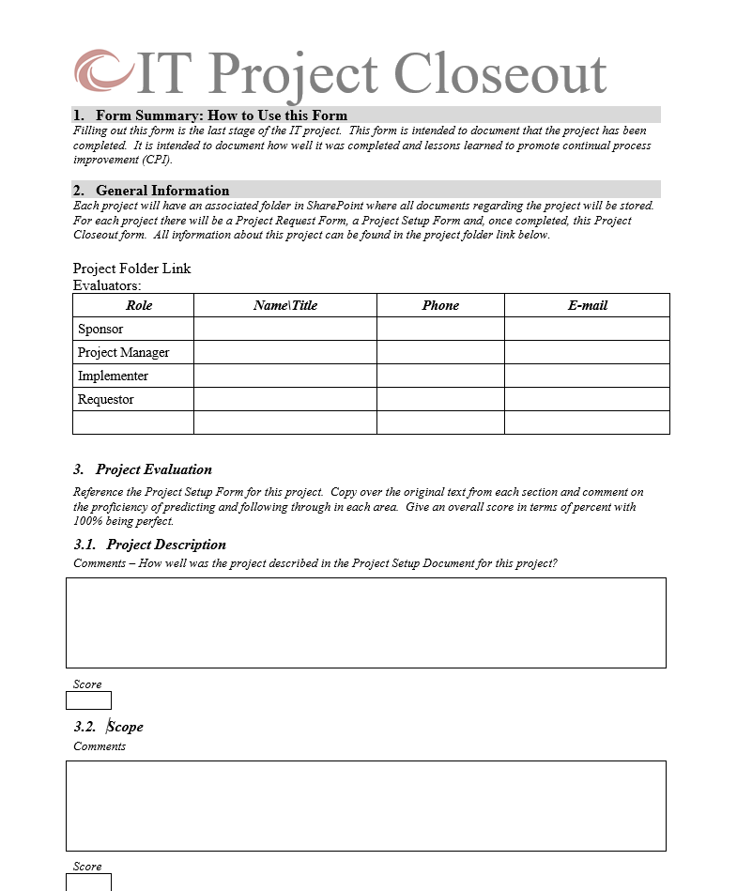
Keeping the plates spinning: developing and implementing IT project planning cycles

Slide 26
Keeping the plates spinning: developing and implementing IT project planning cycles
Ticketing
Community Buy-in
IT Buy-in
Metrics \ Reporting

Slide 27
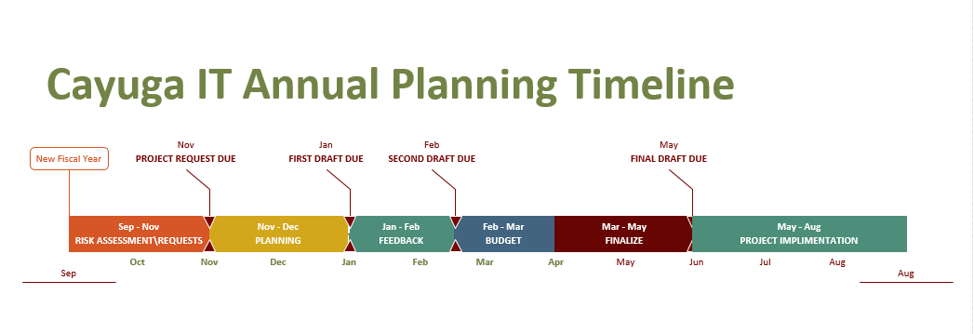
Keeping the plates spinning: developing and implementing IT project planning cycles

Slide 28
Keeping the plates spinning: developing and implementing IT project planning cycles

Slide 29
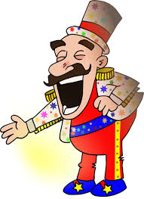
Keeping the plates spinning: developing and implementing IT project planning cycles
For our next and final act: Karlis Kaugers, SUNY Oneonta!

Slide 30
SUNY Oneonta History
Starting point – pre 2011
Series of forms – intake, analysis, execution, closing
Lots of information, but few differentiators
Rating by IT resulted in roughly equivalent priority for all
V 1.0 – roughly 2014
Coalesced form with more focused questions
What's in it for your department?
What's in it for the College?
Low buy-in, still too much form filling, but a step forward

Slide 31
SUNY Oneonta Current
One-page document:
What is it?
Institutional Benefit
Individual Benefit
Institutional Distinctiveness
Document rated by:
IT Directors
Administrative governance
Educational governance
Average ratings
Combine using:
3 * Institutional
2 * Individual
1 * Distinct

Slide 32
SUNY Oneonta Current
Experimental validation through Cabinet early 2016
Benefits
IT project alignment with institution
Very brief form
Governance – involved
Dynamic list allowing agile changes

Slide 33
SUNY Oneonta Future
Process, Publish, Communicate
Improve processing time for proposals
Public list of all projects, ratings and priorities
Automatic notices of progress, reshuffling, delays
Assess and improve process in 2017-2018

Slide 34
SUNY Oneonta Thoughts .. Semi-random
Embracing Eisenhower:
“Plans are useless,”
Priorities shift
You don’t know how long it will take until you do it
The network just went down, server failed, etc..
“ but planning is invaluable”
Working on the right project
For the right people
At the right time

Slide 35
Keeping the plates spinning: developing and implementing IT project planning cycles
Ladies and Gentlemen, Thanks for your attention. You may now remove your 3-D glasses.
And, on to the interactive part of the show!
Questions? Comments? Queries?
Peanuts, Popcorn, Crackerjack?

