Slide 1
Do you REALIZE your situation?
VMware vRealize Cloud Suite
Maria C. Garrity; MS Ed, MCP and ITIL Certified
Individual Development Award (IDA) Recipient
Sr. Systems Programmer
SUNY Buffalo State
VMware vRealize Cloud Suite
Notes:
Good morning and welcome SUNY colleagues.
Individual Development Award - The award committee selects individuals whose ideas will benefit SUNY. I am grateful to have been chosen among many qualified candidates to be presenting the vRealize technology today.

Slide 2
Have you attended VMworld?
Yes
No
Never heard of VMworld before today.
VMware vRealize Cloud Suite

Slide 3
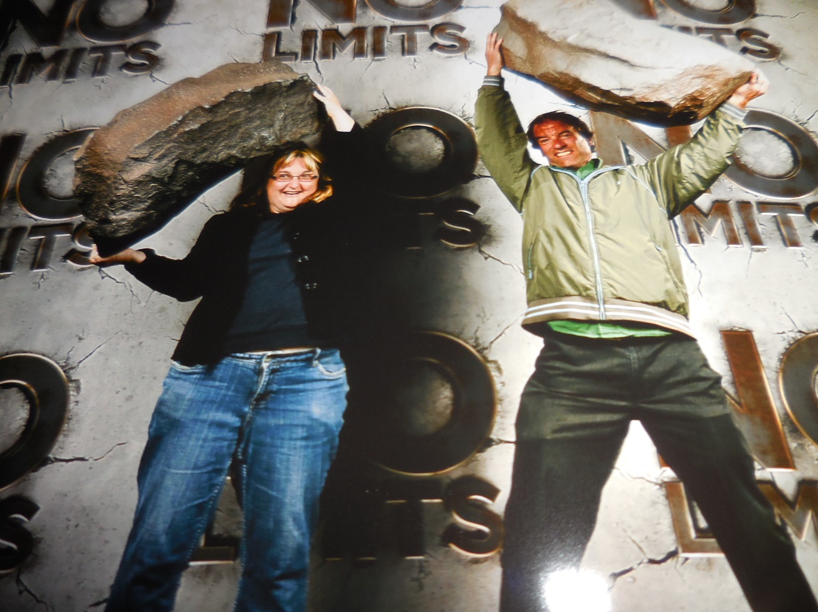
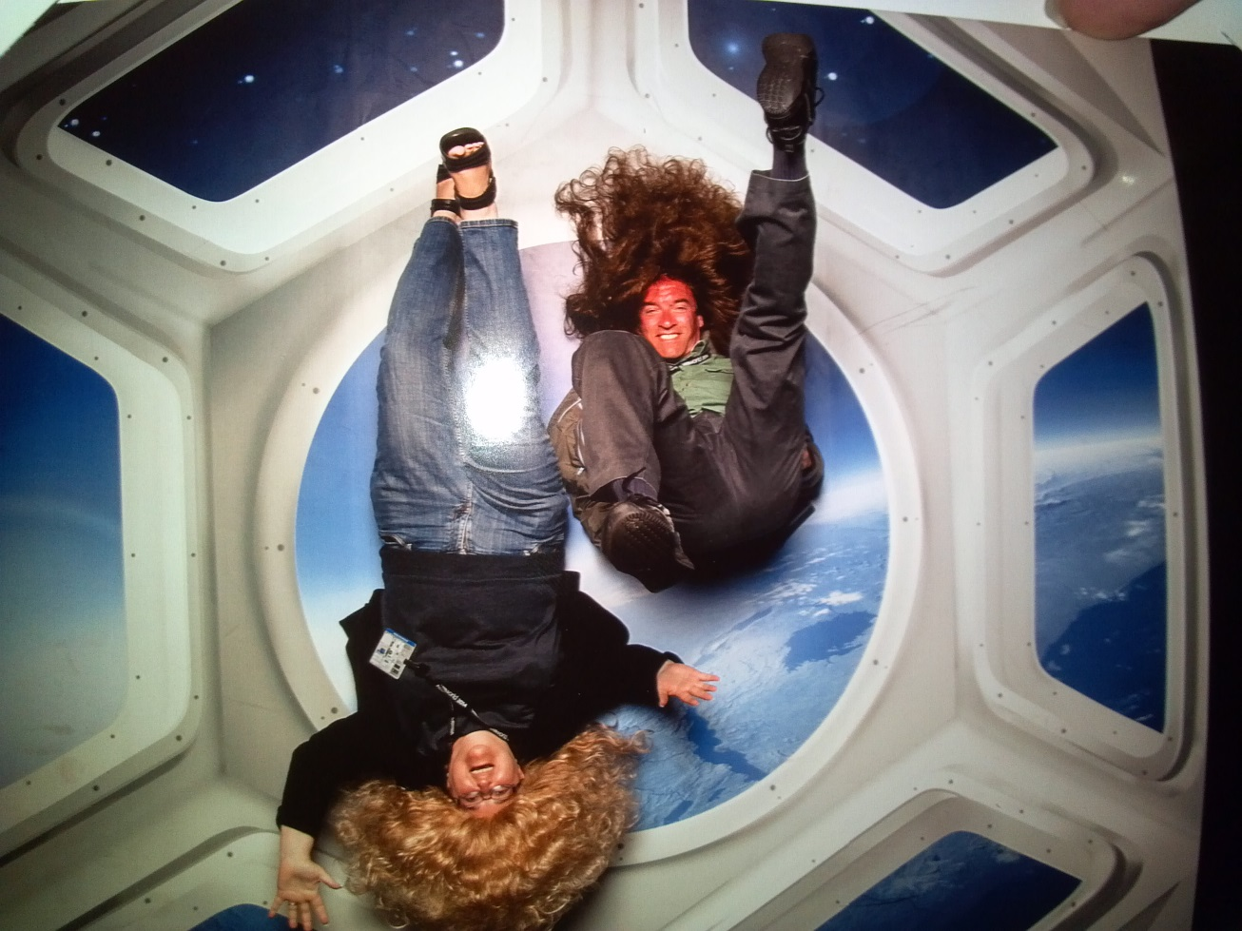
VMWorld 2014 and 2015
Theme: No limits - 2014
Theme: Ready for Any - 2015
VMware vRealize Cloud Suite
Notes:
VMworld each year comes up with these eye catching phrases like “no limits” on what their VMware technology can do or “ready for any” like ready for any IT disaster by implementing a recovery plan.

Slide 4
What version ESXi hypervisor are you currently running?
ESXi 6.0
ESXi 5.5
ESXi 5.1
ESXi 5.0
Less than ESXi 5.0
Mixed environment
Other
Don’t Know

Slide 5
Have you used or are you familiar with vRealize Operations Manager? (vROPs)?
Yes
No
What is vRealize?

Slide 6
Contact information and Online Survey
Questions/ Comments: hejnamc@buffalostate.edu
Help me improve, please fill out the short survey: https://goo.gl/9B1Vq2
VMware vRealize Cloud Suite
Notes:
Contact information and on-line survey. Survey is case sensitive.

Slide 7
VMware vRealize Cloud Suite
vRealize Automation
vRealize Business for the Cloud
vRealize Log Insight
vRealize Operations Manager (vROPs)
https://www.youtube.com/watch?v=eqSvPmuY9aU
Notes:
vRealize Suite is comprised of 4 components but you can use each one independently. Automation, Business for the Cloud, Log Insight and Operations Manager. vRealize Operations (vROps) is the key tool for any VMware administrator to manage their virtual infrastructure. It is the foundation of the entire suite but the entire package unifies each software component.

Slide 8
What is vRealize Automation?
Helps you be in control of your apps, desktops or any IT functions
Servers can be easily managed
One solution for both DevOps and production environments.
Hurray! Development and production in sync.
You can receive more information at https://www.vmware.com/products/vrealize-automation/
Notes:
Helps you be in control of your apps, desktops or any IT functions
Servers can be easily managed
One solution for both DevOps and production environments
DevOps is the high-level collaboration between development teams and operations teams.
Hurray! development and production in sync.
It streamlines your environment so that development and production stays in sync. How many times do you say “it worked on the development server but not on prod” vRealize Automation eliminates that from happening by the synchronization process.

Slide 9
What is IT Agility?
vRealize Automation improves IT Agility.
VMware vRealize Cloud Suite
Notes:
vRealize automation improves IT agility. But what is Agility? Agility is a term that is used to measure how fast IT will respond to changes.

Slide 10
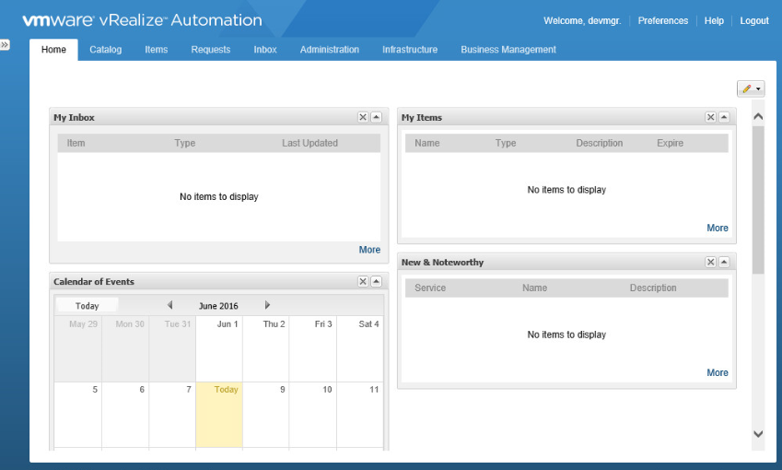
Calendar, Inbox, News all on one dashboard
VMware vRealize Cloud Suite
Notes:
Calendar, Inbox, News all on one customizable dashboard.

Slide 11
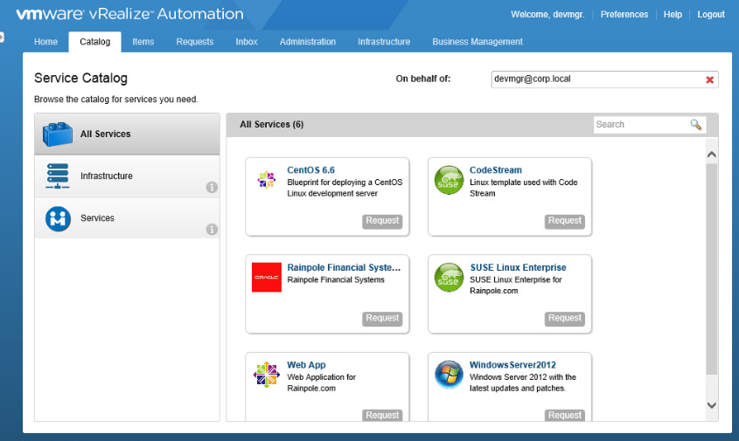
Catalog of Services and Software to deploy
VMware vRealize Cloud Suite
Notes:
Under the catalog tab you can display the services you provide and deploy

Slide 12
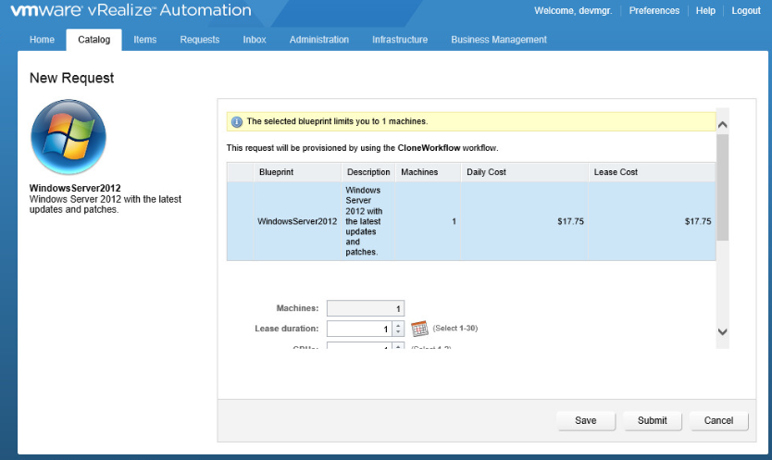
Provides the blueprint, description and cost
VMware vRealize Cloud Suite
Notes:
It further shows the blueprint, description and cost of the deployment of the w2012 OS.

Slide 13
What is vRealize Business for the Cloud?
It automates cloud costing, delivering the insight you need to efficiently manage cloud environments
You can track your cloud costs from a single pane of glass.
You can track cloud consumption
Notes:
There are 3 type of clouds; private, public and hybrid. A private cloud is dedicated to a single organization.(like ITEC), a public cloud has resources, such as applications and storage, available to the general public over the Internet. Hybrid cloud is a cloud computing environment which uses a mix of on-premises, private cloud and third-party, public cloud services with orchestration between the two platforms.
vRealize for the Cloud automates cloud costing and consumption analysis to deliver the insight you need to efficiently deploy and manage cloud environments (click)
You can track your private cloud and your public cloud costs from a single pane of glass. (click)
You can track cloud consumption by quickly identifying which applications or services are consuming cloud resources. (click)

Slide 14
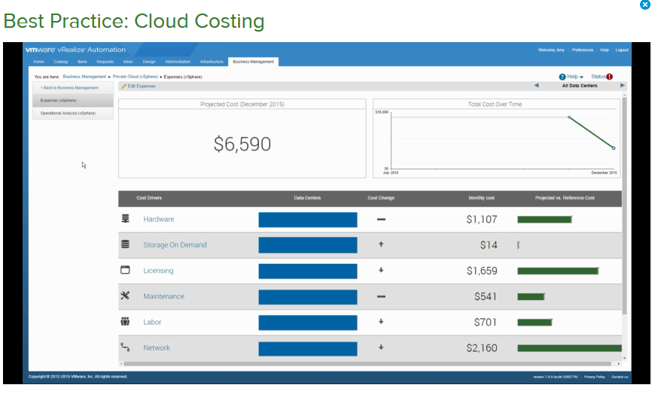
What is Cloud Costing? It’s a database management breakdown of all cloud hosting services
You can receive more information at http://www.vmware.com/products/vrealize-business-for-cloud/
VMware vRealize Cloud Suite
Notes:
Cloud costing provides hardware cost, storage, licensing, labor and network analysis all in one simple report provided from an information database.

Slide 15
What is vRealize Log Insight?
Real time log management and analysis.
Delivers highly scalable log management
Scalable log analytics and log management
Notes:
Log Insight – log management tool

Slide 16
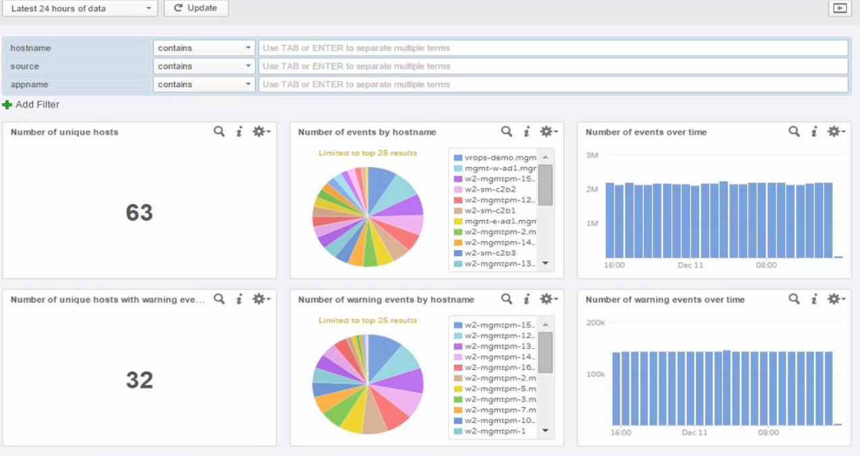
Dashboard of Log Insight. Powerful real time log management in a graphical view
VMware vRealize Cloud Suite
Notes:
One holistic dashboard view, displaying meaningful data
# of hosts, # of events by hostname and over time

Slide 17
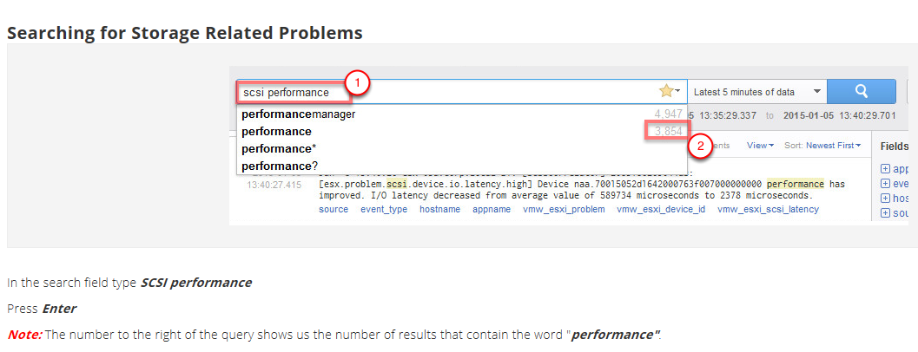
Search for key words like SCSI performance
VMware vRealize Cloud Suite
Notes:
Searches by key words. This example search on SCSI disk performance

Slide 18
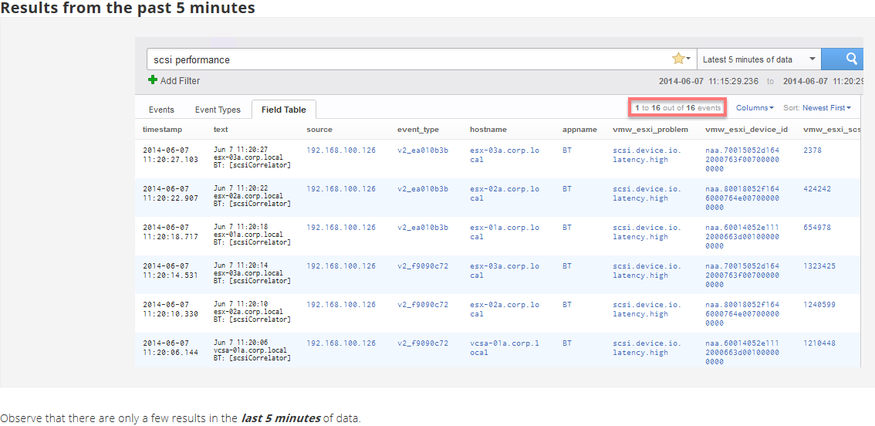
Results over past 5 minutes
You can receive more information at http://www.vmware.com/products/vrealize-log-insight/
VMware vRealize Cloud Suite
Notes:
This shows the results over 5 minutes and you can set that to 24 hour period. Its customizable.
You can see it shows disk latency.

Slide 19
What is vRealize Operations Manager?
Provides health, performance, and capacity management with predictive analytics.
Provides unified IT management to gain comprehensive visibility in one place and across applications, storage, and network devices
Increases efficiency by streamlining key IT processes with out-of-the-box and customizable policies
You can receive more information at http://www.vmware.com/products/vrealize-operations/
Notes:
What is vRealize Operations Manager – Basically it is used to know the health of your environment. But it does a lot more than that. It flags anomalies and helps eliminate finger pointing.
It is capable of being integrated with many packages like EMC’s Avamar backup and recovery software.

Slide 20
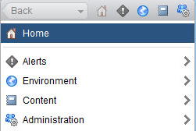
Lets get started by accessing the vROPS dashboard
The operations console provides you with all capabilities that you need to monitor the cloud environment, troubleshoot issues, customize content, and administer vRealize Operations Manager.
Users can access one or more of the following sections, or pages:
• Home: Provides a unified view of cloud operations
• Alerts: Provides a list of current and building issues
• Environment: Provides access to the inventory of objects,
• Content: Provides access to all content that is produced by VMware or third-party vendors.
• Administration: Provides the vehicle for vRealize Operations Manager administrative tasks
VMware vRealize Cloud Suite
Notes:
•Alerts: Provides a list of current and building issues with recommendations and remedial actions
•Environment: Provides access to the inventory of objects, such as applications, virtual machines, storage, networking, resource pools, hosts, and clusters
•Content: Content includes dashboards, views, reports, alert definitions, symptom definitions, and super metrics, and so on.
•Administration: Provides the vehicle for administrative tasks, such as product setup, installation of solutions, licensing, and user access configuration.“

Slide 21
3 Badges; Health, Risk, and Efficiency
vRealize Operations Manager gives you operational insights into the health, risk, and efficiency for the infrastructure and applications. With this knowledge, you can help ensure a certain level of service. You can also detect, earlier rather than later, immediate performance issues, potential resource capacity issues, and opportunities to optimize resource use.
VMware vRealize Cloud Suite
Notes:
3 badges Health, Risk, Efficiency

Slide 22
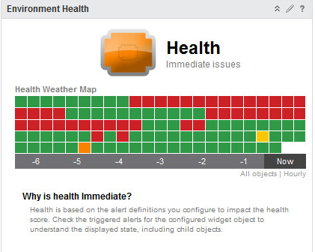
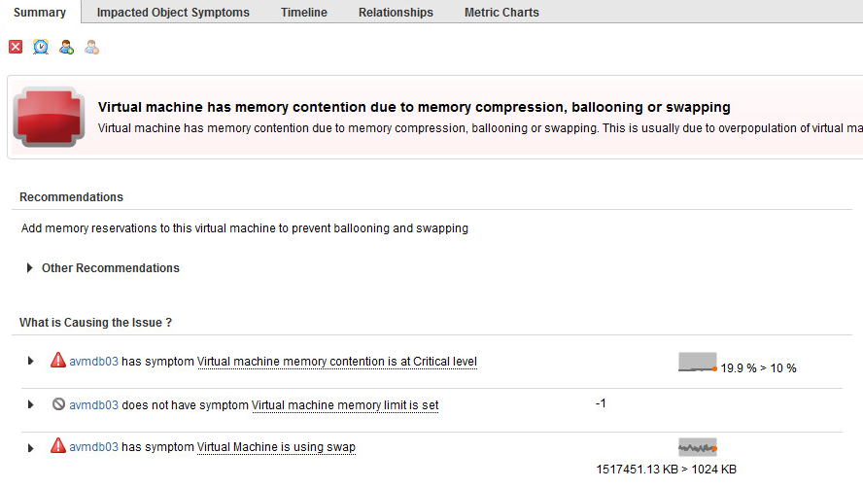
Health – Immediate Issues
Health Badge: The Health badge answers the question "How is my system doing right now?"
VMware vRealize Cloud Suite
Notes:
Health Badge: The Health badge answers the question "How is my system doing right now?"

Slide 23
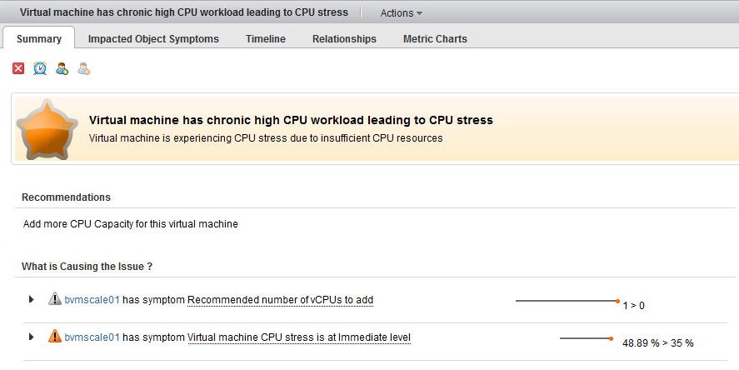
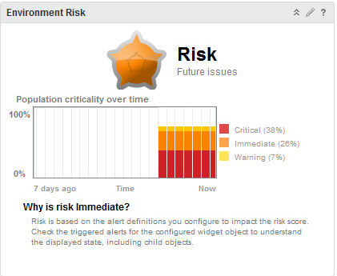
Risk – Future Issues
Risk Badge: The Risk Badge indicates potential problems that might eventually degrade the performance of the system.
VMware vRealize Cloud Suite
Notes:
Risk Badge: The Risk Badge indicates potential problems that might eventually degrade the performance of the system. Risk does not necessarily imply a current problem. Risk indicates problems that might require your attention in the near future, but not immediately.

Slide 24
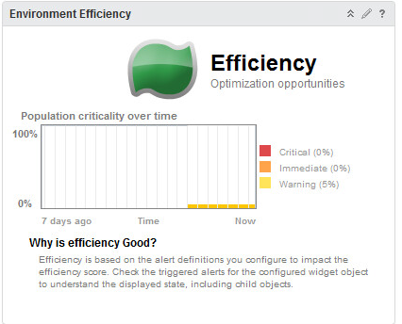
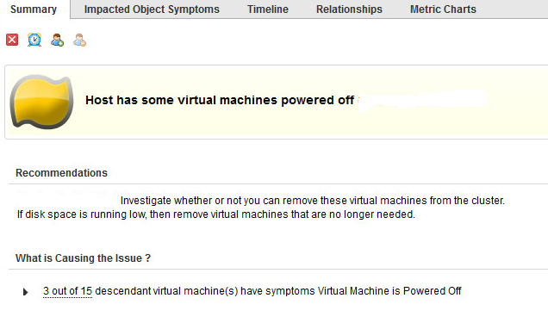
Efficiency – Optimization Opportunities
Efficiency Badge: Efficiency badge helps you identify optimization opportunities in your systems.
VMware vRealize Cloud Suite
Notes:
Efficiency Badge: Efficiency badge helps you identify optimization opportunities in your systems. Efficiency does not tell you about current or future performance problems, but tells you how to run a more efficient datacenter.

Slide 25
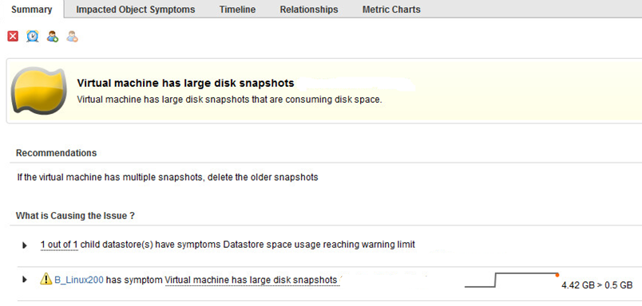
Efficiency – Optimization Opportunities
VMware vRealize Cloud Suite

Slide 26
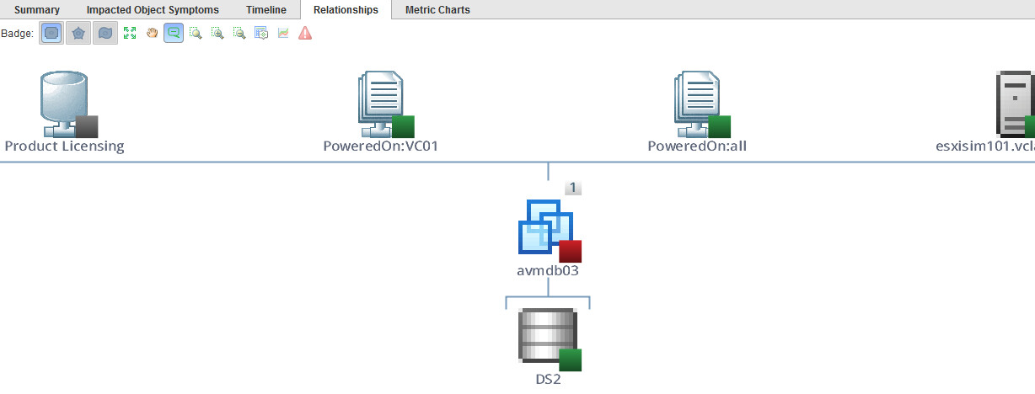
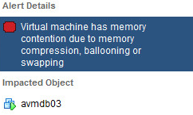
Diagnose Relationships
Relationships tab helps you identify the relationships of your licensing, to your datastores, to your virtual servers to your virtual hosts in your systems in one graphical representation.
VMware vRealize Cloud Suite

Slide 27
Diagnose Relationships
This is another example of a graphical view of clusters, hosts, vms and datastores
VMware vRealize Cloud Suite
Notes:
Graphical representation of the virtual environment (Cluster/host to vm to disk relationship)

Slide 28
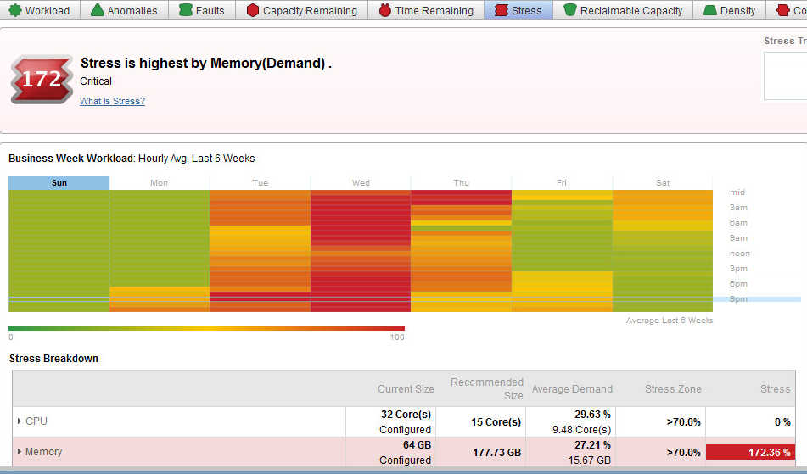
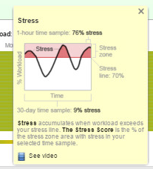
Heat Maps & Stress
A heat map is a graphical representation of data where the individual values contained in a matrix are represented as colors.
Stress accumulates when the workload exceeds the stress line.
VMware vRealize Cloud Suite
Notes:
Heat Maps and Stress

Slide 29
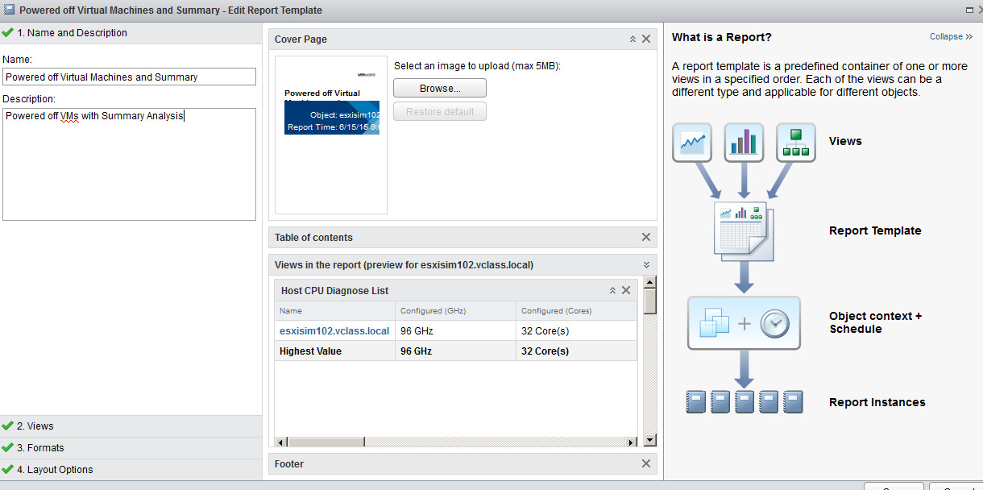
Reports
There are standard predefined templates or you can create your own template.
VMware vRealize Cloud Suite

Slide 30
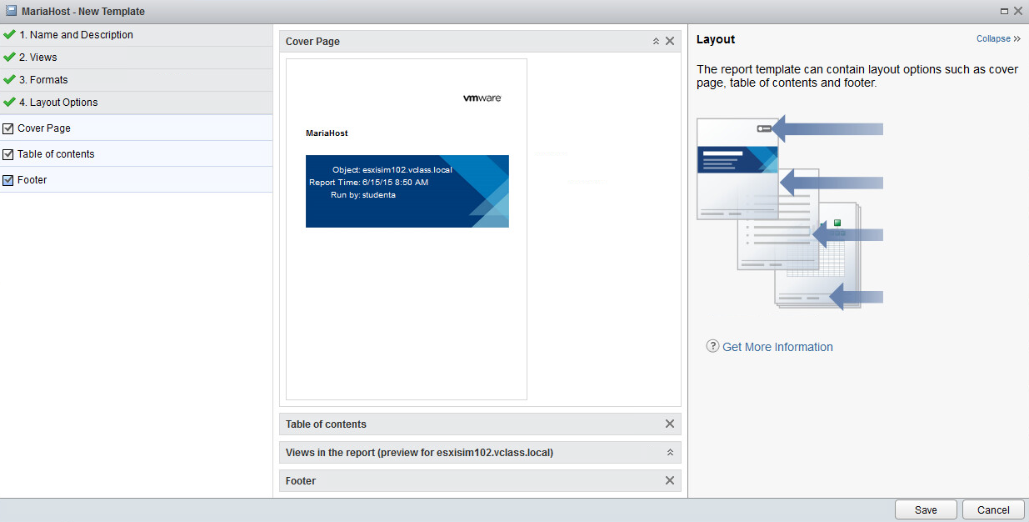
Reports
Once you provide the name and description of the report, the cover page, table of contents and footer are automatically generated.
VMware vRealize Cloud Suite

Slide 31
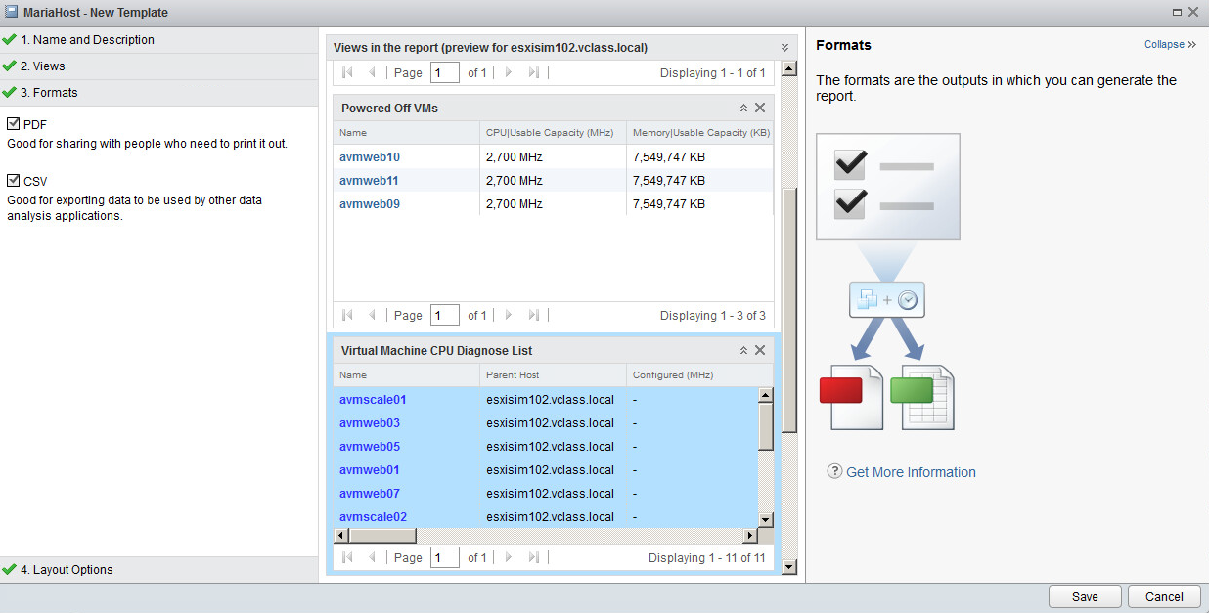
Reports
Reports can be PDF or CSV format for exporting and analysis.
VMware vRealize Cloud Suite
Notes:
The report can be created into 2 formats. PDF and CSV

Slide 32
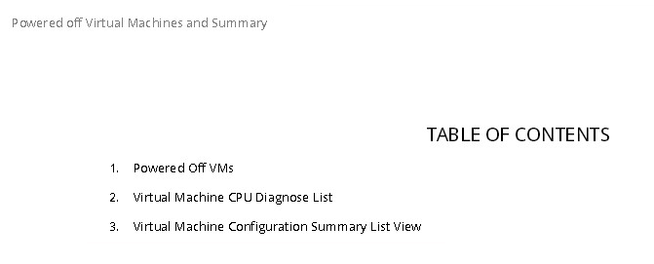
Reports
The Reports Table of Contents page
VMware vRealize Cloud Suite

Slide 33
Reporting
Listed on the first page are the list of VMs that are powered off
VMware vRealize Cloud Suite
Notes:
List of Powered off VMs

Slide 34
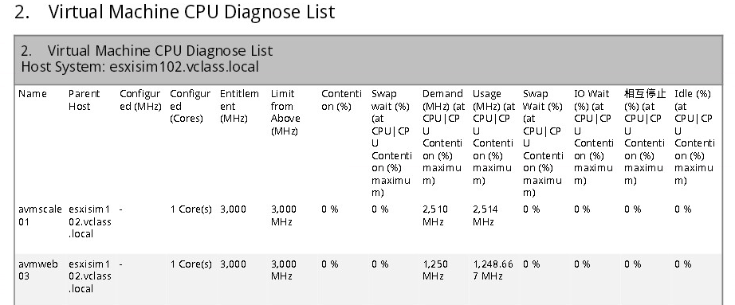
Reporting
Page two displays the CPU Diagnostics
VMware vRealize Cloud Suite
Notes:
CPU Configuration list - provides host name, cores, CPU’s

Slide 35
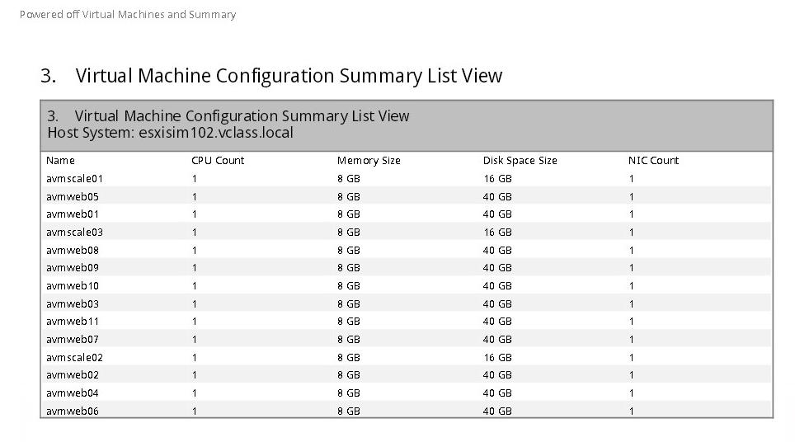
Reporting
Page three lists the VMs specifications, CPU, Memory, Disk space and NIC
VMware vRealize Cloud Suite

Slide 36
DEMO
Live demonstration of vRealize Operations Manager and Log Insight
VMware vRealize Cloud Suite

Slide 37
References
Where to get started: VMware Webinar Portal
http://www.vmware.com/go/getmore
vRealize Operations 6.x Hands On Labs – http://labs.hol.vmware.com
– HOL-SDC-1601 vRealize Operations
– HOL-SDC-1634 vRealize Operations Overview
– HOL-SDC-1635 vRealize Log Insight
– HOL-SDC-1610 & HOL-SDC-1602 vSphere with Operations Management 6
– vRealize Operations Manager What's New [V6.x] Fundamentals
– vRealize Operations Manager: Install, Configure, Manage [V6.2]
VMware vRealize Cloud Suite
Notes:
Referencing Material and hands on labs

Slide 38
On a scale of 1 – 5, with 5 being great and 1 being poor, how would you rate the presentation on vRealize Cloud Suite?
1
2
3
4
5

Slide 39
Contact information and Online Survey
Questions/ Comments: hejnamc@buffalostate.edu
Help me improve, please fill out the short survey: https://goo.gl/9B1Vq2
Dave Davis – VMware –Licensing/Technical
davisd@vmware.com
Melaine Calvanese – VMware Acct Exec -SLED
mcalvanese@vmware.com
VMware vRealize Cloud Suite
Notes:
Contact and on-line survey information

Slide 40
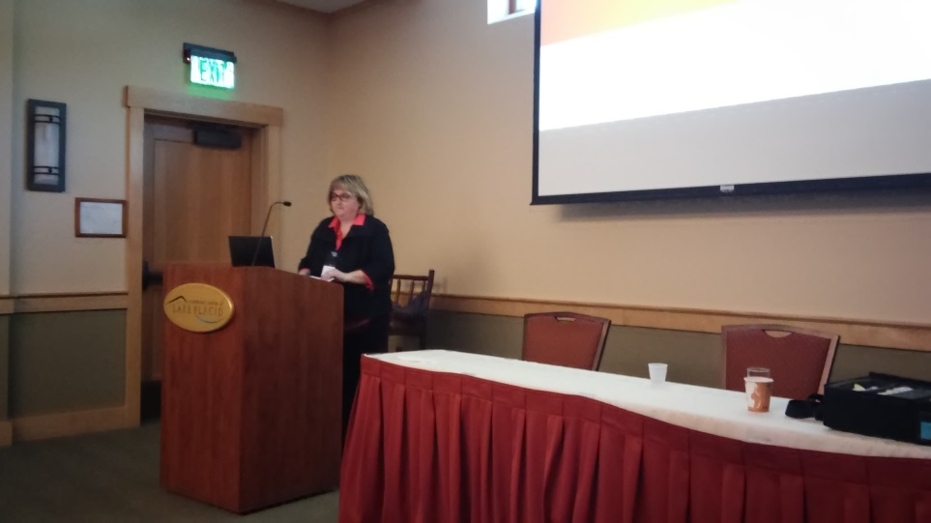
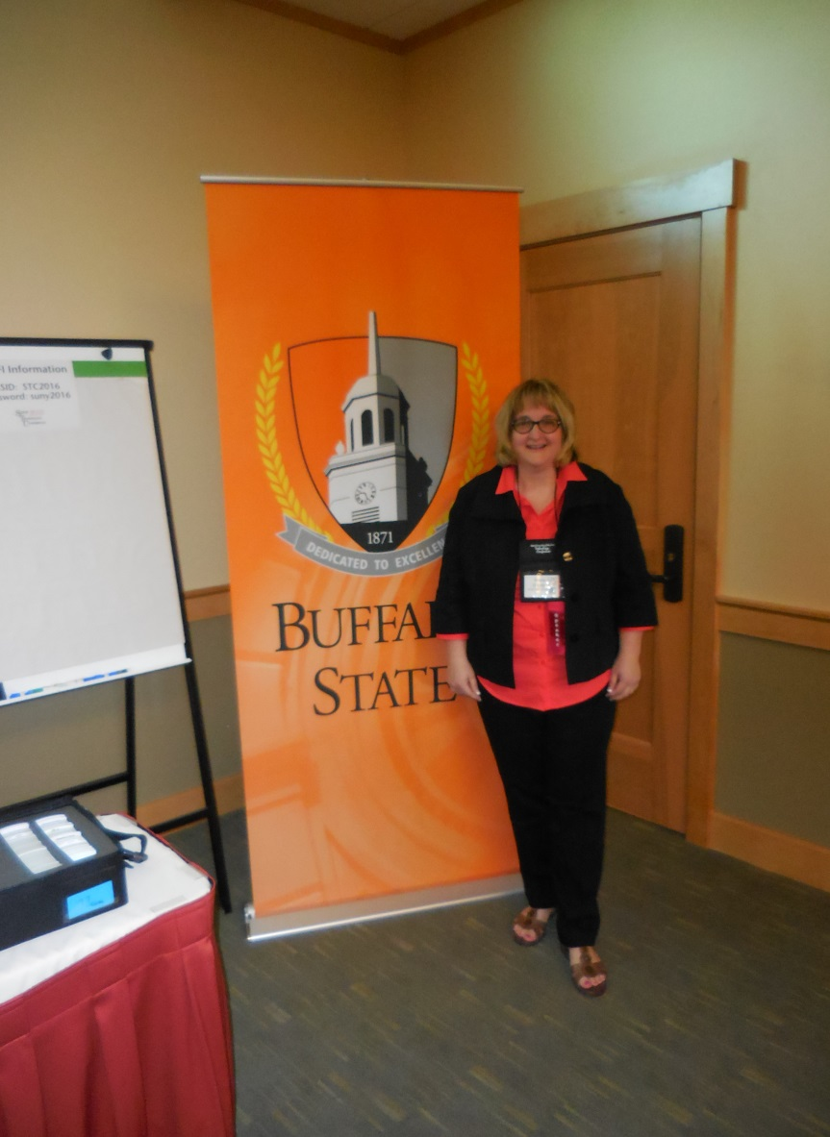
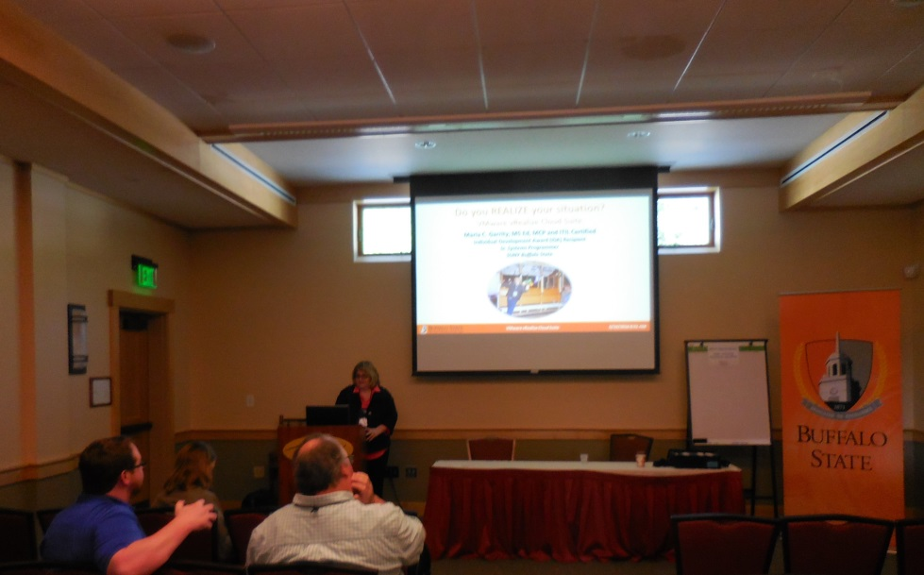
STC Pictures 6/16/2016
VMware vRealize Cloud Suite

