Slide 1
Developing a Data Risk Classification Program
Presenters:
Ben Hartung, Information Security Officer (Fredonia)
Symen Mulders, Information Security Analyst (Plattsburgh)
Notes:
(Ben & Symen)
Welcome everyone to the Developing a Data Risk Classification Program
My name is Ben Hartung, Information Security Officer for Fredonia and Symen Mulders, Information Security Analyst at Plattsburgh.

Slide 2
Background
SUNY-wide taskforce comprised of eight campus members of the SUNY Information Security Working Group (ISWG) charged with developing a template for a Data Risk Classification Policy.
Contributors:
Jeff Murphy (Buffalo)
Alan Tosi (RF)
David Loewy (Downstate)
Walter Kerner (FitNYC)
David Fish (Brockport)
Ursula Wilkinson (Oswego)
Ben Hartung (Fredonia)
Symen Mulders (Plattsburgh)
Notes:
(Ben)
SUNY campuses are all struggling with the sames security and compliance issues
Foundational for all security programs to know what kind of data is in scope and what controls are applicable

Slide 3
Goals
Current, comprehensive and easy to understand
Maps directly to the NYS & Federal regulations
Applicable to Higher Ed (specifically SUNY)
Correlates to Information Security Data Access Policy and other related policies
Aligns with Enterprise Risk Management (e.g. Data Risk Classification Program)
Simplicity of implementation (e.g. DLP)
Leadership Buy-In
Notes:
(Ben)

Slide 4
Development Process
Reviewed Federal and NYS compliance requirements
Reviewed draft policies from other SUNY(s)
Reviewed policies from leading Universities (e.g. Harvard, Stanford, & others)
Michael Duff, Stanford CISO, provided consultation and guidance
Provided DRAFT policy to ISWG, SUNY CCIO, and local campuses for feedback
Reviewed by SUNY Counsel
Reviewed by SUNY Enterprise Risk Management group
Notes:
Ben
Process took about 4-6 months
Fredonia also reviewed the draft policy and related templates with the Information Technology Advisory Board (ITAB) and campus-wide 30-day review process for employee feedback

Slide 5
What is Data Risk Classification?
Data risk classification is broadly defined as the process of organizing data by relevant categories so that it may be used and protected more efficiently. The classification process not only makes data easier to locate and retrieve – data classification is of particular importance when it comes to risk management, compliance, and data security.
Scope = University owned data in motion (transit) and at rest (stored).
Source: https://digitalguardian.com/blog/what-data-classification-data-classification-definition
Notes:
Symen

Slide 6
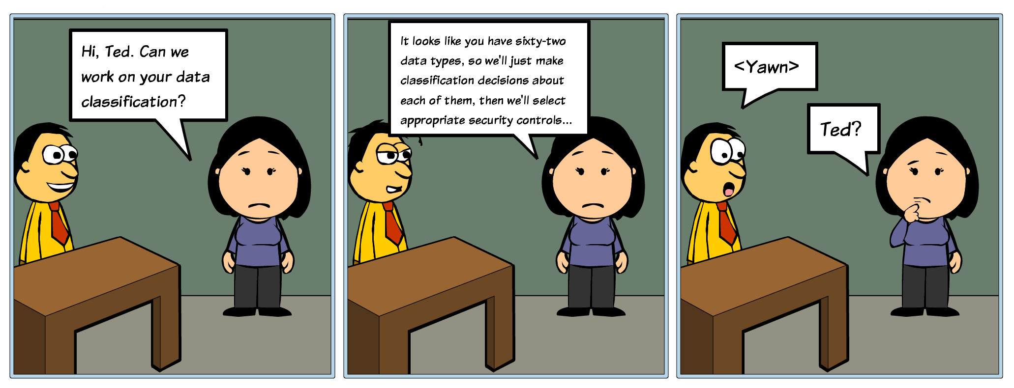
This can be a bit complicated at first...
Notes:
Symen
Every campus has a *lot* of different kinds of data, so classifying it can seem like a really big project...

Slide 7
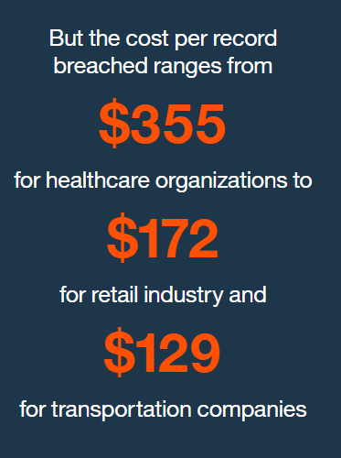
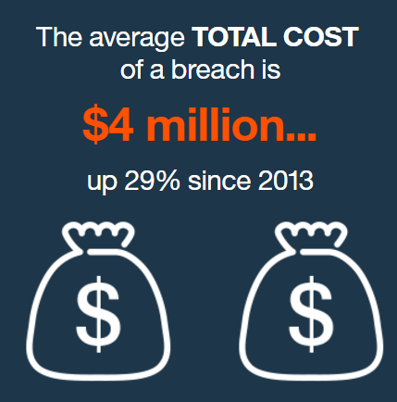
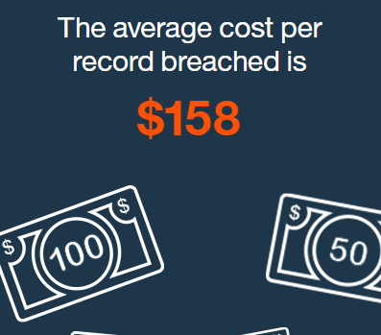
Why do we care?
Security ….protect against data breach
Cost of Data Breach
In 2016, 73% of breaches were financially motivated, per the 2017 Verizon Data Breach Report. Do we understand the financial value of our data so we can apply appropriate security controls? The way we do that is with a data classification.
Reference: 2016 Cost of Data Breach Study: Global Analysis from Ponemon Institute
Notes:
(Symen)
A breach could really hurt, financially. Classifying our data allows us to focus our security efforts where they will be most effective...

Slide 8
Why do we care?.....con’t
Compliance Requirements:
SUNY Procedures 6608: Information Security Guidelines: Campus Programs & Preserving Confidentiality
New York State Information Technology Standard No: NYS-S14-002 Information Classification
National Institute of Standards and Technology (NIST) Special Publication 800-53: Security and Privacy Controls for Federal Information Systems and Organizations
National Institute of Standards and Technology (NIST) Special Publication 800-171: Protecting Controlled Unclassified Information in Non Federal Information Systems and Organizations
Federal Information Processing Standard Publication 199: Standards for Security Categorization of Federal Information and Information Systems
New York State Freedom of Information Law (FOIL)
New York State Security and Breach Notification Act
Family Educational Rights and Privacy Act (FERPA)
Health Insurance Portability and Accountability Act (HIPAA)
Federal Policy for the Protection of Human Subjects (‘Common Rule’)
New York State Information Security Policy
Gramm-Leach-Bliley Act
Payment Card Industry Data Security Standards
Notes:
(Symen)

Slide 9
Why do we care?..... in 16 Words
Restricted = Data that will make a breach expensive.
Public = Data subject to FOIL.
Private = Everything else.
Notes:
(Symen)
...So, we made it as simple as we could.

Slide 10
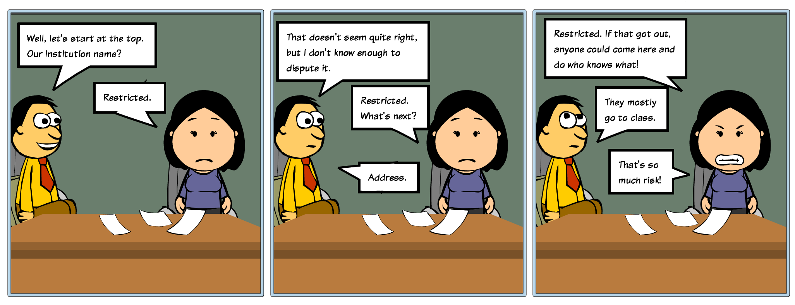
Adapting the Data Classification for Your Campus
Notes:
Symen
You likely have data on your campus that doesn’t fit any of the categories we have already identified, but still needs to be classified.
The important thing to remember is to follow the 16 words. Restricted = expensive breach, public = data available to the public or by FOIL, everything else is private.

Slide 11
Draft Data Risk Classification Policy & Program Templates
Draft Data Risk Classification Policy
Data Risk Classification General Overview
Data Risk Classification & Approved Electronic Services
Notes:
Ben & Symen
Program Development
Policy
Communication Plan
Approved Electronic Services List (Inventory) & Process
Awareness Training
Related to other relevant policies… e.g. Data Security and Access Policy, Mobile Device Policy
What’s Next??...Data Loss Prevention Tools

Slide 12
Questions
???????
Notes:
Symen & Ben

