Slide 1
Improving the Efficiency of the IT Service Desk
Emmon Johnson – Evening Service Desk associate
SUNY Oneonta
STC - 2017

Slide 2
Agenda
A Little On My Background
Organization of Our IT Service Desk in Relation to ITS
Review of Services Offered at the IT Service Desk
Review of Our Tools Before and After
Check User Account Status
SharePoint
Red Dragon Time Log
Lessons Learned

Slide 3
Background
I have my Bachelor of Science in Geology/Mathematics (2008) and in Computer Science (2017).
I have my Master of Arts in Earth Science (2012).
Summer 2012 – Fall 2013: Programmer/Analyst in ITS Research and Development
Fall 2013 – Spring 2015: Programmer/Analyst in Enterprise Application Services
Spring 2015 – Present: Service Desk Associate in IT Service Desk
I love looking at systems and seeing what we can do with them.

Slide 4
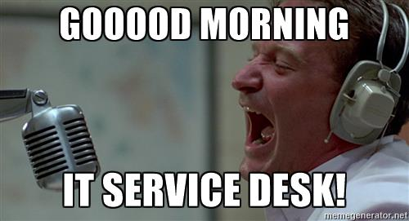
Organization of the IT Service Desk in Relation to ITS

Slide 5
Organization of the IT Service Desk and ITS
ITS Organization has 7 groups:
CIO Office
Customer Support
Enterprise Application Services
Networking and Telecommunications
Security
Systems and Data Center Management
Teaching, Learning, and Technology Center
IT Service Desk is a part of our ITS Customer Support Group:
IT Service Desk/TIPS (3 Professional – 29 Student Workers)
Desktop Support (4 Professional – 18 Student Workers)
Learning Spaces (2 Professional – 0 Student Workers)
Labs (1 Professional* - Share Student Staff with Desktop Support)
Director and Secretary

Slide 6
Organization of Our IT Service Desk
How does the IT Service Desk operate:
Maintain 2 Desks:
Service Desk (2-3 Customer Support Consultants)
Labs Desk (1-2 Customer Support Consultants and 1 TIPS Consultant)
Offer Phone\Walk-in\E-mail\Self-Service support.
Student Workers handles Phone and Walk-in support.
Professional Staff handles Email, Self-Service, Phone, and Walk-in support.

Slide 7
Who We Support
Teaching/Professional/Contract Staff and On-Campus Third-Party Departments (OAS/SICAS/etc.)
~1,000
Students
~6,500
Alumni
~9,000

Slide 8
Hours of the IT Service Desk
Labs Desk Hours (when classes are in session):
Monday thru Thursday: 8 am – 1 am
Friday: 8 am – 9 pm
Saturday: 12 pm – 6 pm
Sunday: 12pm – 1am
Service Desk Hours (when classes are in session):
Monday thru Friday: 8 am – 9 pm
Saturday: 12 pm – 6 pm
Sunday: 12pm – 9pm

Slide 9
Responsibilities of the Service Desk
Phone and Walk-in Support
Pretty much all IT incidents/request
User accounts
Password Resets
Account Setup/Issues
Device Registration
Hardware/Software Issues
Faculty/Staff Appointments
Machines in for Service
Equipment Loans

Slide 10
Responsibilities of the Lab Desk
Walk-in Support
Lab Incidents/Requests
Printing Incidents/Requests
Paper Deliveries
Toner Deliveries
Paper Jams
Laptop Loans
TIPS Support

Slide 11
How Can We Improve Efficiencies at the IT Service Desk?
Evaluate current tools:
See how they are being used.
See what information they are providing us.
See what information is behind the scenes that we can use.
Evaluate current processes and procedures:
See how they are being used.
See what information they are providing us.
Ask questions:
Can we develop a program to provide more or better information for initial troubleshooting?
Can we develop a program around a process or procedure?

Slide 12
Requirements
Everything has to be maintainable within ITS Customer Support and minimally involve other IT Departments.
Flexible programming and development.
Need to work within systems that are currently being used.
Can’t be too large or complicated.

Slide 13
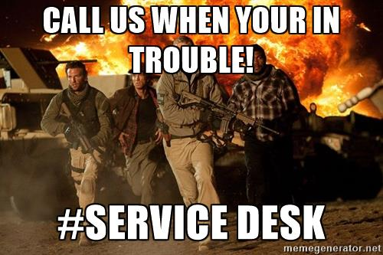
Review of Our Tools Before and After

Slide 14
Check User Account Status - Before
Used for User Accounts:
Password Resets
Account Issues
Information used:
Full Name
Account Active/Expires
Password Last Set/Expires
Account Type
Net user command

Slide 15
User Accounts – Check User Account Status
Developed in C# and uses a direct query to AD.
Flags and Color Coding for quicker troubleshooting.
Information is grouped and more information is presented allowing for better troubleshooting.
Can search for a user account using part of username, first name, last name.
Direct access to tools.

Slide 16
ITS Customer Support SharePoint - Before
Used for:
Appointments
Announcements
Knowledge Base
Schedules
Student Login
SharePoint 2010 on an in-house server.
One site for everything

Slide 17
ITS Customer Support SharePoint – Before

Slide 18
ITS Customer Support SharePoint - After
SharePoint 2013 on Office 365
Each group has it’s own sub-site
Used for:
Appointments
Announcements
Schedules
Cover Requests
Data Storage
Student Login
Emails sent when an Announcement or Cover Request is posted.

Slide 19
ITS Customer Support SharePoint – After

Slide 20
ITS Customer Support SharePoint – After

Slide 21
ITS Customer Support SharePoint - After
Cover Requests
Now made or claimed online.
Emails everyone when created or claimed.
All open request are shown on groups page.
Creates a record on a SharePoint calendar.
Allows Supervisors/Professional Staff to see who is going to cover a shift.
Easier to see potential issues.

Slide 22
ITS Customer Support SharePoint - After

Slide 23
ITS Customer Support SharePoint – After

Slide 24
Red Dragon Time Log - Before
We had a system called ‘Lab Login’
Integrated in SharePoint 2010 Customer Support Site.
Developed/Maintained in-house. (Labs and Systems group)
Stopped using because of maintenance issues.
Developed a replacement app in Microsoft PowerApps
Easy and quick development.
Saved data directly to the new Customer Support SharePoint Site.
Easy to use.
Minimal input from the users.
Significate reliability issues from Microsoft.

Slide 25
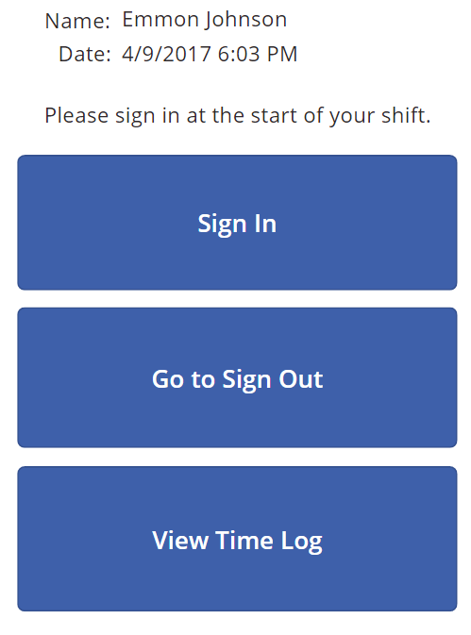
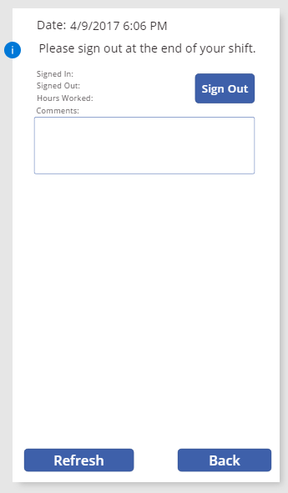
Red Dragon Time Log – Before (PowerApps)

Slide 26
Red Dragon Time Log - After
Standalone client.
Developed in C# (Part of a group project for a Computer Science class).
Stores and queries data on SharePoint and uses SharePoint for authentication.
Operates similar to the PowerApps program but much more stable.
Can only be run on authorized computers in ITS Customer Support.
It is used by the Supervisors to verify shifts and by the Student Workers to track the shifts they work for their time sheets.
There are 2 views, Student and Admin. Driven by group membership in AD.
‘Helpdesk Consultant’ – Student Worker – Student View
‘ITS – Customer Support Staff’ – Professional Staff – Admin View *Still in development

Slide 27
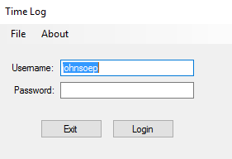
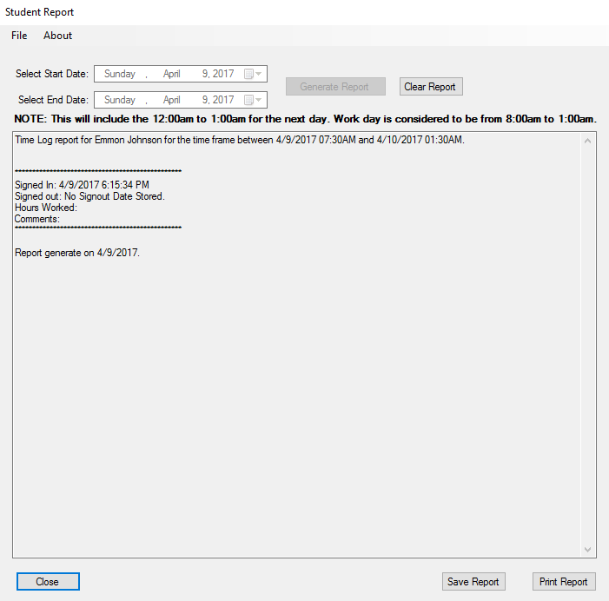
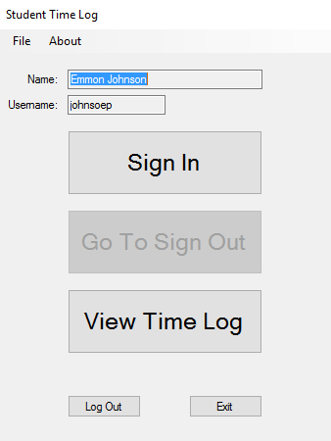
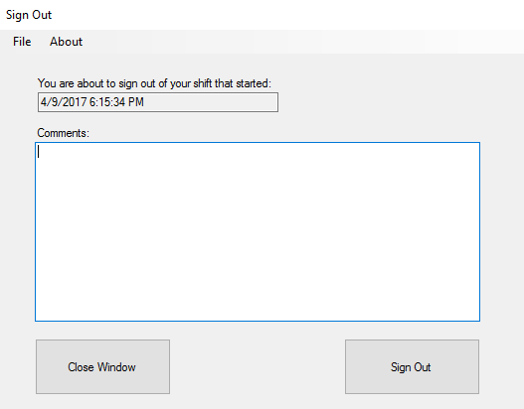
Red Dragon Time Log - Student

Slide 28
Red Dragon Time Log – Admin (Still in Development)
Admins can access data in 2 different ways:
Directly thru SharePoint.
Currently developing a user interface for admins to use.
Admins can see all the time data for the students.
Admins can also authorize computers that students can use to sign into their shifts with.

Slide 29
Student Feedback
A Microsoft Forms Survey was sent to Student Workers a week after deployment, 8 users responded:
On a scale of 1-10, with 1 being that you hate the program and 10 being that you like the program, how do you like the new program?
Average: 9
On a scale of 1-10, with 1 being that you have great difficulties with the program and 10 being that you find the program easy to you, how easy is the new program to use?
Average: 9.75
On a scale of 1-10, with 1 being that you have great difficulties with the process and 10 being that you find the process easy to you, how easy is it to sign into your shift?
Average: 9.63
On a scale of 1-10, with 1 being that you have great difficulties with the process and 10 being that you find the process easy to you, how easy is it to sign out of your shift?
Average: 9.63

Slide 30
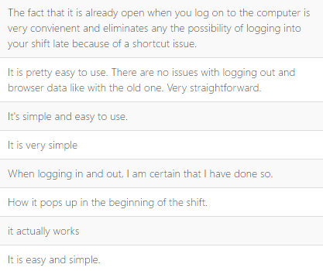
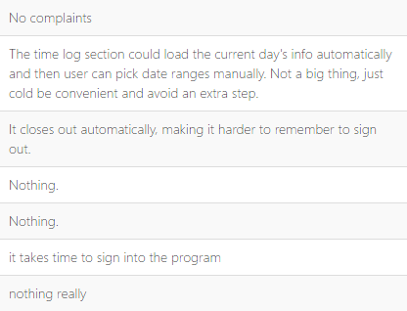
Student Feedback
What do you like about the program?
What do you dislike about the program?

Slide 31
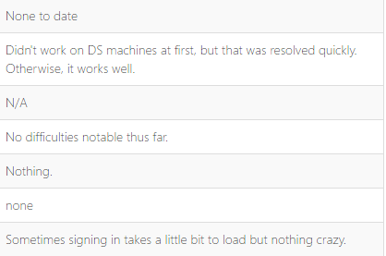
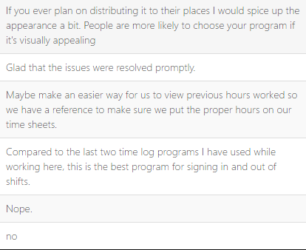
Student Feedback
What are the difficulties that you have encountered while using the program?
Are there any other comments that you would like to make regarding the new program?

Slide 32
Lessons Learned
Red Dragon Time Log
Issues with initial deployment
Program had issues with local accounts
Feedback from Student Workers
Had issues initially with student failing to report issues with the program
Relied on professional staff and verbal communication with students
Updated program to record errors, when possible, to SharePoint.
Exploring different solutions/systems is important.

Slide 33
Lessons Learned
We can improve efficiency by:
Updating tools to provide more/better information.
Developing/designing tools around current processes and procedures.
Have to make sure everything can be done internal to your group with existing systems.

Slide 34
Questions?
Emmon.Johnson@oneonta.edu

