Slide 1
It’s All About the Captioning
Nazely Kurkjian
Coordinator of Disability, Diversity & Nontraditional Student Services
SUNY System Administration

Slide 2
Order of Presentation
Audio-Visual Accessibility
Laws & Technical Standards
Considerations & Challenges
How campuses are handling
Expectations
Copyright
Industry Trends
Takeaways
Questions
Resources

Slide 3
Audio-visual Accessibility
Effective Communication
Auxiliary Aids & Services:
Transcript
Closed captions
Open captions
Audio descriptions
Video remote interpreting
Real time captioning
Notes:
Audio-visual accessibility is about effective communication. The goal is to ensure that communication with people with disabilities is equally as effective as communication without disabilities.
The ADA uses the term “auxiliary aids and services” to identify ways to communicate with people who have communication disabilities.
Generally speaking, audio-visual content needs a text equivalent
Audio files, such as podcasts, must be transcribed
Videos must be transcribed and captioned (open or closed, closed is better because people can turn on/off)
Transcript alone is not sufficient for access
Visual demonstrations need a text or audio description
CART and VRI may be provided on as needed basis. CART and Interpreters should be provided for public events.
The primary focus of this presentation is closed captioning.
Additional questions: Is the audio/video pre-recorded or live? When marketing live events, provide an accessibility statement - just like there was for this webinar. Example: If you anticipate a need for disability-related accommodations or auxiliary aids to participate, please contact X at X. We ask that you provide us with at least 2-5 days of advance notice regarding your equal access needs.

Slide 4
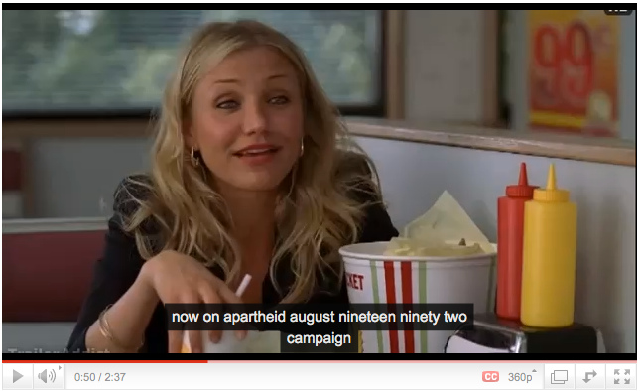
Captioning
Barriers:
Lack of/Unintelligible closed captions
Insufficient description by text or audio
Accessibility Criteria:
Intelligibly-captioned multimedia and descriptive audio.
Bad Teacher - what YouTube captions; Dirk Houbrechts
Notes:
Original line by Cameron Diaz is “From now on, my full-time job is finding a man who will take care of me” - the caption in this screenshot is taken from Youtube’s automatic captioning feature.
Research shows captions help everyone - people wearing headphones, persons whom English is a second language, & improves retention of information.

Slide 5
Relevant Laws & Technical Standards
Section 504 - Rehabilitation Act of 1973
Americans with Disabilities Act of 1990
Web Content Accessibility Guidelines (WCAG) 2.0 AA
Upcoming: SANPRM
What UC Berkeley Taught Us
Notes:
Besides being the right thing to do, it’s the law:
US Department of Justice continues support for digital accessibility
The Office of Civil Rights has received thousands of complaints about inaccessible websites (particularly public websites)
WCAG 2.0 AA is baseline for web accessibility
SANPRM (supplemental advance notice of proposed rulemaking) on Nondiscrimination on the Basis of Disability; Accessibility of Web Information and Services of State and Local Government Entities
There’s a lack of clarity around what is required to be accessible
DOJ is considering revising the regulation implementing Title II of the ADA in order to establish specific technical requirements to make services, programs and activities accessible via the web
WCAG 2.0 AA is being considered to apply to websites and web content (on any device, including mobile)
Includes sound and video
Keeps being pushed back
Once updated, 2 year compliance timeframe - Start now!
There are exceptions (archived content, third party web content linked from a public entity’s website) but must be made accessible upon request
Berkeley (2016) : about free audio & video content available to public
Issue with inaccuracy of YouTube CC (from auto-speech recognition feature) and lack of captions in iTunes U. Content in BerkeleyX (edX partnership)
Clarified: public facing content MUST be accessible. Undue administrative/financial burden extremely challenging to prove. If you have a policy, follow it.
Under title II, public universities must afford individuals with disabilities an equal opportunity to participate in or benefit from any aid, benefit, or service provided to others.
UC Berkeley is not, however, required to take any action that it can demonstrate would result in a fundamental alteration in the nature of its service, program or activity or in undue financial and administrative burdens.
Based on our findings of accessibility barriers, we conclude that UC Berkeley is in violation of title II because significant portions of its online content are not provided in an accessible manner when necessary to ensure effective communication with individuals with hearing, vision or manual disabilities.
UC Berkeley’s administrative methods have not ensured that individuals with disabilities have an equal opportunity to use UC Berkeley’s online content.
While the University of California’s Information Technology Accessibility Policy adopts the WCAG 2.0 AA technical standard, which provides clear parameters for ensuring online content is accessible to individuals with disabilities, UC Berkeley has not ensured compliance with its policy.

Slide 6
Considerations & Challenges
Resources
Cost
Personnel
Time
Tools
Responsibility
Notes:
Who captions content? Faculty, staff, captioning coordinator, etc. Combination of. Student workers? Need to figure this out and let everyone know.
How is captioning funded? Ideas: Portion of tech fee, centralized pool of money (institution), per department.
Product selection is also incredibly important. When researching and selecting vendors, ask them about accessibility. What do they have now? What do they plan to offer in the near future?
Risk management is a reality. We have thousands of hours of video and cannot caption them all at once. Strategize and prioritize captioning of content...

Slide 7
Nationally
Campuses with a video accessibility strategy:
Establishment of a formal policy
Define clear roles and responsibilities
Have a process in place to remediate content on the spot
Clearly communicate where to locate accessible content
Provide training to create accessible content
Trending: Requiring all content to be captioned
Notes:
How campuses are handling nationally...
Nearly all campuses require captioning:
University of Illinois Springfield: http://www.uis.edu/disabilityservices/alternativeformats/closedcaptioning/
University of Colorado Boulder: https://oit.colorado.edu/services/consulting-professional-services/captioning/faq
San Jose State University: http://www.sjsu.edu/cfd/teaching-learning/accessibility/captioning/#captionsrequired
The University of Arizona: http://itaccessibility.arizona.edu/guidelines/captioning-commitment
Education for faculty, staff, students. Provide notice on public websites...

Slide 8
SUNY
Video accessibility/compliance policy
Video accessibility process in place
Variation in roles & responsibility, how to request, tools & vendors used, funding mechanisms
Assessment
Surveys for faculty, students with hearing impairments
Notes:
Across SUNY...
Several campuses have a video accessibility/compliance policy (MVCC, Farmingdale, Alfred State College, SUNY Empire State College)
Discusses purchasing captioned media, mentions copyright...
Many campuses have a process in place to caption upon request
Responsibility can be shared or centralized (from faculty to disability/accessibility services to IT, educational technologies/distance learning offices or ALL have a role in ensuring access)
Requesting can be provided through forms or even simpler means like buttons (faculty press to send to third party captioning vendor)
Tools vary from little to no tools available to built-in accessibility features in video management platforms to integrating with closed captioning vendors
Funding is also all over the map; from as needed to designated portion of tech fee
One campus surveyed students with hearing impairments to better understand their classroom/overall experience accessing information. Many videos used still not captioned, had to ask professors to turn captions on, believed watching closed captions helped them learn course content

Slide 9
SUNY Administration Efforts
Video Accessibility Surveys
Faculty
Professional Staff
Future
Accessibility website
CC Vendor Agreements
Pilots
Notes:
At SUNY Administration...
More to come...
SUNY Accessibility website: centralized one stop accessibility shop with resources and professional development opportunities
This summer, pursuing centralized agreements with closed captioning vendors
This summer, preparation for potential pilots with vendors (email me for more information)

Slide 10
SUNY Administration Surveys
Professionals:
How much video? We don’t know…
Diversity in responsibility (where it lives, who pays for, etc.)
Faculty:
Why not? Lack of training, knowledge; No requirement
Notes:
Professional Staff has more to do with you...perhaps some of you responded to this survey.
About 20 responses, half CC half four year
As you can imagine, video is posted in a lot of places (LMS, campus website, YouTube, etc.)
Some caption in-house, outsource, do both, or do nothing. Some responded that they don’t know what is currently done.
Costs: Either less than a $ per minute or between $1 - 2 per minute
Huge gap in knowledge regarding captions for LIVE video
Nearly ALL are interested in agreements with captioning vendors
Faculty
More responses from 4-year institutions
Most use video for instruction
Many use videos from another source, but decent number create their own
Majority posted in LMS

Slide 11
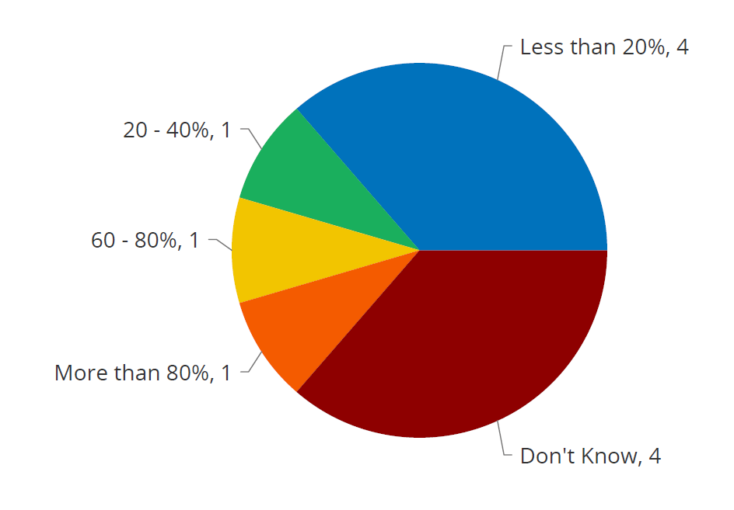
Notes:
For those who responded that they do caption in-house, outsource, or do both (11) here’s a snapshot of the percentage of video captioned.
For those who stated they do not address accessibility for video content, they cited reasons such as: lack of training, lack of funding, lack of knowledge, and no requirement

Slide 12
Expectations
Public websites/open settings must be captioned
Films and videos used repeatedly must be captioned
Captions must be at least 95% accurate
“After the fact” is not acceptable anymore
“As needed” OK for one-time use in closed setting, if no one needs accommodation
Notes:
Expectation includes closed captions and audio descriptions (read Berkeley letter)
95% is from FCC. Fully accessible is obviously 100%. Aim for 100...95 can still make people miss critical information. 100 improves access and searchability.
“After the fact” expectation...is the greatest debate right now. Higher ed disability lawyers and the disability/accessibility services field at large interpret that the government is moving towards all content, private and public facing, must be captioned. I believe this is somewhat true. There are exceptions. Currently, the DOJ (SANPRM) is considering exceptions for password-protected web content. But until the government clarifies this for sure, institutions are at risk of complaints/lawsuits. People are still filing complaints, private lawsuits citing ADA. Many of these resolutions require institutions to ensure new content is accessible and have a process in place to remediate archived content.
“As needed” content must be set up to caption immediately upon request
Courses that use a large volume of media files, specialized software, or technology tools will need more adjustments and a higher prioritization.
The first two weeks of content should be made accessible first, then additional weeks should be remediated. Prioritizing the initial week’s content will allow any student needing accommodation to assess the effectiveness of the adjustment.

Slide 13
Copyright
Purchase or obtain copy
Commercial shows for television
Academic videos
News clips
Owns copy without captions
Does not own. Receive permission from owner to caption
Notes:
Transcripts/CC videos must be provided to students who require an accommodation. However, the distribution of the content may be restricted because of copyright.
Commercial Shows for Television: Since the FCC requires captioning for television programs, these programs often have captions on their DVDs* or when provided online through a vendor like iTunes, Hulu, Amazon or Netflix.
Academic Videos: Videos from academic institutions, including some MOOC videos posted online, may also be captioned if their institutions comply with accessibility guidelines. Check online videos for captions.
News Clips: Some online news clips may also be captioned, but if they are not captioned, the content of the clip may also be in an article. If the information in the article contains the relevant information, it can be given as an alternate source of information.
If captioned version is not available, contact the owner to receive permission. Caption video and provide to student with disability. Share captioning file with owner so others may access this content in the future.
If an instructor owns a copy of the DVD or VHS without captions, it may be possible to exchange it for a newer copy with captions.
Try to contact owner 3 times. If they don’t respond, go ahead and caption. Caption video and provide to student with disability only.

Slide 14
Industry Trends
Captioning vendor integrations with most video hosting products and websites
Automated captioning/transcription is getting better and cheaper
Video management systems are including subtitle editor & automated closed captioning within system
Notes:
Outsourcing is getting easier, cheapter
My recommendation is to strategically choose video platforms that offer manual captioning ability and automated captioning for little to no money

Slide 15
Takeaways
1. Caption proactively as much as possible. Prioritize content.
2. Be prepared to provide accurate captions immediately upon
request.
Notes:
Don’t wait for the government to provide technical standards. Have a balanced approach
Prioritize: Requests for accommodation, public-facing content
Courses: repeated use, high impact, required courses, online, new content
Number 2 requires:
· an easy method to request/notify when captions are needed
· readiness to respond (consider weekends for distance learners)
· a plan (existing contract/agreement with caption/transcription vendor, tools in-house to readily caption)
· resources and funds
Number 2 is riskier because many professors use videos they don’t own. While captioning content for a student with a disability trumps copyright, it adds complications to our process and may slow it down. Some captioning vendors may refuse to caption because of copyright/permissions questions. It may even be challenging to download the video and caption in-house in a timely manner. Clearly, this speaks to the need for educating faculty to only use videos that are accurately closed captioned. Also advocating libraries to only purchase content with subtitles/closed captions.

Slide 16
Questions & Discussion

Slide 17
Contact Information
Nazely Kurkjian
Coordinator of Disability, Diversity & Nontraditional Student Services
SUNY System Administration
Nazely.Kurkjian@suny.edu
518-445-4078

Slide 18
References & Additional Resources
WCAG 2.0 Time-Based media
SANPRM - Nondiscrimination on the Basis of Disability; Accessibility of Web Information and Services of State and Local Government Entities
ADA Requirements: Effective Communication
DCMP Captioning Key

