Slide 1
Leveraging SCCM: Brockport’s Journey to Software Deployment and Image Automation
Thomas Calandra
Stephen Lane

Slide 2
zxcsdfsd
Environment Overview
Production Environment
Application Server
Database Server
EDW Distribution Point
MC Distribution Point
PKI Server
Roughly 3,000 Windows Devices
Roughly 350 Mac Devices
Test Environment
Application Server
Database Server
PKI Server

Slide 3
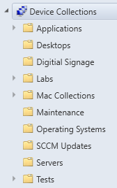
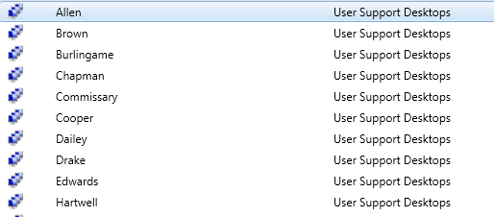
zxcsdfsd
Asset Management
Device Collections
Groups based on Active Directory OU’s
Groups based on specific software or tasks
Groups based on compliance information
Hardware / Software Reporting
Resource explorer
Report subscriptions
File queries

Slide 4
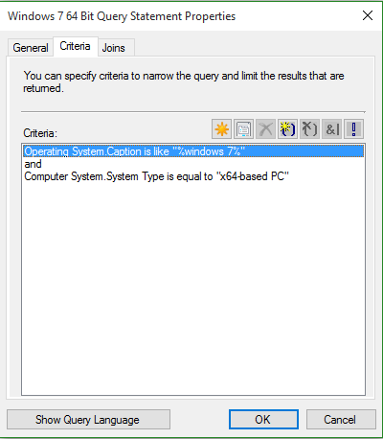
zxcsdfsd
Asset Management
Device Collections Organization
Queries based on properties or location
Query builder or WQL
Allows software deployment segmentation

Slide 5
zxcsdfsd
Pre SCCM Imaging Overview
WinPE to deploy WIM based images (Golden Image)
USB boot stick Needed & External HD With images
Windows 7 32bit & 64bit
Windows 8 32bit & 64bit
Windows 8.1 32bit & 64bit
UIU for drivers & sysprep
Batch script to join domain and license windows and finalize settings
Windows Easy Transfer to move data
More time consuming for both Service Desk and Imaging administrator

Slide 6
zxcsdfsd
Current Imaging Overview
Main Points
UDI Deployment
Pxe Boot
No Golden Image
Windows 10 Task Sequence Steps
Format Legacy or UEFI
Set Deployment Type
MDT
Apply OS – Base WIM
Apply Windows Settings
Drivers
Setup Windows
Join Domain
Activate Windows 10
Set Variables
Office 2016
Dot Net Framework
Restart
Label Image
Maintenance Window Settings
BIOS
Power Settings
Software Installations

Slide 7
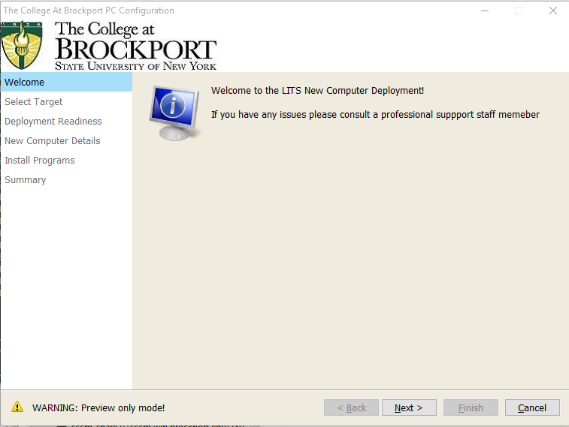
zxcsdfsd
UDI Wizard

Slide 8
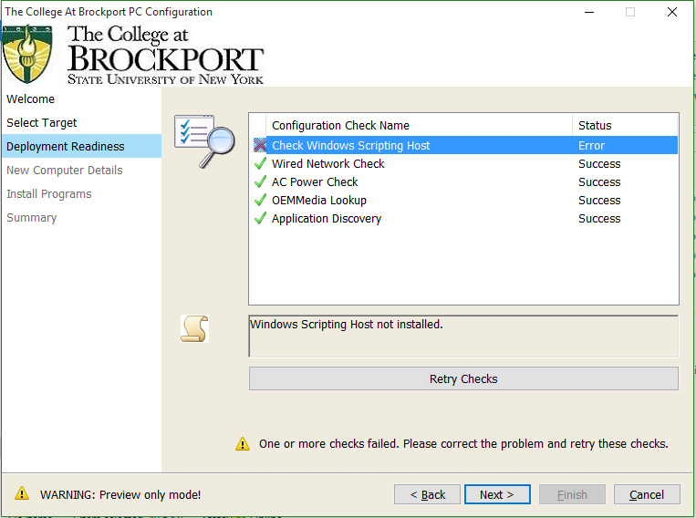
zxcsdfsd
UDI Wizard

Slide 9
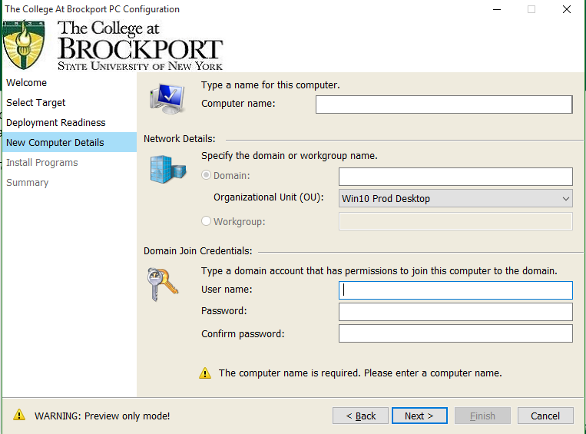
zxcsdfsd
UDI Wizard

Slide 10
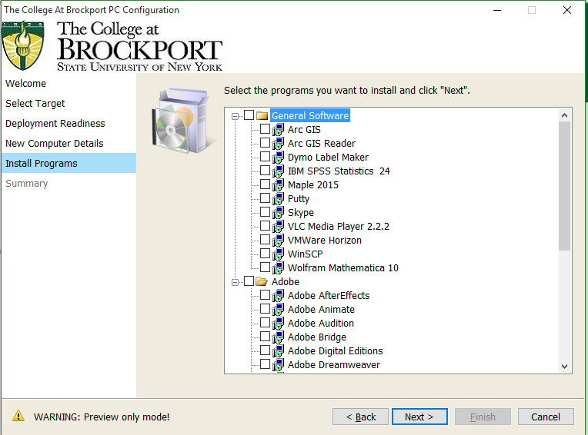
zxcsdfsd
UDI Wizard

Slide 11
zxcsdfsd
Service Desk Perspective
Imaging:
Much more accessible
Reduce Student Hours with an increase in productivity
2015/16 – 200 Reimage Tickets
2016/17 – 379 Reimage Tickets
Software Center
Software Troubleshoot dropped from 915 to 117 tickets from 2015-2016 to 2016-2017
Increased Self Service
Changed training techniques

Slide 12
zxcsdfsd
Software Deployment Overview
Software Center
Portal for available software
Over 50 Titles
Does not require administrative privileges
Service Window
Daily 2am – 5am
BIOS Powers on
Script shuts down
Windows Updates
Deployed to Windows 10 computers with SCCM
3rd Party App Required Updates
Deployed Monthly
Web Browsers, plugins, pdf readers…

Slide 13
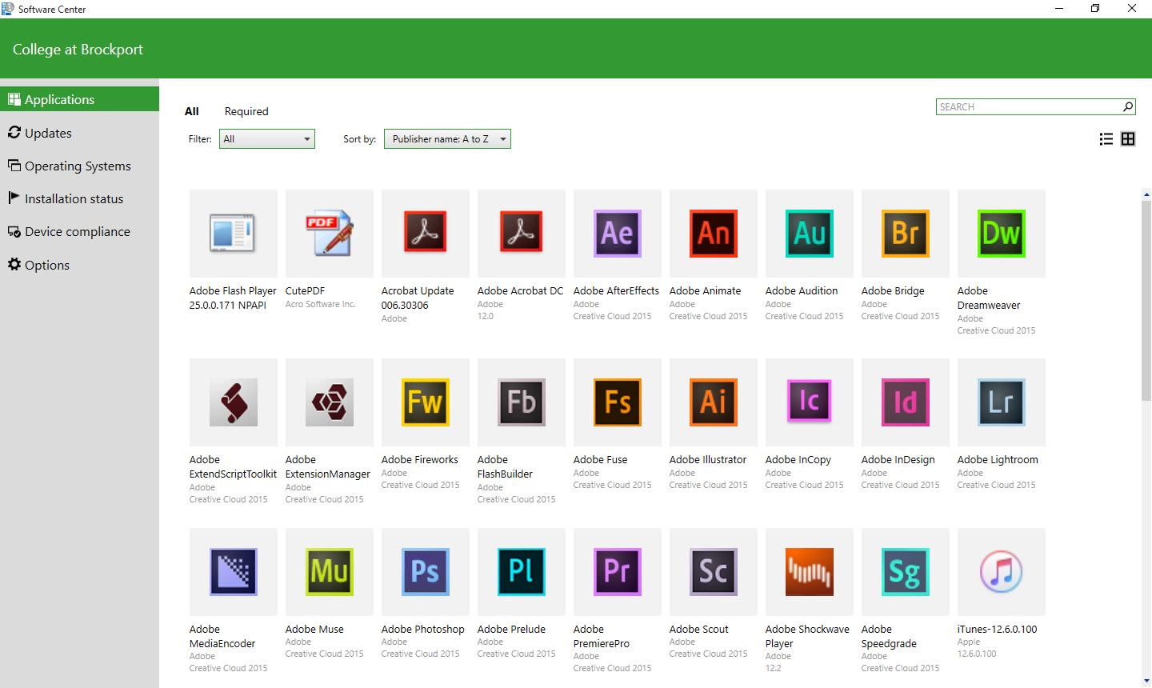
zxcsdfsd
Software Center
Notes:
This has helped to drive self service. Users are now able to install the software without admin. Students who receive a call about a program in software point users towards the program and show the customer how to use the program. This drives down costs, and improves efficiency. We can also pull reports through Service Now to figure out what programs have been isntaled recently, and package them in SCCM. → Skype and Dymo Label Maker

Slide 14
zxcsdfsd
Additional Tools
Data Transfer Tool
PowerShell script with GUI
Uses Microsoft User State Migration Tool
Dell Warranty Tool
SCCM Console Extension
PowerShell script to query Dell API for Warranty information
Works on a computer or a collection of computers
3rd Party Updates Script
PowerShell script used to deploy updates
Allows for consistency and accuracy with deployments

Slide 15
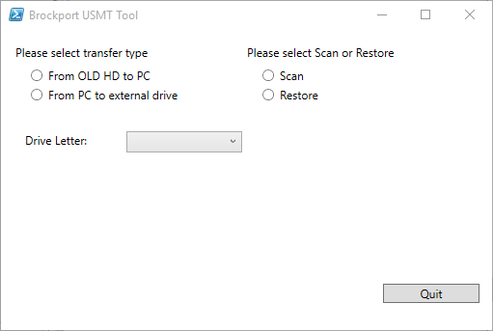
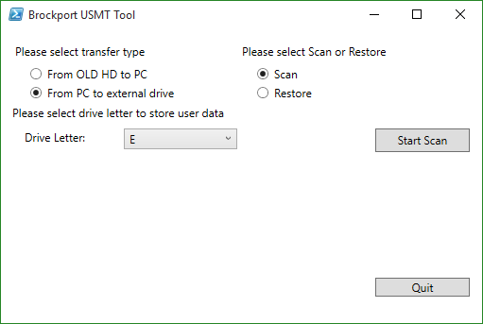
zxcsdfsd
Data Transfer Tool
Notes:
Data scans and transfers take from 30-60 minutes and make it easy for technicians to transfer data. They are no longer searching for .pst files in 2 different locations, and don’t have to worry aout missing key information. Firefox and Chrome, and preferences
Hard drive can be removed or not
Students can easily transfer data
2 lines of actual code, rest are graphics

Slide 16
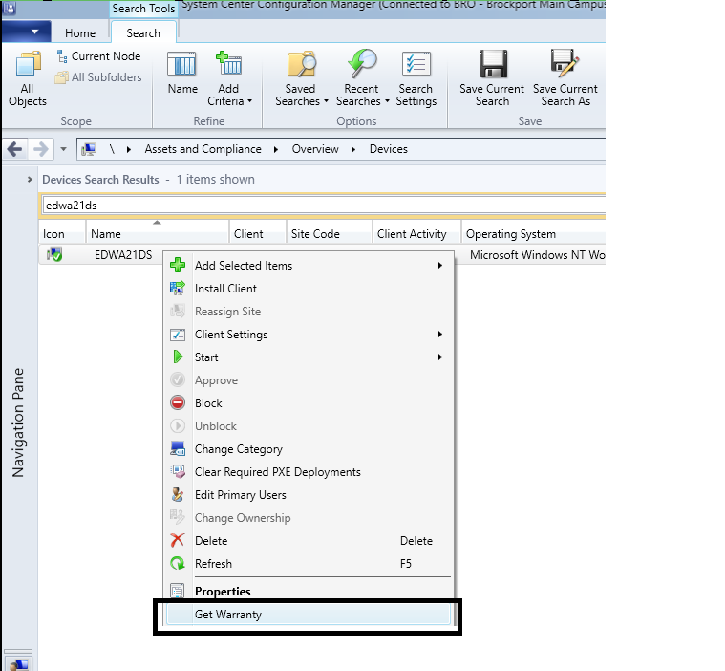
zxcsdfsd
Warranty Extension
XML File
PowerShell Script
Dell API
Windows Forms Graphics

Slide 17
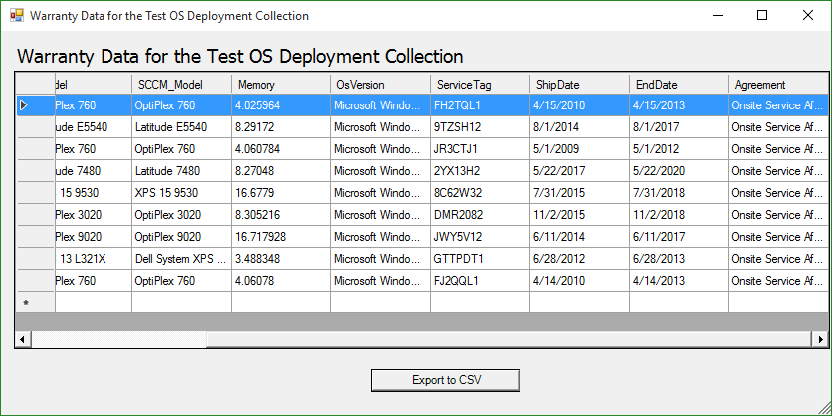
zxcsdfsd
Warranty Extension

Slide 18
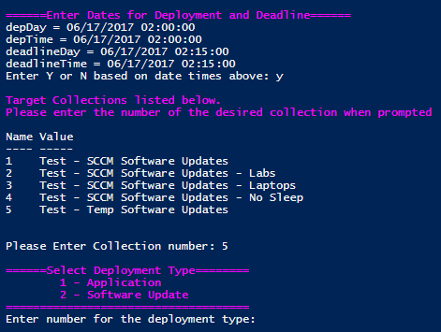
zxcsdfsd
Updates Automation
Notes:
Tom has created a knowledge base article in SNOW and pushes out a campus notification to let the users know Windows 10 updates are coming out.as a campus communication

Slide 19
zxcsdfsd
Pitfalls & Future
Pitfalls
Drivers on deployment
Computer restarts during service window
Imaging errors can be vague and difficult to troubleshoot
RBA Permissions
Historic Reporting
Mac management
Future
Integrate SCCM with Service Now and Automation
Finish software deployment automation
Software Metering / Reporting
Notes:
Tom and I can

