Slide 1
SSO Discussion & Roundtable
STC 2017

Slide 2
Today’s Discussion
What’s ITEC currently working on with campuses?
What are the current challenges that ITEC is seeing?
What SSO solutions are campuses using or evaluating?
What drove the decision for selecting a specific SSO solution?
What is the design of your SSO environment?
What challenges did your campus face implementing your SSO solution?
What types of service providers are connected to your SSO solution?

Slide 3
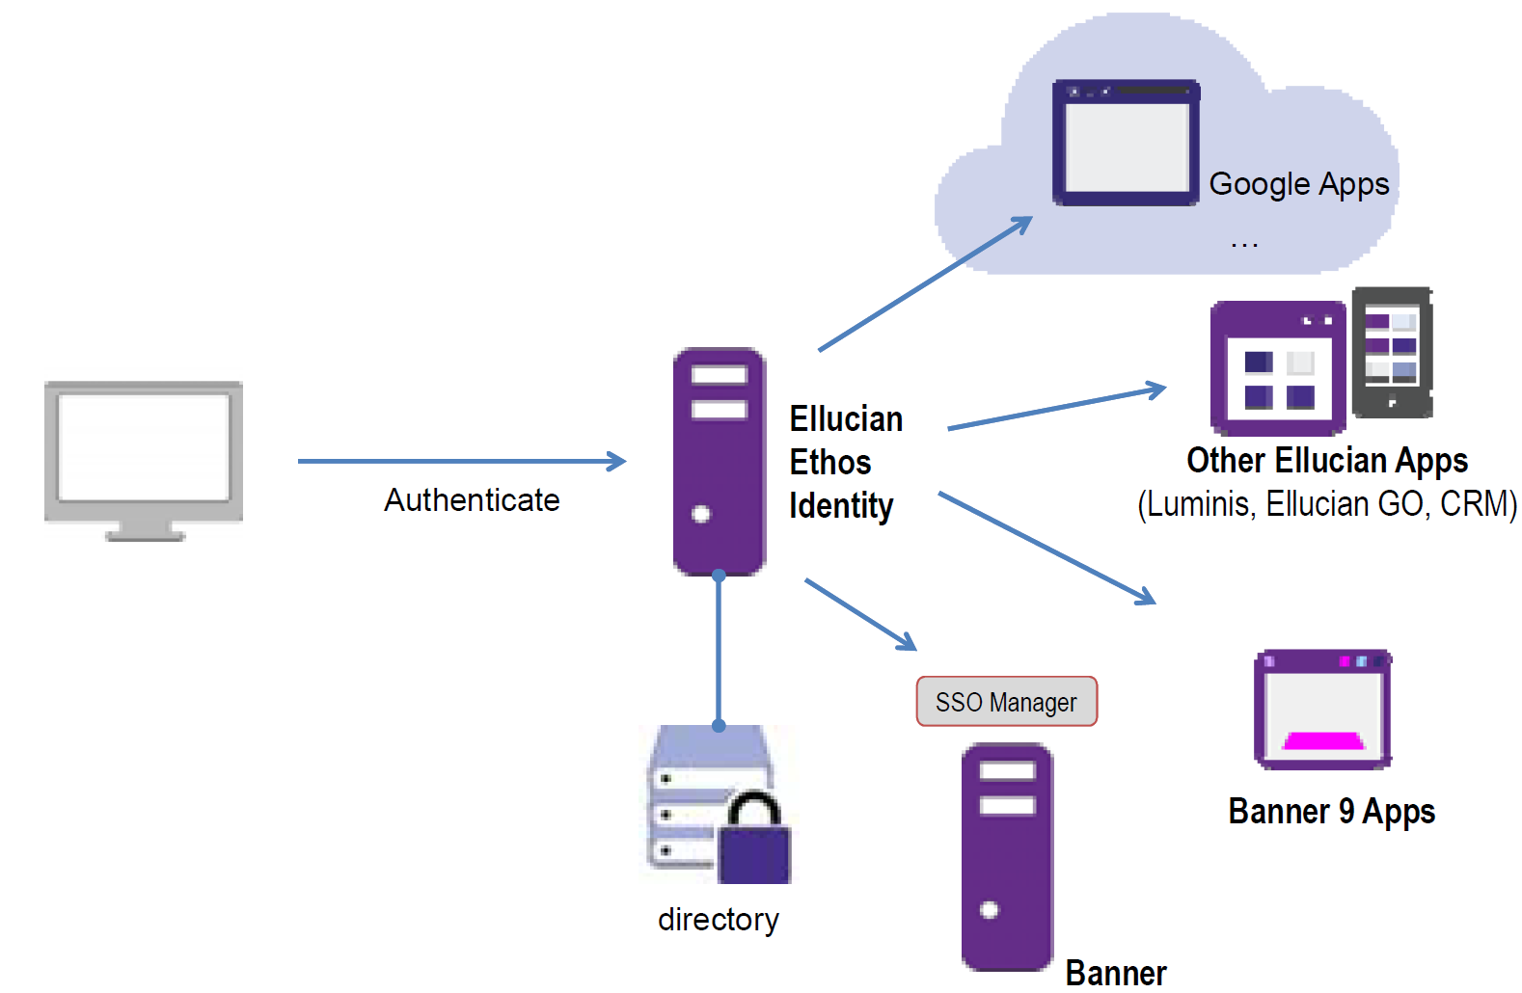

Slide 4
What’s ITEC currently working on?
Ellucian Ethos Identity
Hosting: 5
OLD, DUT, BRM, BRO, NIA
Campuses implementing: 10+
ONE, MON, POT, CAN, ALU
Integrated with:
Banner 8.x SSO Manager
Banner 9 apps
3rd party Service Providers

Slide 5
What’s ITEC currently working on?
SAML using ADFS 3.x
Pilot campuses:
Maritime
Delhi
Buffalo State
Integrated with:
Banner 8.x SSO Manager
Next steps:
Banner 9 apps

Slide 6
What are the current challenges?
SSO with Banner has a lot of moving pieces which all need to fit together
SAML with ADFS Relaying Party issues
SAML for Banner 9 complexity
CAS certification by Ellucian for versions higher than 3.x

Slide 7
What SSO solutions are campuses using or evaluating?

Slide 8
What drove the decision for selecting a specific SSO solution? Is SSO a good thing?

Slide 9
What is the design of your SSO environment?
Cloud, ITEC Hosted or local?
Clustered for HA or single server?
Connected to AD, ADFS, LDAP, other?

Slide 10
What challenges did your campus face implementing your SSO solution?

Slide 11
What types of service providers are connected to your SSO solution?

Slide 12
SSO Open Discussion
What challenges is your campus facing?
What are the pros/cons of your current SSO solution?
How can the SUNY community better support campuses with their SSO projects?

