Slide 1


SUNY Old Westbury
Better Together
(Cisco Email Security with Office 365)
Milind Samant – Director of ITS and Information Security Officer (ISO)
Damian Obara – System Administrator
June 2017

Slide 2
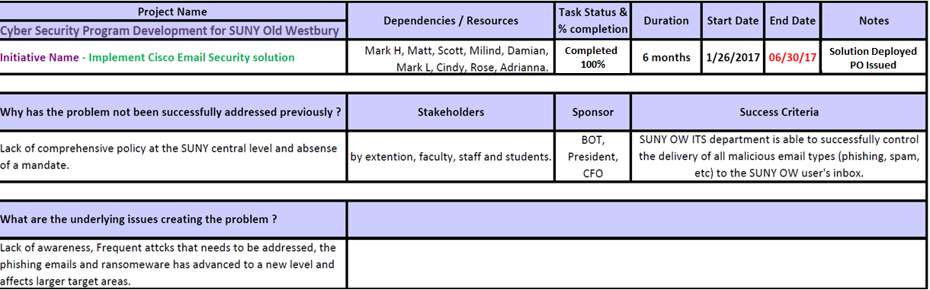
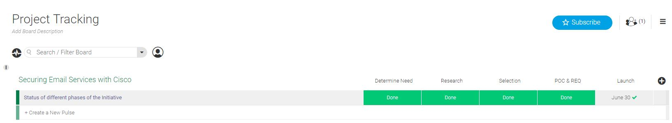
Project Details – The Why’s, The Who’s, The What’s….
Always keep about this distance between text and the edge of slides and other content.

Slide 3

Email is the #1 threat vector!
Due to wide reach of Email and its nature, it remains #1 attack vector.
    Customers are plagued with Phishing campaigns, Business Email Compromise scams (BEC) & Ransomware attacks
    Over $50M lost by US companies due to Phishing attacks
    Close to $3.1B lost due to Business Email Compromise (BEC) scams
    $60M average loss due to a single Ransomware campaign
Notes:
Even today Email is still the #1 threat vector. It constantly attacks our users with many different attacks. Ransomware, phishing or viruses are some of the few we have to watch out for.

Slide 4
Blended Attacks
Ransomware
With a high success rate and significant revenues being generated. The sophistication of these attacks will only increase.
9515
$60M
Ransoms paid per month
In revenue
per campaign
2015 2016
Spoofing / BEC
270%
$2.5B in losses reported by US firms
increase
Phishing
94%
of phish
have an attachment
$500M in losses due to phishing
2015 2016
30%
are opened
Notes:
Unfortunately these attacks are profitable to the hackers launching them. Just in the past 7 months of 2017 we have seen an increase of 6000% in ransomware attacks alone. You might have heard about Locky or most recently Petya and WannaCry to name a few. Just in that short amount of time many of these abuse the most recent security vulnerabilities. And they will only get more sophisticated.

Slide 5
Benefits and Risks of Cloud Email Services
Human & Technical Resource savings
Legal & Regulatory Compliance
Disaster Recovery and Fault Tolerance
Integration with existing infrastructure
Business Continuity
Simplified Architecture Maintenance
Audit, Visibility & Location of Data
Scalability and On-Demand resources
Future demand & cost
Notes:
Many of you might already be using cloud email. Many might be planning a move soon. But I’m sure you are familiar with these. The benefits of cloud hosted email are great. Human and tech resources are terrific. Now ease of use for administrators allows for an easy to configure and powerful suite of apps. Than architecture is no longer a concern along with disaster recover and scalability. We do not have to provide new hardware for 1000 new additional students. We can just generate them. On the other sides legal reports might be difficult to obtain or not existent. Location of the data might be difficult to locate. Or sometimes licenses might become quite expensive.

Slide 6
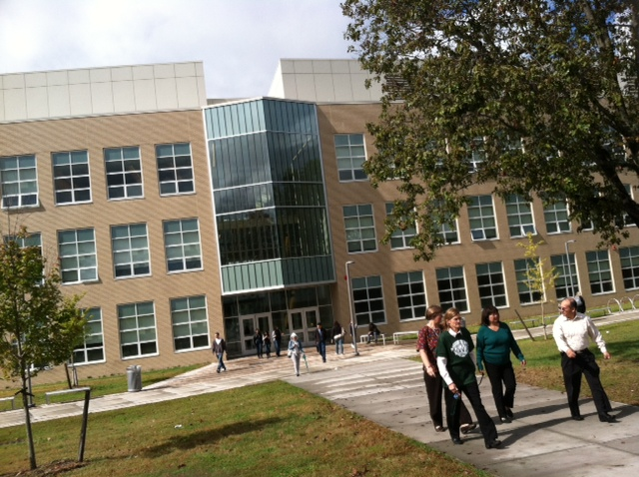
History of OW Email
SUNY OW had the same concerns about cloud email platform
Moved from Google Apps to Office 365 in Summer of 2016
On both systems users were attacked by spam, ransomware and phishing campaigns
Prior to Cisco, we evaluated Microsoft Active Threat Protection and Symantec
  Microsoft Active Threat protection didn’t prove sufficient
  Symantec licensing turned out a bit too expensive
Notes:
Short summary of recent OW email adventures. We had quite similar worries as we just talked about. We moved to Office 365 just last year. On both systems we were equally venerable to phishing and ransomware campaigns. Prior to deploying Cisco we tried to configure Microsoft Active Threat protection and Symantec Email Security.

Slide 7
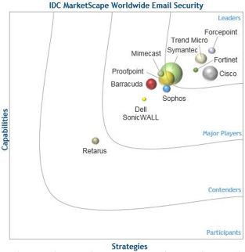
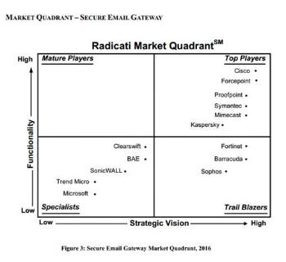
Industry Recognition – Cisco Email Security
Notes:
Both IDC and Gartner show Cisco as the leader in the email security market. Now we really have to get the device.

Slide 8

Intelligence is the key!
Cisco Email Security is backed by unrivaled global threat intelligence
100 TB
Of Data Received Daily
250+
Full Time Threat Intel Researchers
with SenderBase
III00II 0II00II 0I0I0I0I 0I I0 I00 000II0 I0I0 0II0 00
III00II 0II00II I0I0II0II0 I0 I0 I00 00I0 I000 0II0 00
1.5 MILLION
Daily Malware Samples
III00II 0II00II I0I000 0II0 00I0I00 I0 I000I0I 0II 0I0I0I
MILLIONS
Of Telemetry Agents
00I00 I00I0I II0I0I 0II0I I0I00I0I0 0II0I0II 0I00I0I I0 00
II0III0I 0II0II0I II00I0I0 0I00I0I00 I0I0 I0I0 I00I0I00
II0II0I0I0I I0I0I0I 0I0I0I0I 0I0I00I0 I0I0I0I 0II0I0I0I
III00II I000I0I I000I0I I000I0I II 0I00 I0I000 0II0 00
600 BILLION
Daily Email Messages
00I I0I0I0 I0I0III000 I0I00I0I 0II0I0 I00I0I0I0I 000
4
Global Data Centers
0II00 I00I0I0 0I00I0I I00I0I0 I0I0I0I 0I0I0I 0I0I0I0
00I0I0 0I0I0I0 I0I0I00I 0I0I 0I0I 0I0I I0I0I 0I00I0I
16 BILLION
Daily Web Requests
Over 100
Threat Intelligence Partners
  24  7  365 Operations
Deploy the world's largest email
traffic monitoring network
Leverage industry-leading
threat analytics

Slide 9


Is “good enough” security good enough?
Notes:
Talk about the highly sophisticated spam attack some time after we switched.

Slide 10

Integration with our Office 365 cloud email platform
Cloud Email Security with Office 365
*Anti-virus provided by O365
O365 | Cisco Email Security w/ O365
Anti-spam filters | Anti-spam filters
Anti-virus protection | Anti-virus protection*
Policy enforcement | Policy enforcement
Disaster recovery | Disaster recovery
Directory services | Directory services
Advanced threat protection | Graymail detection
Message tracking | Outbreak Filters
Visibility | Message tracking
 | Email encryption
 | AMP
 | Detailed reporting
 | Zero-day incident mgmt
 | Data loss prevention
Outbound
Outbound
O365 Exchange Online
Inbound
Inbound
SUNY OW Email
Cisco Email Security
Cisco Email Security
Other Email Users
Point Mail Exchange (MX) records to the
Cisco Cloud Email Security
Configure an outgoing connector to forward any outbound email to Cisco
Notes:
The email security appliance integrates very well into our O365 cloud email Not only do we keep the existing protection services like thread protection (difficult to configure but still good), as well as plethora of others. Outbreak filters antimalware protection or email encryption just to name a few.

Slide 11
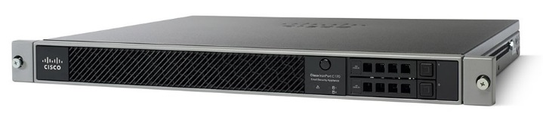
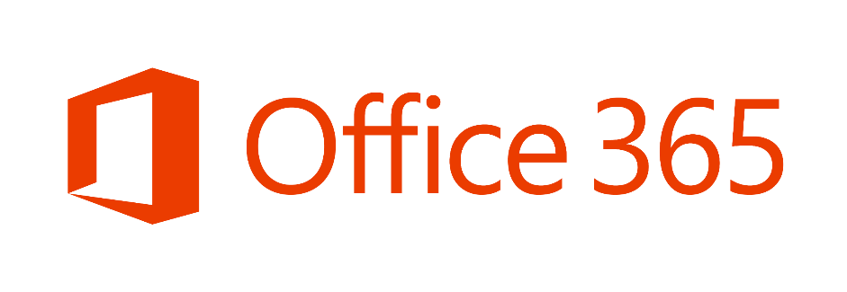
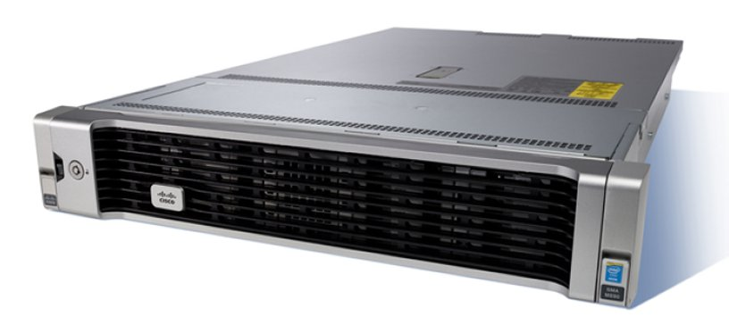
So what’s the setup like for OW?
Email Security Appliance
(ESA)
Email Security Appliance
(ESA)
MX Record
Security Management Appliance
(SMA)
Centralized Report management
Message Tracking
Message, Policy and Virus Quarantines
Notes:
The way we set up our devices at OW is quite simple. Our MX (mail records) point to our cloud hosted pair of ESA (Email Security Appliances). The above scans the messages and than forwards to O365. From O365 on the other side we use an outbound connector to route any outgoing email back through the ESA units. After more filters are applied the emails are sent out. The security management appliance (SMA for short) although not required provides us with centralized management with detailed reports from both units, consolidated message tracking and message, policy and virus quarantines.

Slide 12
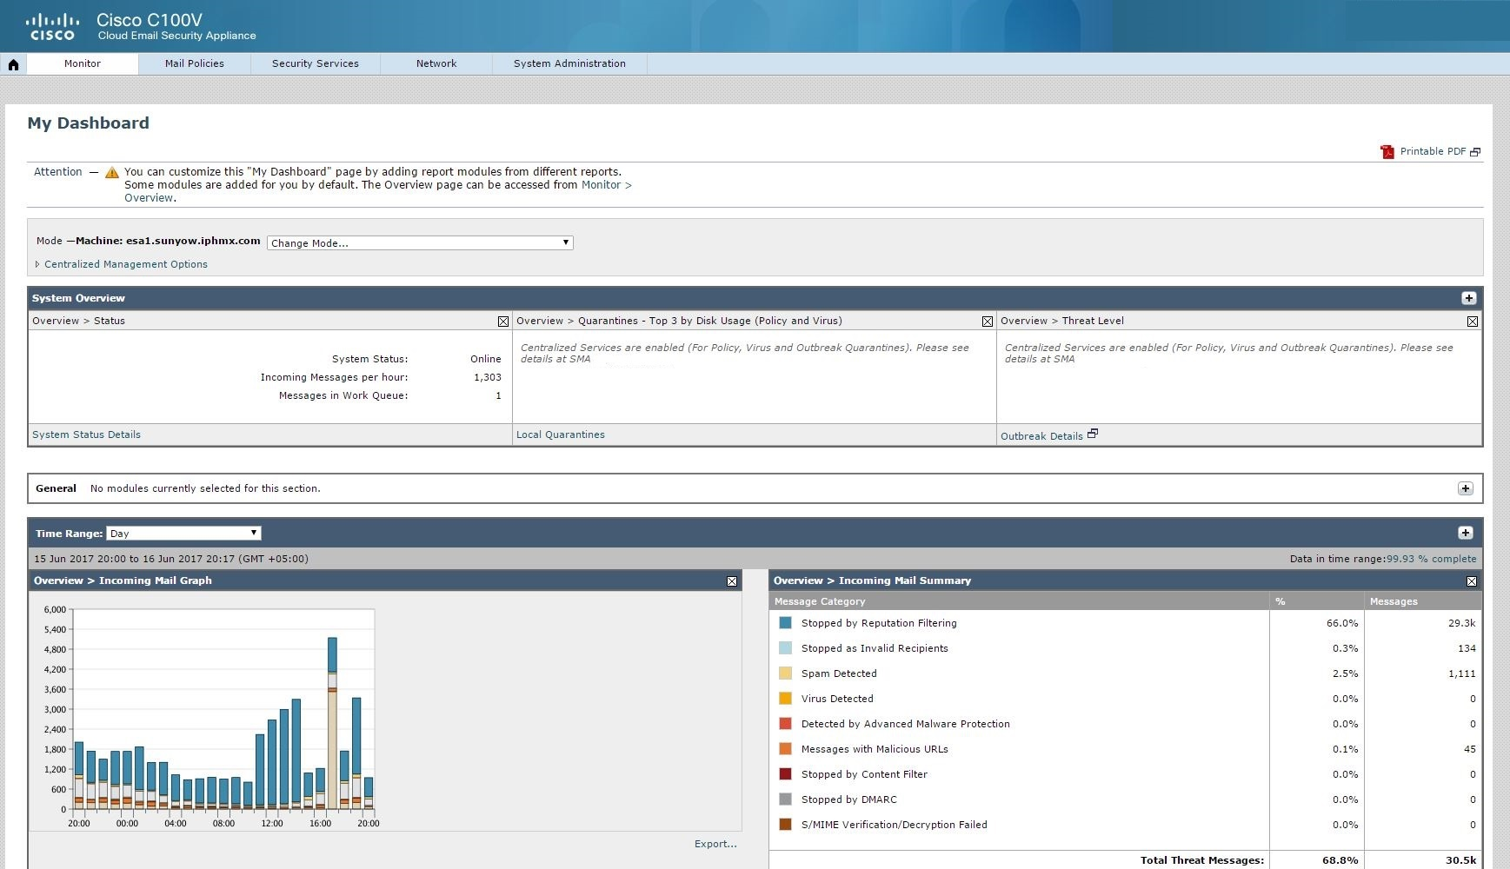
ESA GUI and Configuration
Notes:
The ESA Gui shows some good details from the first particular unit.

Slide 13
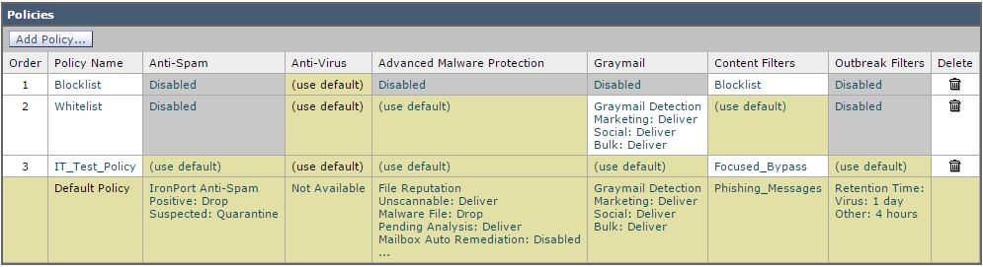
Inbound Email Flow
Notes:
The policy scanner works on a top down rule model. If any emails fall under the blacklist they get immediately discarded. Whitelist bypasses certain security features. While the default applies to all the other messages. If required we can create additional policies and enable / disable features as required.

Slide 14
Inbound Security & Outbound Control
Sender Reputation
Connection
Control
CASE
(AS,GM,OF)
Anti-Virus
(Sophos, McAfee)
File Reputation
File Analysis & Retrospection
Graymail Detection
Content Filtering
Outbreak Filtering
80-90%
Block Rate
Throttling, DHAP, SPF, DKIM, DMARC
Multi-Verdict scanning
Block 100% of known viruses
SHA based file blocking
Over 300 Behavioral Indicators
Control marketing, social and bulk
Business and Security Rules
9-12 hr lead time on Outbreaks
Connection Filters
Spam Filter
Anti-Malware Defense
Marketing
Filter Rules
0-day Malware
Spoof Detection
URL Analysis
Advanced Malware Protection (AMP)
Anti-Phishing and URL Analysis
CASE
(AS,GM,OF)
Anti-Virus
(Sophos, McAfee)
Data Loss Prevention
Envelope Encryption
Web Interaction
AMP Retrospection
Mailbox Auto Remediation
Outbound Spam Filters
Throttle Senders and Destinations
Over 140 pre-built filters
Push Based Encryption
Track User clicks
Alerts on File Disposition
Delete or Forward from O365
Outbound Threat Filters
Outbound Data Protection
Post-Delivery Analysis & Interaction
Notes:
The inbound messages are funneled through a set of security scanners, sender reputation (known spammers) are discarded immediately. Others scan for other inconsistencies or infected attachments or other errors. On the way out (from o365 to the outside) some scanners are not available (we trust you) but the most important case engine and antivirus are still standard.

Slide 15
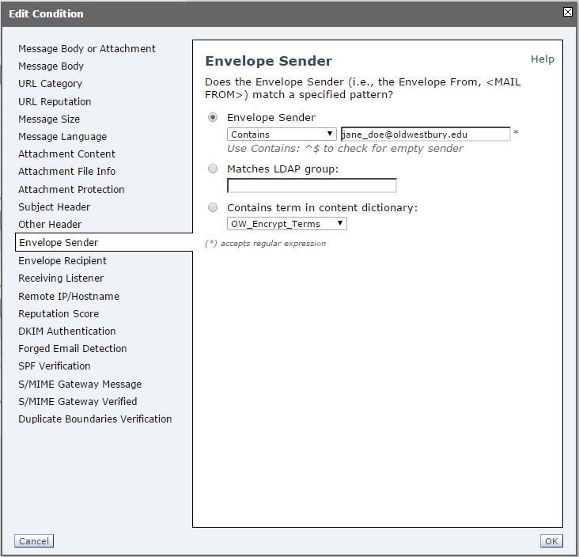
Configurable Content Filtering
Both inbound and outbound flows of email allow for a very detailed content filtering options
Any incoming or outgoing message can be modified, re-routed, quarantined or dropped
Support regular expressions
Notes:
Content filtering allows for further customization of rules. We can configure both outbound / inbound traffic. They can be modified (subject, body), quarantined or dropped. It also supports regular expressions for further customizability.

Slide 16
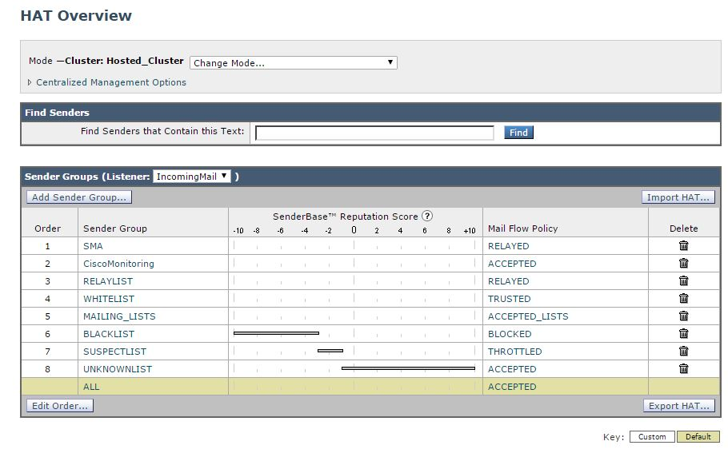
Host Access Table (HAT)
Notes:
Hat or host access table uses Talos to place a message with a sender score and place some other limits. Here we can control connection security TLS, Attachment sizes, how fast emails are delivered or when they should not be. Again policy can be shaped quite extensively.

Slide 17
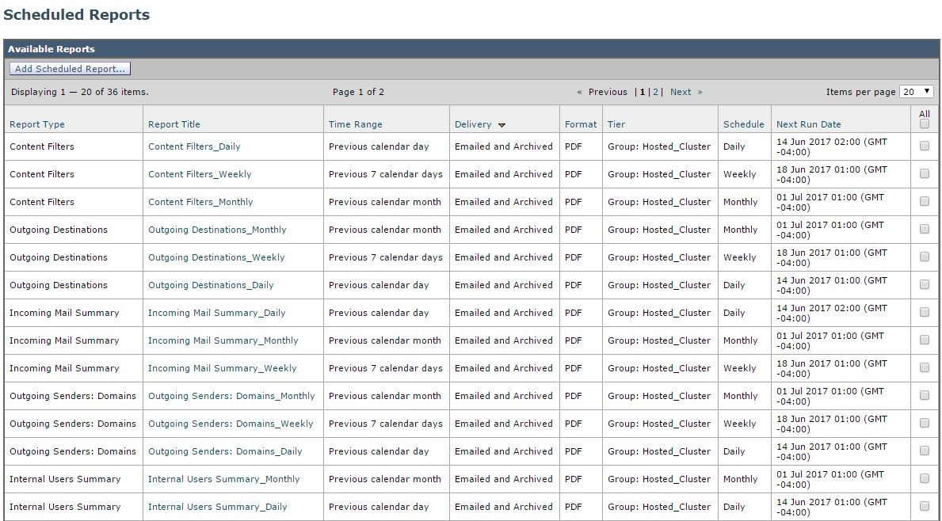
Automated Reporting

Slide 18
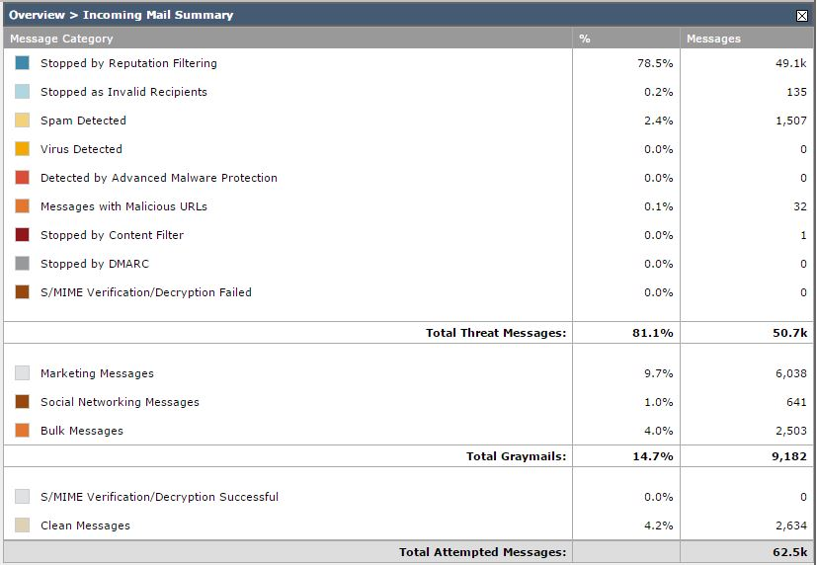
Daily Statistics
On a daily basis SUNY Old Westbury has received over 60k messages
Out of those 49k got stopped by reputation filtering
Another 1,700 spotted as spam, different errors and other inconsistencies
Only about 2,600 messages per day turned out to be valid messages
Notes:
Let’s look at some daily stats.

Slide 19
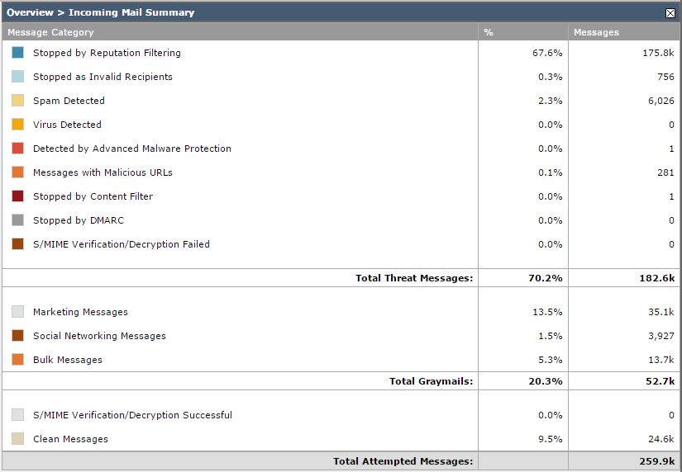
A bit more stats…
During a particular week over 180k messages were stopped
Most just by reputation filtering alone
Notes:
Some more stats.

Slide 20
Additional Cool Features
Outgoing email encryption
Outbreak filters trigger on unusual mail flow
URL Filtering
Detailed Troubleshooting Tools (Message Tracking, Message flow logs)
Full access to the device (ssh, observe instant log flow)
Ldap integration (AD group based rules)
Notes:
Some more cool additional features.

Slide 21
The Difference 1% Makes
Average mail flow: 10M/day
1% difference in efficacy means approx. 100K more threat messages entering the system
A .11% increase in FPs is 11K legitimate messages being blocked
Cisco Reputation and Anti-Spam combined will block a variety of threats such as Phish, scams, in addition to spam.
The real issue is not the additional spam – it’s the behavior of end users
Over time they have learned to trust what is being delivered as legitimate
A drop in efficacy would result in more threats be executed by the users, costs associated with cleanup as well as loss in productivity
Even a minimal increase in the False Positive rate could have a significant impact on business
Coupled with no near time reporting or tracking, and this could result in a significant business risk
Notes:
User education + if we can stop at least some of those messages from reaching our users we can protect them much better.

Slide 22

Questions?
SUNY Old Westbury Enhances Office 365 - Cisco Case Study
https://goo.gl/ny7mr5
Notes:
Any questions?

