Slide 1
So… Which Learners *Are* You Willing to Exclude?
Fostering Engagement on Accessibility Initiatives through an Emphasis on Diversity and Inclusion

Slide 2
Beginning an Accessibility Initiative: A Two-Prong Approach
How To
Why

Slide 3
More Than Just Compliance
Yes, it’s the law
But, it’s also about
Diversity and Inclusion
Meeting Student Needs
Designing for All Students
Student Identity

Slide 4
Laying the Groundwork
Building Trust
Individualizing Need
Paced Training

Slide 5
Building Trust
Outreach and Support

Slide 6
Consistent Reinforcement
/
Weekly email campaign
Friendly tone
We’re all in this together!
Small bites
Blackboard Community
Information repository
Developing resource
All faculty/staff have access

Slide 7
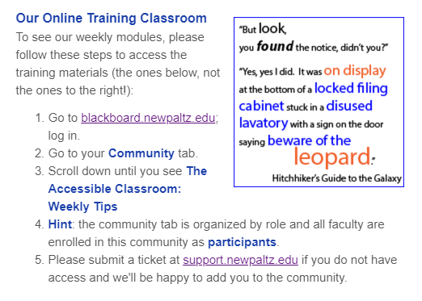
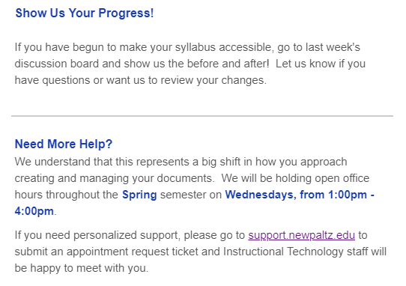
Sample Email
Conversational
Focused on one key idea
Reinforces finding resources
Emphasizes how to get help

Slide 8
Demo 1: Blackboard Community
Accessible Classroom: Faculty and Staff Toolkit

Slide 9
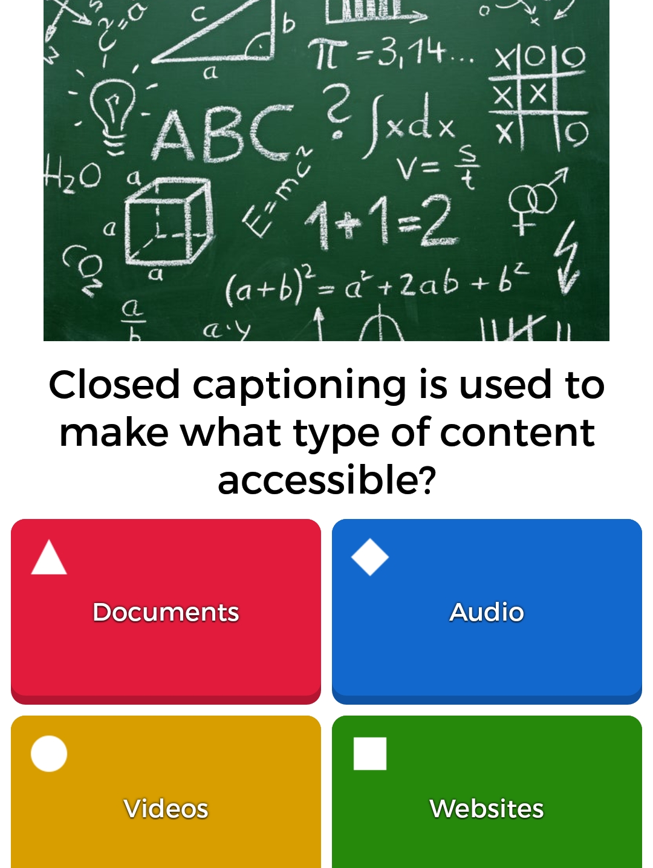
Kahoot! Quiz
Goal: a fun way to test knowledge
Reality: only 1 person played!
What Happened?!
Tech Roadblocks?
Remote Challenge
Need to download app / use mobile device
Could a “test” have heightened fear?
Build awareness vs. highlight knowledge gaps
Better used as a live tool?

Slide 10
Demo 2: Ticket and KB
Course Copy Form + Accessibility Notice and Remediation Plan Recommendation

Slide 11
Chair and Department Meetings
/
Ensure awareness
Reach non-early adopters
Dispel rumors

Slide 12
Individualizing Need
Who Benefits from our efforts and How?

Slide 13
Diversity of Disability

Slide 14
Types of Need
Low Vision
Color Deficiency
Visual Impairment
Hearing Impairment
Cognitive Disorders
Mobility Issues

Slide 15
Screen Reader Demo
Provide Frame of Reference
Understand the Device to Plan Accessible Content
Encourage Empathy

Slide 16
“But, I’ll Know If Someone Needs Assistance”
/
“Invisible” Disabilities
Online Classes

Slide 17
Burden of Reporting a Disability
/
Fear of Being Stigmatized
Increase Faculty / Student Power Imbalance
Avoid Feeling of “Special Treatment”

Slide 18
The Payoff!!
“Thanks for your presentation on the accessible online classroom to LA&S Chairs today. It was quite informative, and it impressed upon me the real need for this initiative (of which, I must confess, I have in the past been more inclined to be critical rather than supportive). I'll get to work on my courses!”

Slide 19
Paced Training
Small Steps Still Make a difference

Slide 20
Take It Easy
Ensemble and Closed Captioning
Ally
Adobe Acrobat Pro
Lynda.com
Read & Write + EquatIO

Slide 21
Where To Start (when you can’t do it all at once)
Convert scanned PDFs
Utilize accessible syllabus template
Submit videos for CC
New doc? Start accessible!
Alt tag images
Use accessible hyperlinks

Slide 22
Demo 3: Blackboard Community
Accessible Classroom: Faculty and Staff Toolkit

